Slide 1
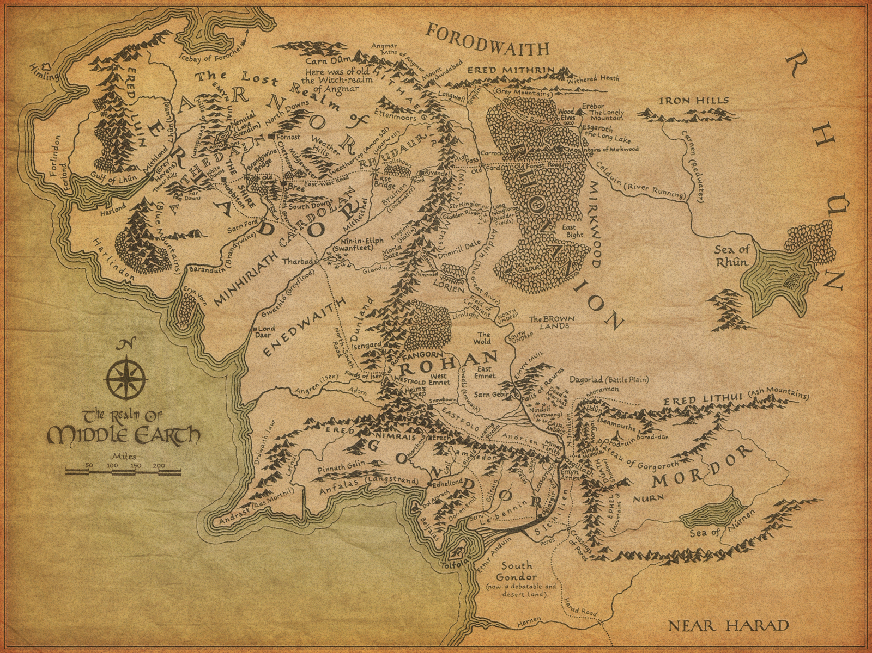
The Continuing Journey Towards a Common Assessment
Jennifer Coleman, CAI Statewide Project Director
Alicia Muñoz, CAI Steering Committee Member, Cuyamaca College
Craig Rutan, CAI Steering Committee Vice Chair, Santiago Canyon College
2015 ASCCC Spring Plenary Session
Notes:
Craig

Slide 2
Overview
Goals of CAI
Work To Date for CAI
CAI Workgroups
Creating the Common Assessment Test
Multiple Measures
Pilot Phase
Professional Development
Future Timeline
Notes:
Craig

Slide 3
Student Success Task Force
The Student Success Task Force looked at assessment, they found the current assessment structure to be inefficient for students and proposed recommendation 2.1:
Community colleges will develop and implement a common centralized assessment for English reading and writing, mathematics, and ESL that can provide diagnostic information to inform curriculum development and student placement and that, over time, will be aligned with the K-12 Common Core State Standards (CCSS) and assessments.
Notes:
Craig

Slide 4
SB 1456
While you may be happy with your current assessment, your college must use the common assessment to receive SSSP funding (once available)
The requirement that any district or college receiving funding pursuant to this section agree to implement this article, implement the board of governors’ system of common assessment, if using an assessment instrument for placement, and implement the board of governors’ accountability scorecard, pursuant to Section 84754.5, when established during the period in which it receives that funding.
Notes:
Craig

Slide 5
Goals of CAI
To develop a comprehensive, common assessment system that will:
align to state legislation
reduce unnecessary remediation
provide statewide efficiencies
effectively support faculty and staff to ensure accurate student placement, resulting in more successful student outcomes
Notes:
Craig

Slide 6
CAI Objectives
A fully adaptive test that covers
Math
English
English as a second language (ESL)
A Validated Collection of Multiple Measures Available to Colleges
Assessment Preparation (EPI/OEI)
Professional Development
Integrate data across the system
Notes:
Craig

Slide 7
Work Before Fall Plenary
Launch initiative project website – January 2014
www.cccassess.org
Establish Governance – March 2014
Stakeholder representation
Environmental scan – May 2014
Pilot College Application and Selection – May 2014
Request For Information (RFI) – June 2014
Work Group formation and meetings – June 2014

Slide 8
Work Since Fall Plenary
Follow-up to Environmental Scan
Non-cognitive measures
Draft Competency Maps
Dissemination and Feedback
Request for Proposal (RFP)
Released to Vendors
Review of Responses from Vendors

Slide 9
Vendors Selected
Vendor Selection
Unicon, Inc. – software development
Platform
Administration
Link Systems, Inc. (LSI) – World Wide Test Bank
English
Math
ESL

Slide 10
CAI Workgroups
Math (includes above college-ready)
English (includes Reading)
ESL (includes Noncredit)
Multiple Measures
Professional Development
Test Development Process
Platform (User Interface, Reporting)

Slide 11
Assessment Competencies
The competencies are designed to assess skills from basic skills courses.
Math: 4 Levels Below Transfer and transfer level math including College Algebra, Trigonometry, Calculus, and Statistics
English: 4 Levels Below Transfer
ESL: 8 Levels Below Transfer
The competencies do not distinguish between credit and noncredit
The competencies do not correspond to specific course levels. They simply include skills covered in those levels.
Notes:
Alicia

Slide 12
Creating The Assessment Test
Step 1 – Convert assessment competencies into test specifications and test blueprints
Step 2 – Begin evaluating and creating test items to assess the skills in the competency maps
Step 3 – Have pilot colleges begin piloting test items and collecting data to determine any bias or disproportionate impact

Slide 13
Faculty Developed Content
With the selection of LSI as the content partner, faculty developed test items can be incorporated into the common test
Items incorporated into the common assessment will belong to the CCCs and not LSI
Previously developed open source test items will be evaluated and added to the item banks as appropriate
Notes:
Susanna

Slide 14
Hopes for the CAS
Provide diagnostic information about each student’s performance on the skills outlines in the competency maps
Colleges will use this new information to develop targeted ways of addressing skills deficiencies and help students transition to college level courses as quickly as possible

Slide 15
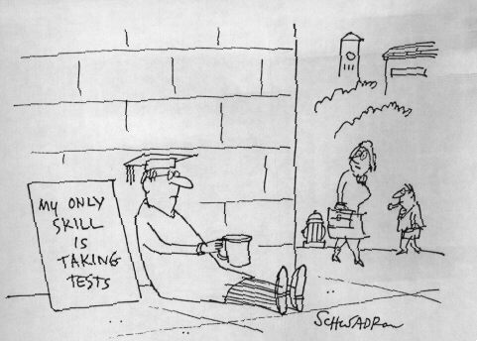
Multiple Measures
Is there data that could be combined with the new Common Assessment to more effectively place students?
The Multiple Measures Assessment Project is looking at different types of data to evaluate how effectively student success can be predicted.
Possible data include:
High School GPA
Highest Level Math and English in High School
Years Since Completing High School
Scores on Smarter Balanced Assessments
The RP Group and the CAI Multiple Measures Workgroup are investigating different measures that could assist colleges with student placement
Notes:
Susanna

Slide 16
Multiple Measures (2)
Environmental Scan Recommendations
Follow-up on Non-cognitive measures
Overlap with MMAP
Currently convening
Pilot college overlap
Additional research still to come

Slide 17
Pilot Colleges
Bakersfield College
Butte College
Chaffey College
DeAnza College
Delta College
Diablo Valley College
Fresno City College
Rio Hondo College
Sacramento City College
Saddleback College
Santa Monica College
West Los Angeles College
Notes:
Craig

Slide 18
Pilot Phase
Two components
Test
Data collection and Validation
Technology/Platform
Student information system interface
Professional Development
Iterative process
Notes:
Craig

Slide 19
Professional Development
User types
IT/Software interface
Assessment Center staff
Faculty
Local control factors
Saddleback College as project lead
PD Advisory Committee over all three initiatives with ASCCC in lead role
Notes:
Craig

Slide 20
Professional Development Workgroup
Meetings begin in April and will continue meeting in the summer
Intensive training for pilot college faculty planned for September
Regional presentations about the common assessment being planned for late 2015/early 2016

Slide 21
Launch and Validation
Pilot Colleges then Early Adopters
External factors for phased implementation
Existing contracts
College resources
Ongoing support and continued validation

Slide 22
Future Project Timeline
Summer/Fall 2015
Begin test item piloting
Spring 2016
Testlet Adaptive Field Testing
Feedback from the field
Development of resources for implementation
Fall 2016
Release and Implementation
Ongoing feedback and development
Success!

Slide 23
Are You Interested in Being Part of the Common Assessment Initiative?
The Common Assessment Initiative is always looking for faculty volunteers with backgrounds in assessment, placement, mathematics, English, ESL, and reading. If you are interested in serving on a CAI workgroup, please go to http://asccc.org/content/application-statewide-service and fill out an application to serve!

Slide 24
Questions
Notes:
All

