Slide 1
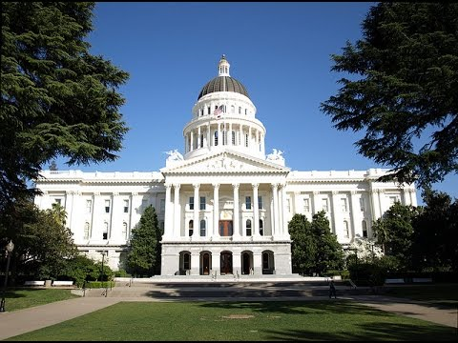

Legislative Cycle and Advocacy:
Political Landscape and Power Dynamics of Sacramento
Dolores Davison
Evan Hawkins
Jonathan Lightman

Slide 2
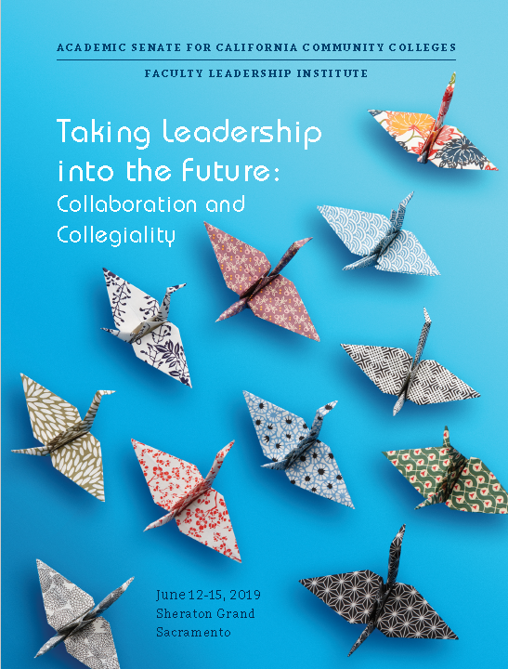

Slide 3
“…best political voice for community college faculty in the state.”
~ Sacramento News & Review

Slide 4
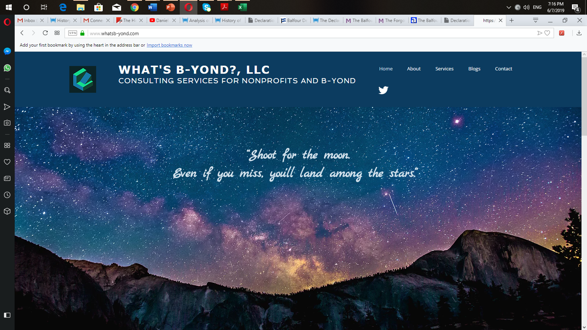
www.whatsb-yond.com

Slide 5
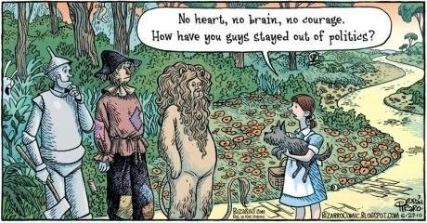

Slide 6
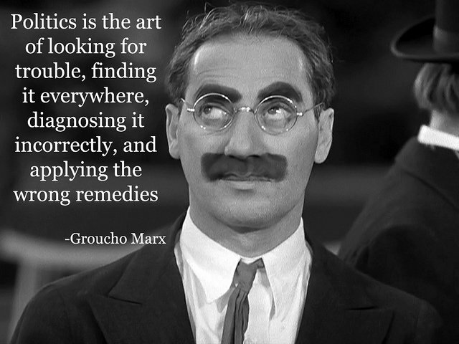

Slide 7


Policy
Politics

Slide 8
Partisan Composition of the California Legislature

Slide 9

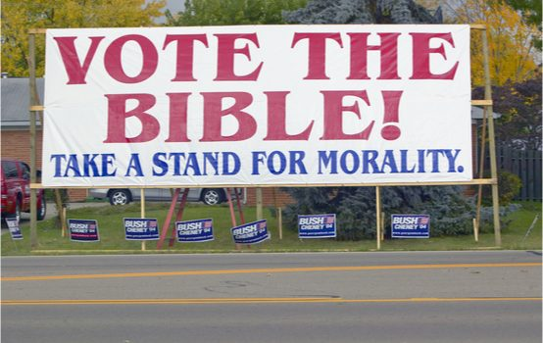
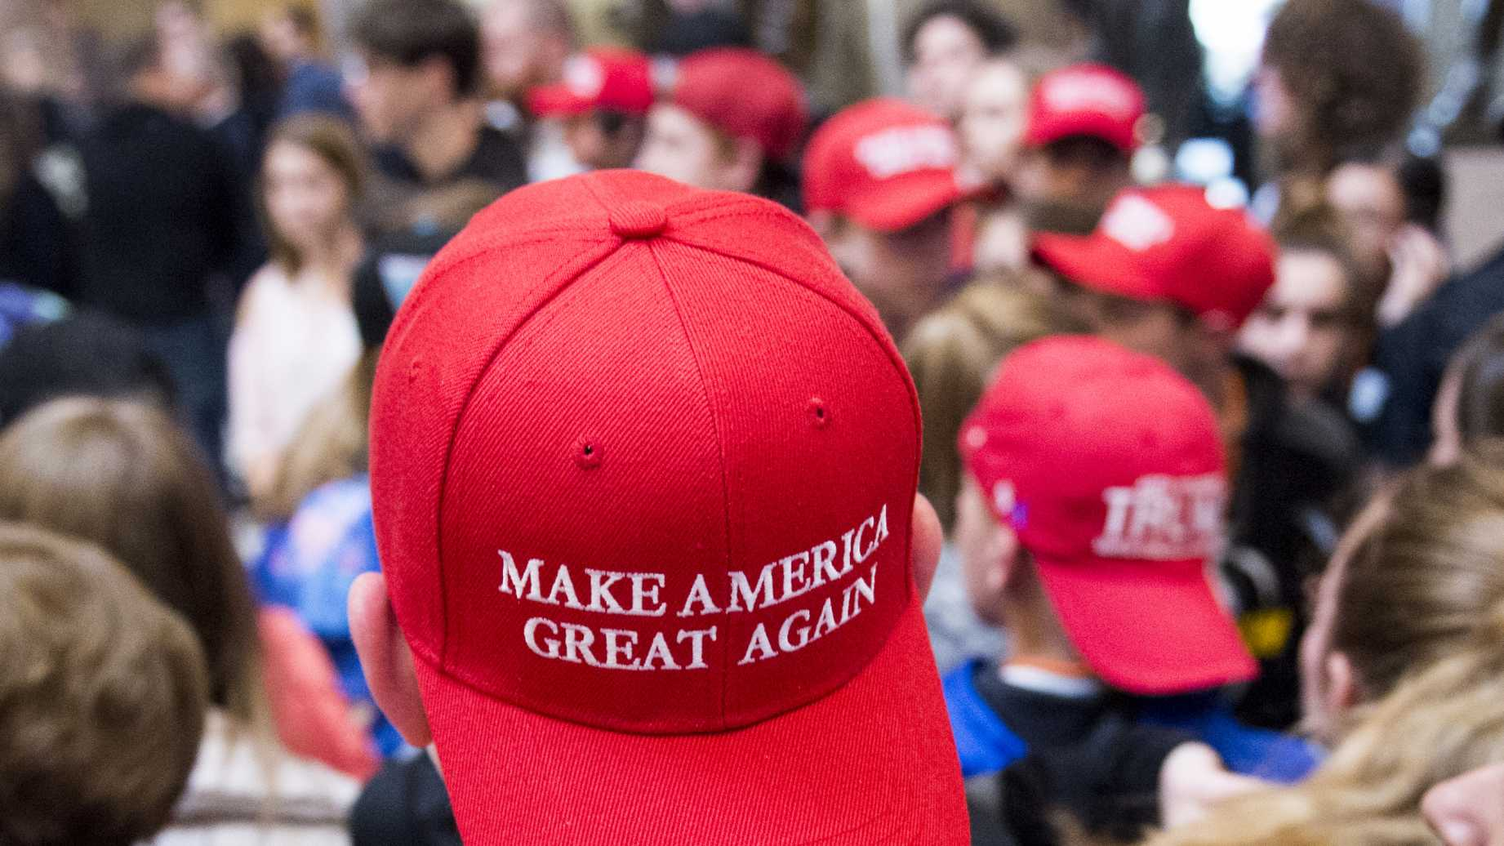
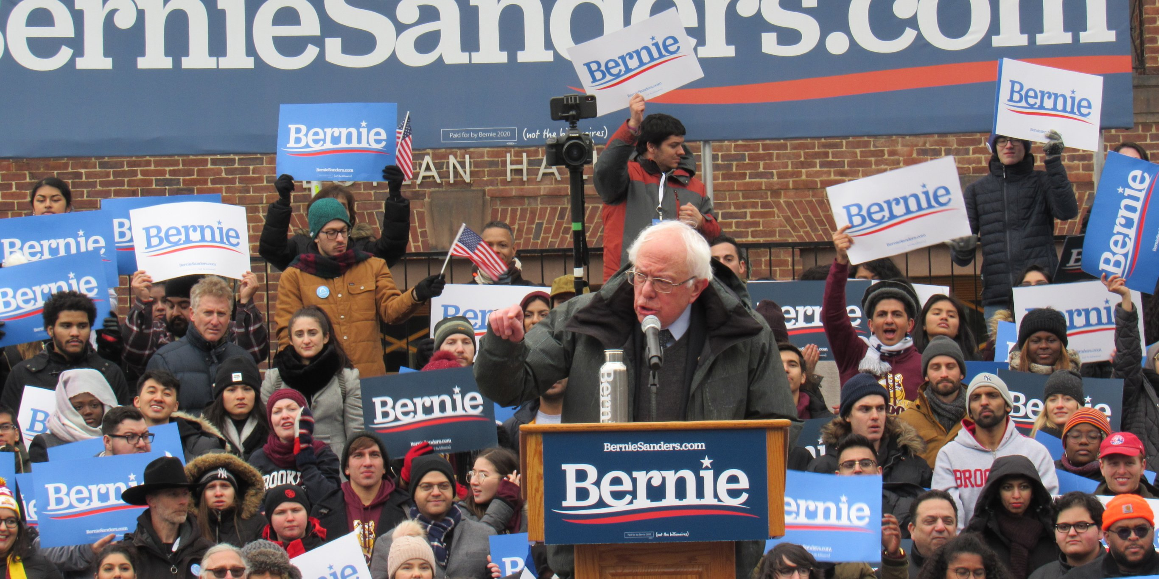

Who are Today’s Political Parties?
Liberals
Progressives
Corporatists
Wall Street
Religious
Right
Trump/
Tea Party
DEMOCRATS
REPBULICANS

Slide 10

How it’s Taught

Slide 11
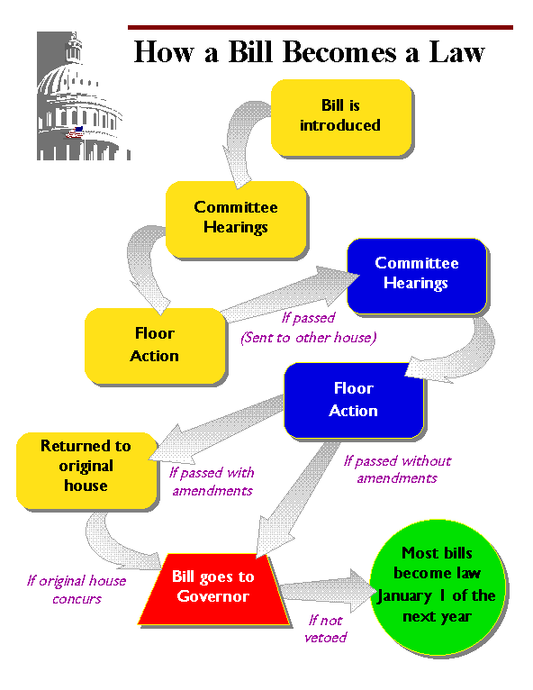

Slide 12
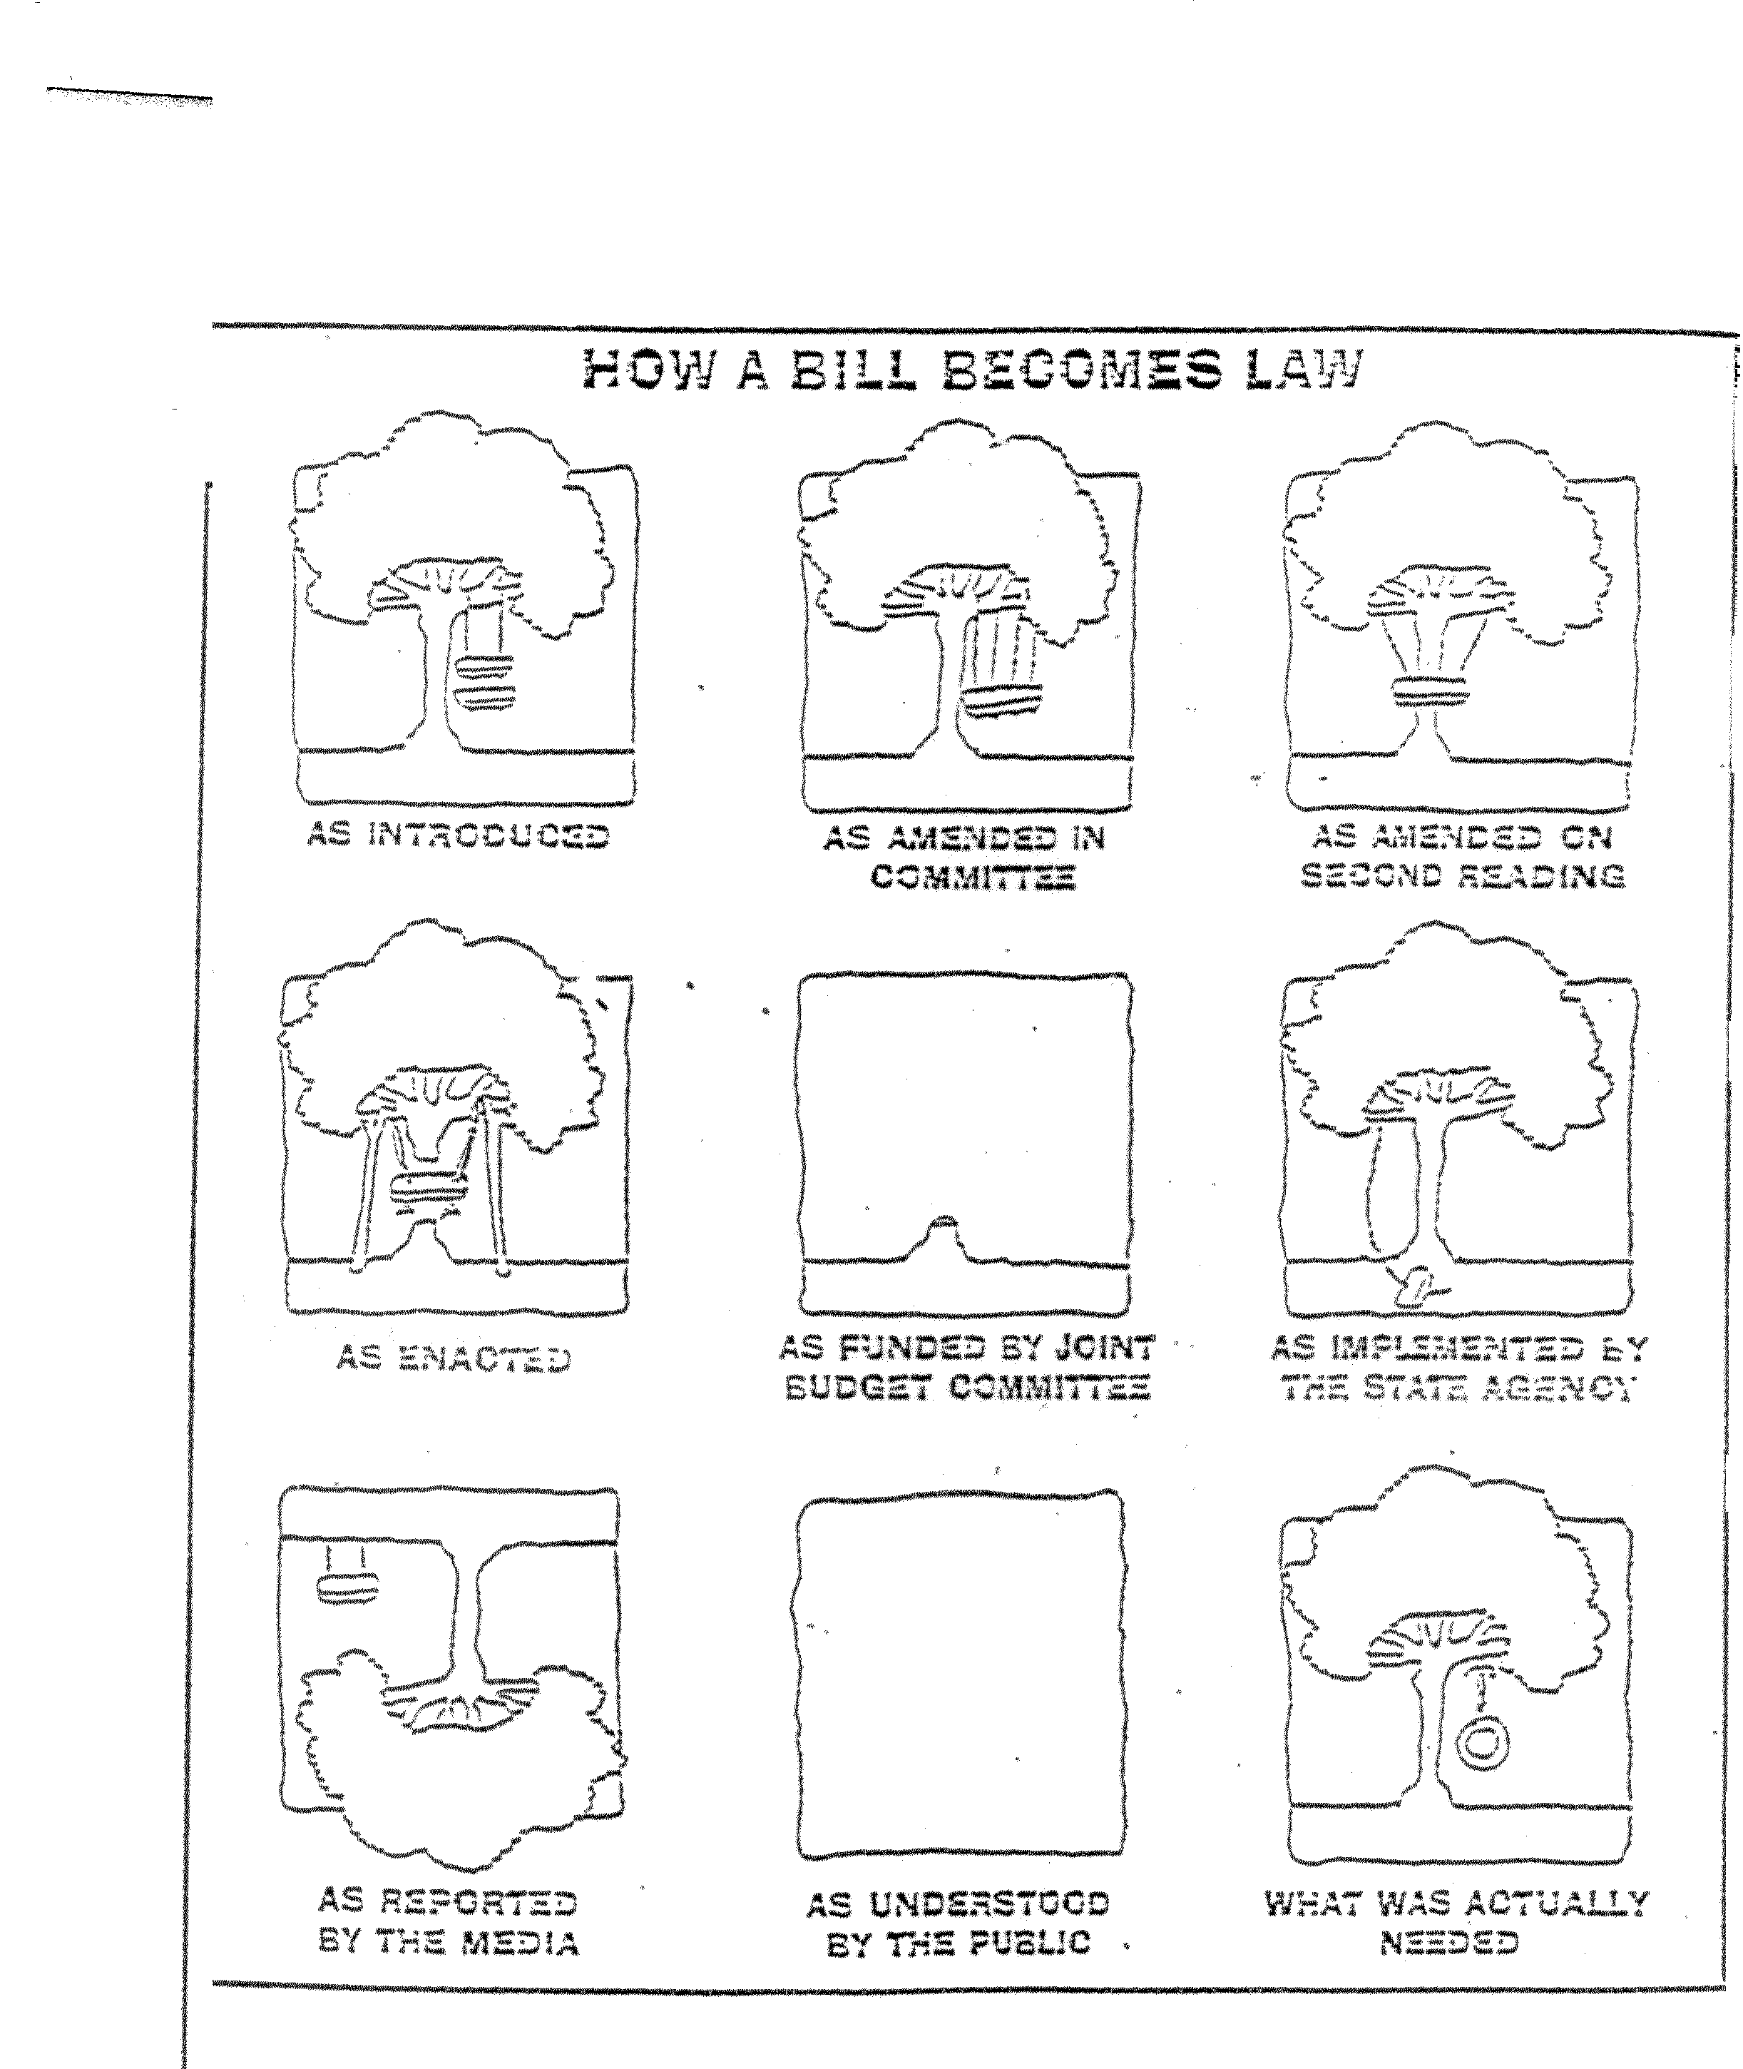
How it Works

Slide 13
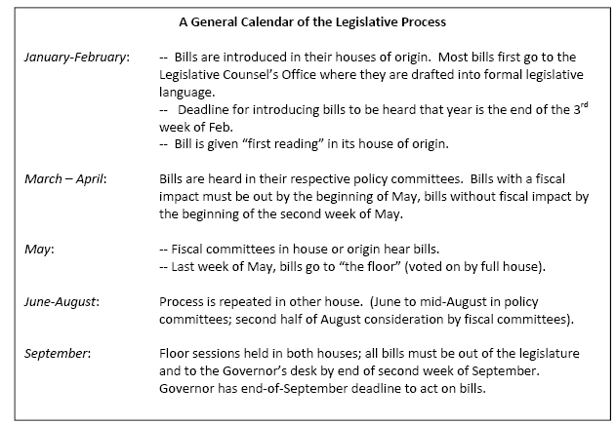

Slide 14
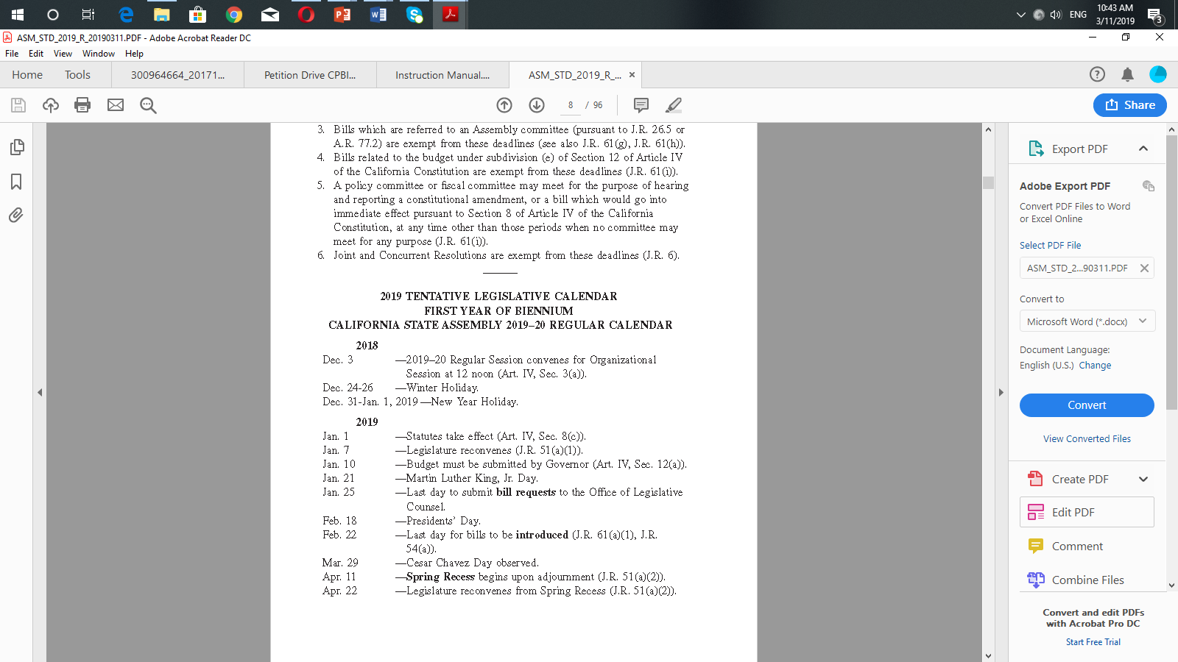
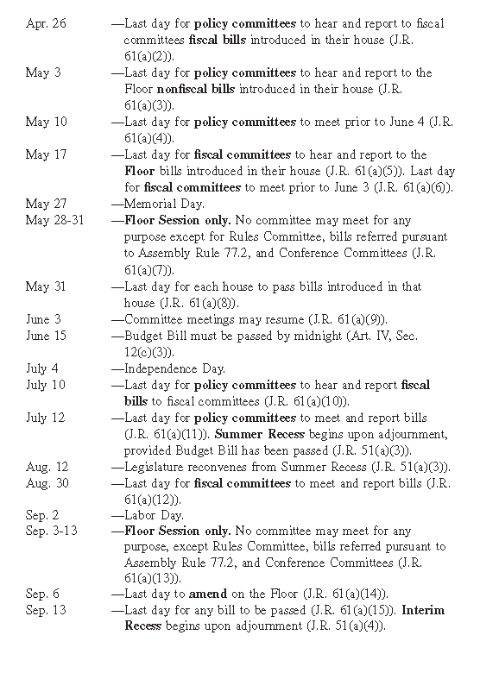

Slide 15
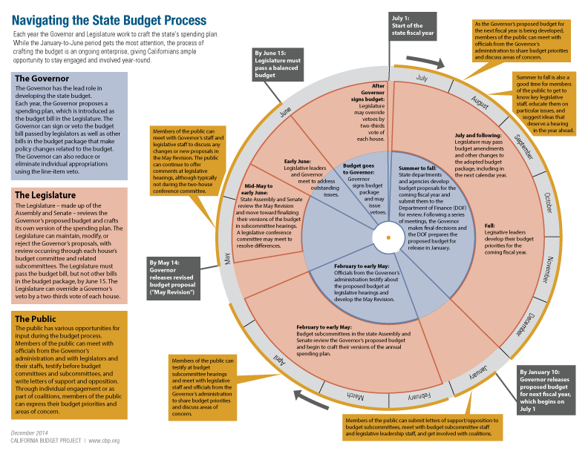

Slide 16
Overall Revenues
Prop 98
Community College Share

Slide 17
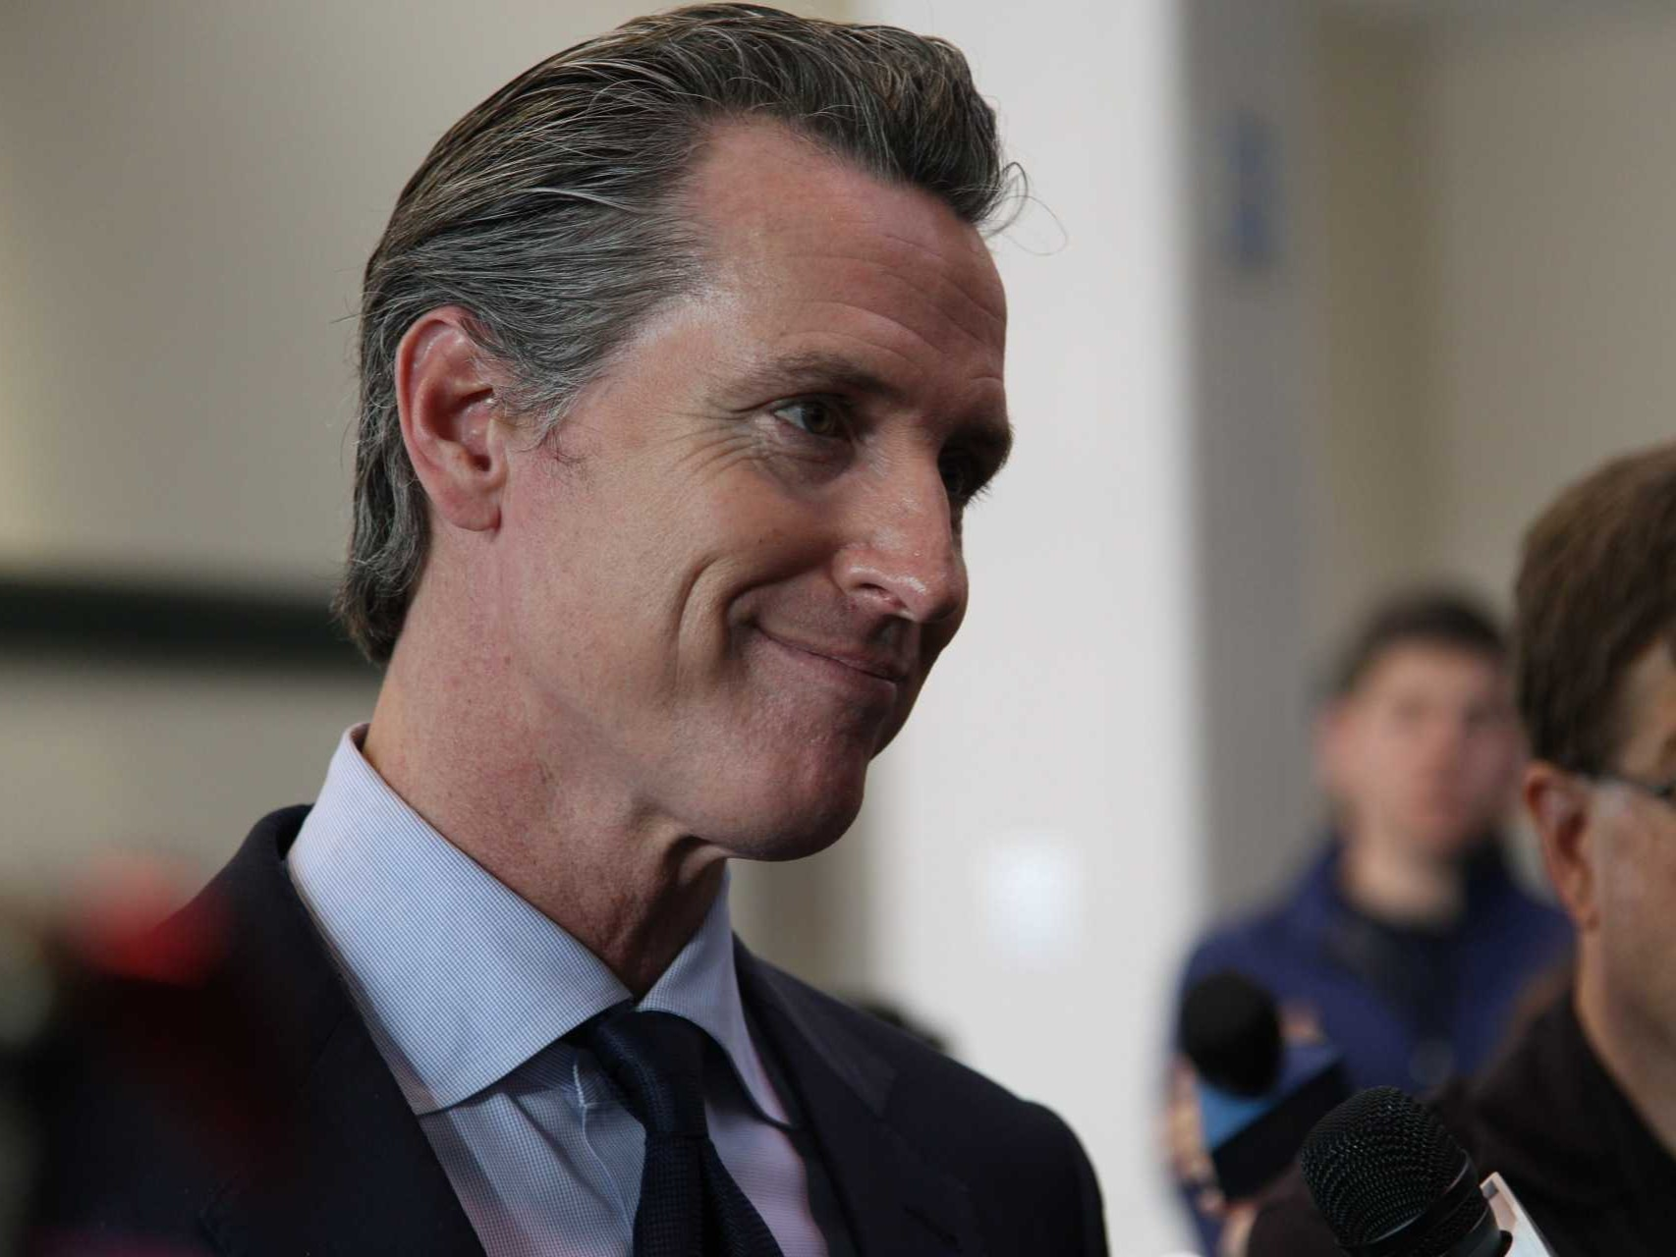
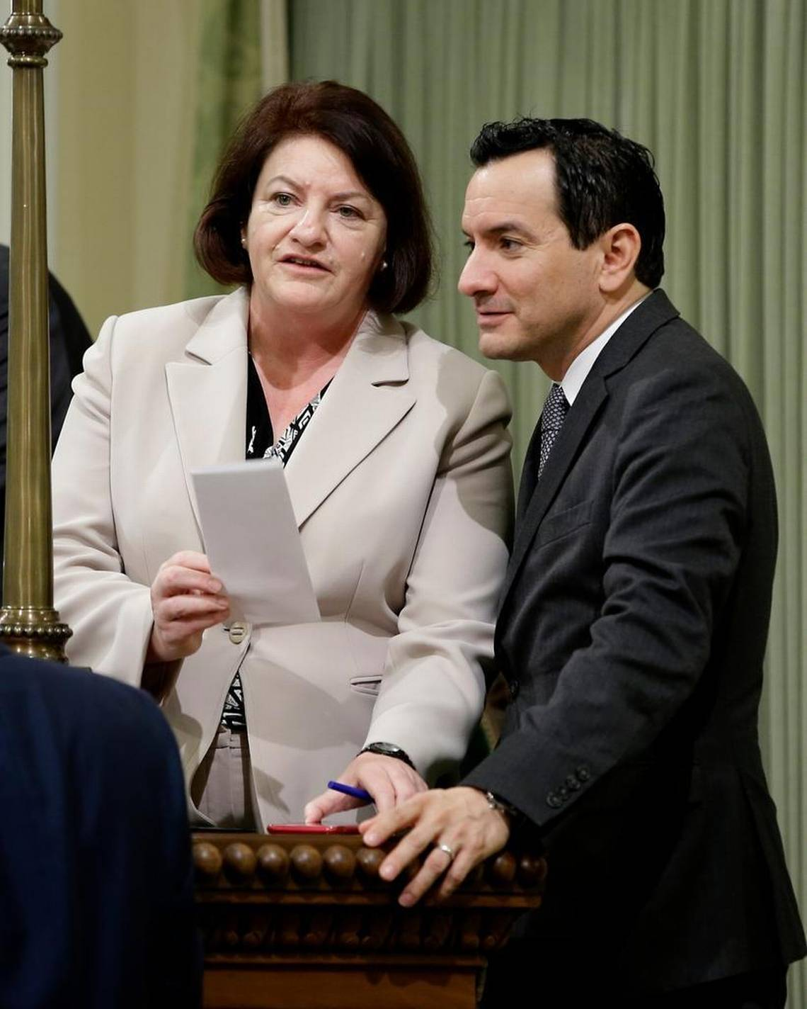
Who Determines the Budget?
Note: Line item veto gives Governor more influence over budget.

Slide 18

Stakeholders

Slide 19
Colleges as Community Institutions Funded and Regulated by Local Government Districts
Colleges as a System Funded and Regulated by State Government
Constituent Organizations Representing those in the Colleges
Outside Interests Seeking to Influence Fiscal and Policy Decisions
Legitimacy vs Power

Slide 20
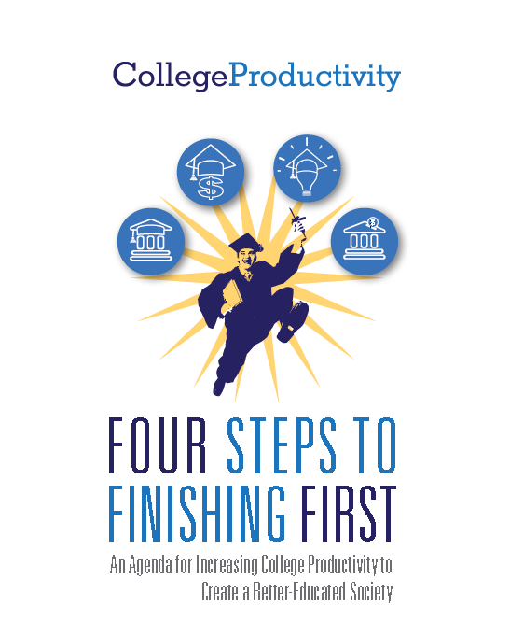

Slide 21
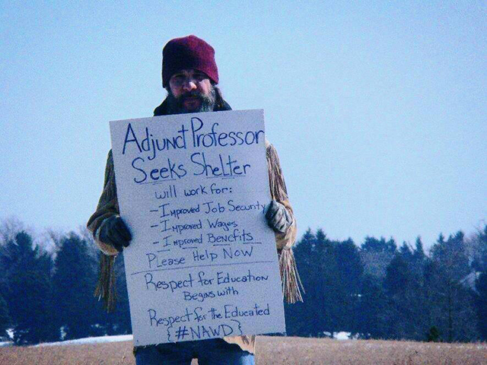



Business Efficiencies
Completion Incentives

Slide 22

Who Will Repair Tensions within the System?
Chancellor’s Office
Legislature
Governor

Slide 23
Where are Faculty?
Slide from 2013
Foundation Supported
Legislation “Fixing”
Problems Described in Study
Foundation Supported
Organizations Advocating Legislative Solution
Solutions Benefitting Industries Which Support Foundations
Foundation Supported
Study Using Flawed Methodology Decrying
Problems

Slide 24


Slide 25
Multiple Fronts
Legal
Political
Financial
Legislative
Others
Media
Regulatory

Slide 26
Public Record

Slide 27
What You Can Do
Slide from
Joint FACCC/ASCCC Presentation 2014
Bite-Size Information
Relevant
Analysis
One-Minute
Advocacy
Clear
Communication

Slide 28
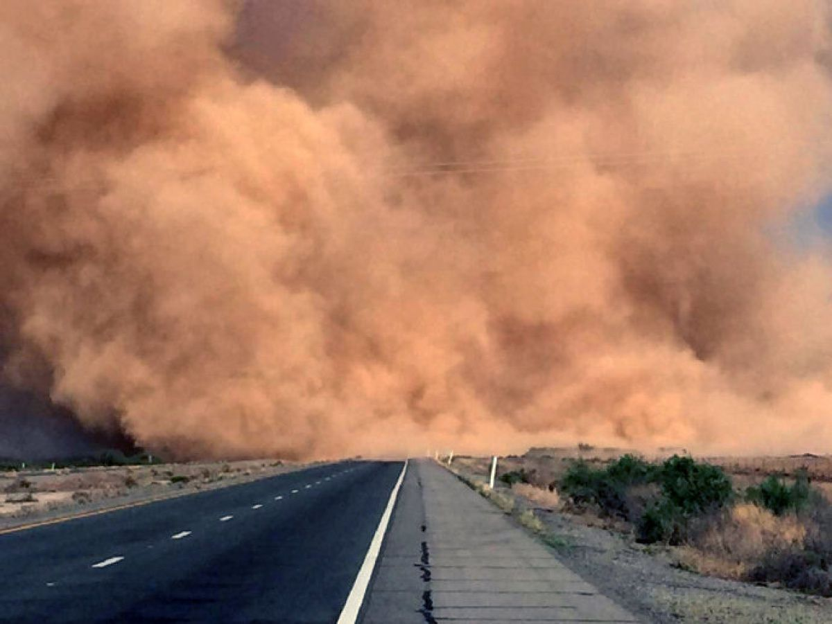
Even in a sandstorm,
we continue
to move forward.

Slide 29
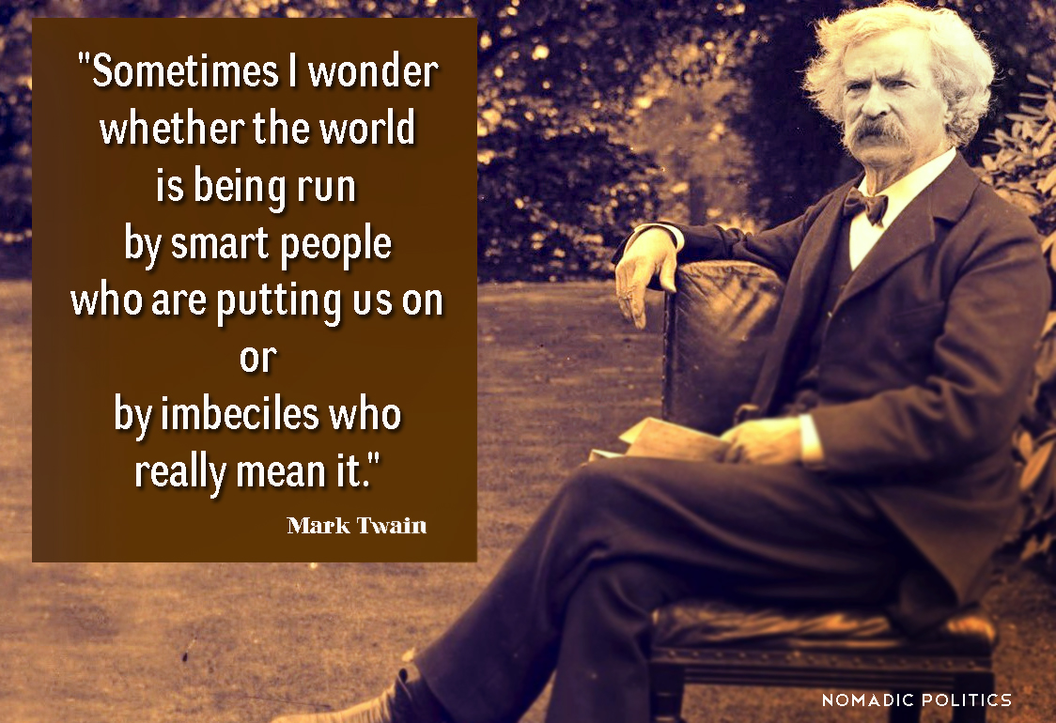

Slide 30


