Slide 1
Noncredit Counseling
Presented by: Edith Hernandez-Cabrera,
Jacqueline Garner, & Rosa Salazar de la Torre

Slide 2
Los Angeles Southwest College
Presented by: Edith Hernandez-Cabrera, Ed.D.
Counselor
Cabrere@laccd.edu

Slide 3

Noncredit Programs at LASC
ESL
High School Equivalency
Citizenship Prep
Computer Literacy
Apple Coding
Phlebotomy
Construction
Careers for a Cause

Slide 4
Partnerships – CTE/Noncredit
Construction – LAX
Maintenance & Logistics – Mass Liberation & ARC
Careers for a Cause – St. Joseph’s Center
Apple World & Ecosystems – Dual Enrollment
Phlebotomy – Local clinic & hospital
Probation Offices in LA – multiple programs

Slide 5
Noncredit Counseling at LASC
Selecting noncredit courses – educational planning
Orientations
Workshops
Process noncredit certificates
Available walk-in, by appointment, in person, online, phone
Career, academic, and personal counseling
  Transitioning to credit courses
  Currently working on noncredit to credit pathways
Notes:
Host noncredit new student orientations & workshops: goal setting, career exploration, study skills, stress management

Slide 6
Practices before, during, and after COVID
BEFORE: Met students in person, assistance with applications, educational planning, registration, in person workshops & orientations
DURING: Same but online, via phone or text. Created how to videos on youtube and sent the links to them. Assigned a staff member to each course to communicate with the students individually and assist them with tech needs or any other need.
NOW: We continue to do both, in person, online, and phone services. We assist students from applying to the college until registration. Including laptop loan applications, wifi/hotspots assistance, etc.

Slide 7
Cerritos College
Presented by: Jacqueline Garner, M.A.
Counselor
(jgarner@cerritos.edu)

Slide 8
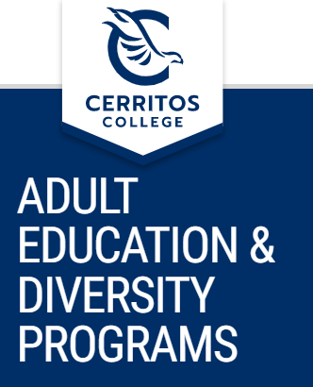
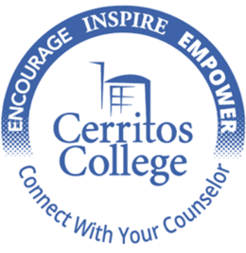
The Partnership for Adult Academic and Career Education (PAACE) regional consortium
Cerritos College PAACE (Partnership for Adult Academic and Career Education)
ABC Adult School
Downey Adult School
Norwalk-La Mirada Adult School
California Conservation Corps (CCC)

Slide 9


The right tools for College success
AED
English Support & ESL classes
AED
Math Support
Credit classes
Partnerships

Slide 10
Workforce Readiness and/or Job Advancement
GED
(English & Spanish)
Small Business Entrepreneurship
(English & Spanish)
Credit classes
Apprenticeship Program

Slide 11
Transitional and Support classes
AED 42.17 ESL High Intermediate and 42.18 ESL Low Advanced
ESL 4 ESL Grammar,Reading&Writing 4 4.0 Units
ESL 5 ESL Grammar,Reading,&Writing 5 4.0 Units
AED Math Support (40, 60, 80, 75, 112 and 114 classes)
MATH 40 Pre-Algebra 4.0 Units
MATH 60 Elementary Algebra 4.0 Units
Prerequisite: ESL 3 with a grade of "C" or higher or "Pass" or equivalent or AED 42.17 or equivalent (non-credit Adult Ed. ESL) with a grade of "Pass" or satisfactory completion of the assessment/placement process with eligibility for ESL 4
Prerequisite: ESL 4 with a grade of "C" or higher or "Pass" or equivalent or AED 42.18 or equivalent (non-credit Adult Ed. ESL) with a grade of "Pass" or satisfactory completion of the assessment/placement process with eligibility for ESL 5
MATH 75 Math Literacy for College Stud 6.0 Units
MATH 80 Intermediate Algebra 4.0 Units
MATH 112 Elementary Statistics 4.0 Units
MATH 114 College Algebra 4.0 Units

Slide 12

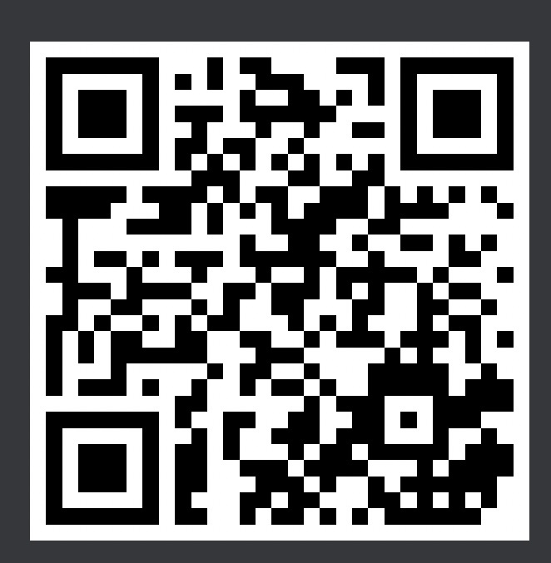
Contact us to help you get started
Please scan QR code to connect with our office for assistance and information

Slide 13
Santiago Canyon College
Presented by: Rosa Salazar de la Torre, M.A.
Professor Department Chair
Dela_Torre_Rosa@sccollege.edu

Slide 14

Facts & Data
Santiago Canyon College/RSCCD is the largest non-credit program in the state of California.
Awards and Accolades
  California Department of Education Best Practices for College Transition.
  California Community College Accreditation Committee Best Practices in College Transition
Pandemic Results 2019-2022
  400% Increase in Student Contact by Counselors Online and Non-Credit Growth to Over 30% FTES

Slide 15
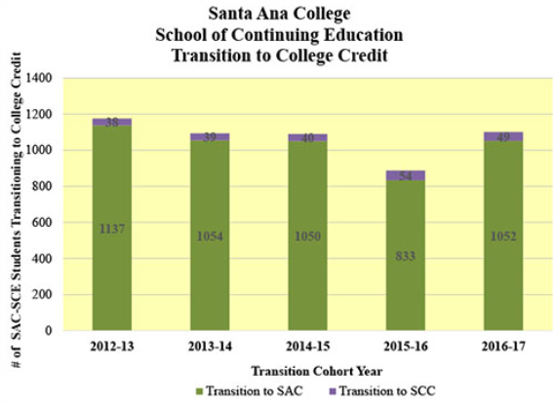
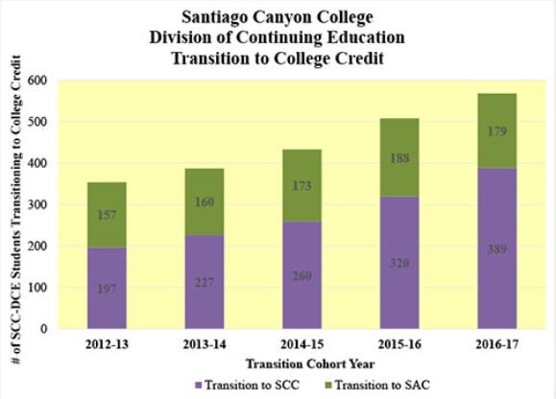
# of Students Transitioning from Noncredit to College Credit

Slide 16
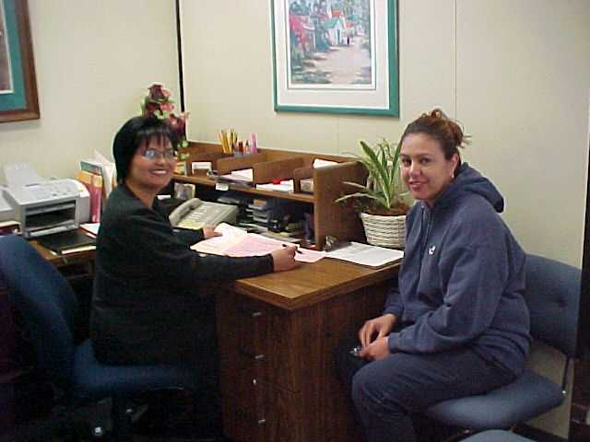
How STARS was developed & its history
Our agency wanted to help make the transition to college credit as simple and easy as possible for our noncredit students.
Growth of matriculation funding from the state was the drive to create a “seamless” matriculation pipeline program from the noncredit program to college credit.
“Passport to Your Future” program started in 1997 to transition students from the noncredit program to college credit.
In 2009 the name was changed to STARS.

Slide 17
Research Findings
57% of SCC graduates transferred to four-year universities.
67% of former noncredit graduates transferred to four-year universities.
57%, more than half, of the of former noncredit graduates transferred to California State Universities.

Slide 18
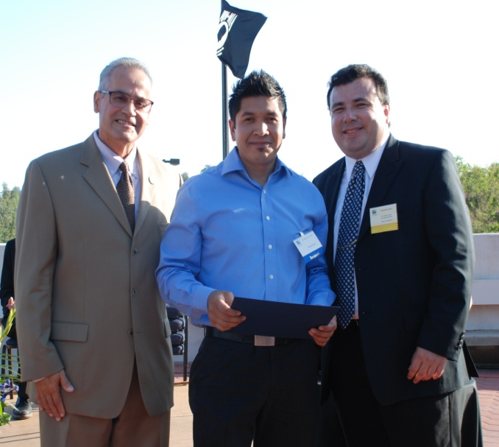
“The first time I thought of attending school it was a lonely day. I was sitting in a jail cell reading a book called The Alchemist by Paolo Coelho. In that book I learned that you have to listen to your heart.”
“I started attending school. I had attended school in México, but I had only completed sixth grade. I had the education of an eleven year old. Whatever math I had learned had stayed in México.”
“Obtaining my high school diploma is just one more step toward a higher education.”
“So far I will be the only one out of eleven brothers and sisters that will make it to college. I hope that I can encourage others to do the same.”

Slide 19
Application Steps
Step 1: Complete College Application
Step 2: Complete Financial Aid Application
Step 3: Welcome Orientation
Step 4: Registration Session
Step 5: Free Backpack Pick-Up
For more questions contact:
Counselor Skyler Phamle at Phamle_Skyler@sccollege.edu

Slide 20
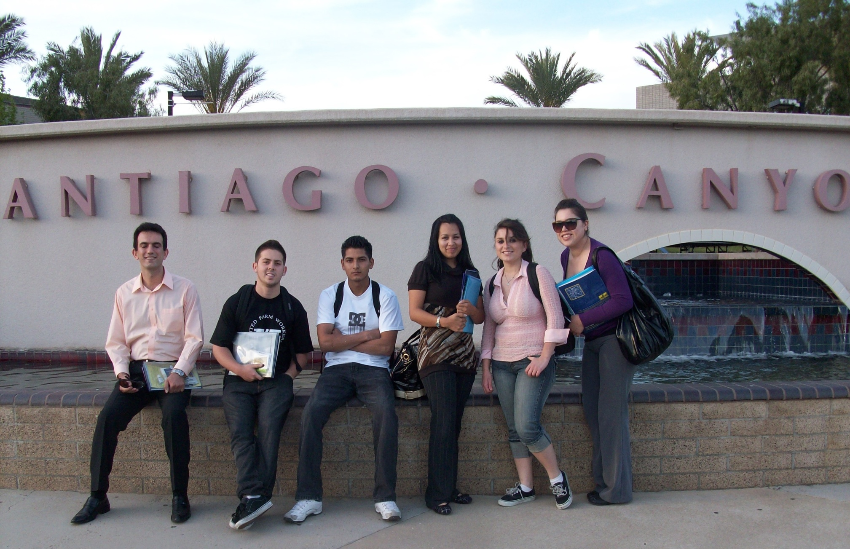

Slide 21
Project RISE: Inmate Education Program
Basic skills and developmental courses to students who are in custody
at any of the five Orange County jails and juvenile hall.
Courses taught by SCC Continuing Education instructors
RISE Counseling
  Program serves formerly incarcerated students at SCC launched in Fall 2018
  Now more than 40 active participants
  Services include:
    Educational, career and personal counseling
    Specialized services for college enrollment, financial aid and successful transition
    Community resources for wrap-around needs
    Tailored workshops and events
    Case management for support and retention
  Past RISE events include:
    Preview Day for students, Summer 2018 and Summer 2019
    FLEX Workshop for faculty and staff, Fall 2018, Fall 2019, Fall 2020

Slide 22
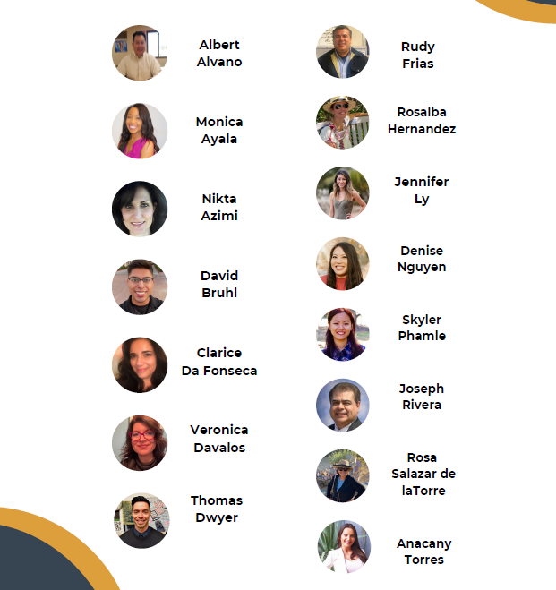
Meet Your Counselors

Slide 23
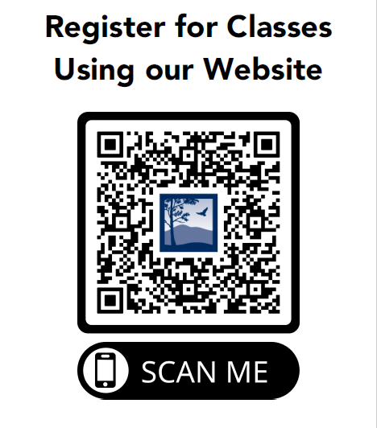
Questions:
Contact Us!
  Links:
    sccforme.com
    sccparami.com
Questions for Rosa?

