Slide 1
OER Ancillaries: A Community Model
Larry Green
Lake Tahoe Community College

Slide 2
Math OER Textbooks

Slide 3
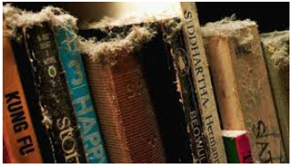
Textbooks are Old School
MyMathLab
Alex
Lumen Learning
All Cost $$$$$$$$
Can’t Sell Used Licenses

Slide 4
The Old Model
One Pioneer Writes a Book
Eventually CC-by
Organization Polishes It Up
Without Online Homework System, Few Adoptions

Slide 5
The New Model
Work Together as a Community
Bring in Multiple Experts
Faculty Subject Experts who Program
Error Checkers
Disability Expert
Student Feedback
Faculty Subject Experts Who are Not Computer Savvy

Slide 6
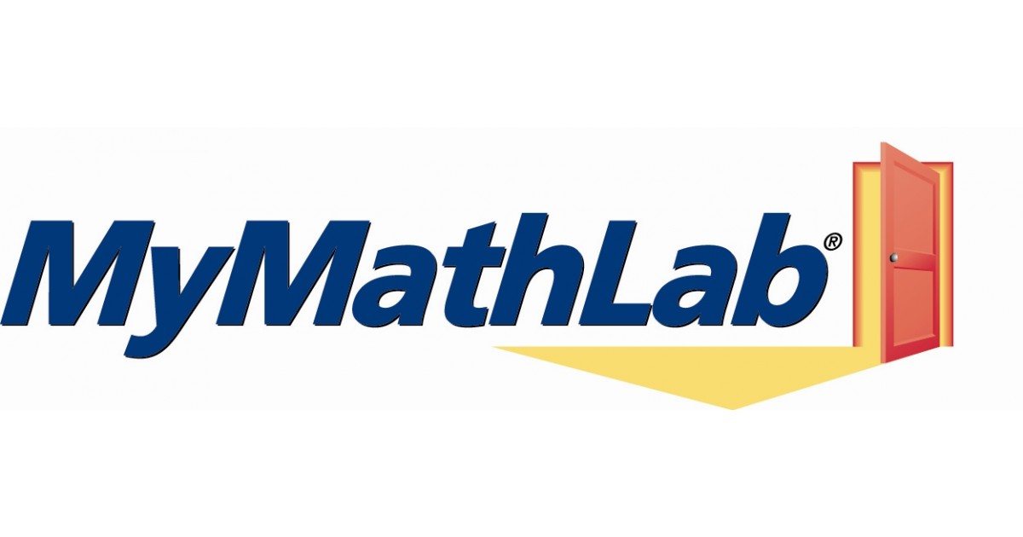
Ancillaries to Create
PowerPoints
Test Banks
Online Homework Systems

Slide 7
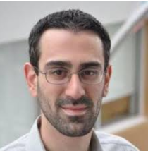
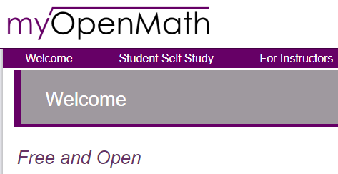
MyOpenMath
Written for Math Homework Systems
Free and Open
Tens of Thousands of Questions already written.
Complete Courses Available
Integrates Into Canvas
https://www.myopenmath.com/
David Lippman

Slide 8
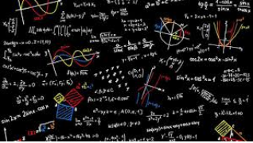
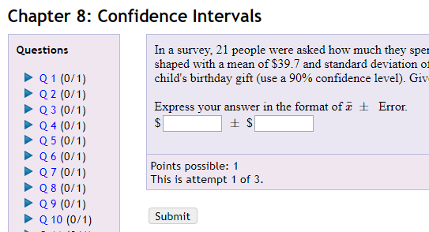
MyOpenMath Pilot Statistics Project
Cindy Moss: Skyline College
Jessica Kuang: Oxnard College
Larry Green: Lake Tahoe Community College

Slide 9
Statistics MyOpenMath Details
Separated by Chapter or Section
Questions Contain Links to:
Videos
Textbook Pages
Hints
Numbers Randomly generated
Question Pool for Each Question
Ongoing Project

Slide 10
Steps to Join
Get MyOpenMath account
Watch two videos
Customize your course
Be Part of the Community

Slide 11
ZTC Grant
Beginning Algebra through Differential Equations
Partnering with College of Alameda
Jan 1 – Dec 31, 2018
$150,000 Funded by Chancellor’s Office

Slide 12
Andres Bazos: Sierra College
George Rothbart: College of Marin
Cindy Moss: Skyline College
Jacqueline Anderson: Sierra College
Jay Kesler: Sierra College
Jessica Kuang: Oxnard College
John Gee: Evergreen Valley College
Julie Harlsnd: Mira Costa College
Karl Ting: Mission College
Linda Hoang: Cosumnes River College
Mark Harbison: Sac City College
Peter Rankenburg: CC of San Francisco
Rick Hough: Skyline College
Roy Shahbazian: Santa Ana College
Sean Nguyen: CC of San Francisco
Sherry Sharufa: Contra Costa College
Farzan Riazati: College of Alemeda
Gina Karunaratne: College of Alemeda
Christopher Wu: College of Alameda
Larry Green: Lake Tahoe CC

Slide 13
Project Details
Teams for Beginning and Intermediate Algebra, PreCalculus, Calculus, Vector Calculus, Linear Equations/Differential Equations
Find the Best MyOpenMath Questions Out There
Develop New Questions Where Needed
Links to Videos, Hints, and Textbook Pages
Other Ancillaries
Accuracy Checker: Mark Harbison

Slide 14
A New Model
Not just one person doing the work
A partner near every college
Customizable to Fit
Easy to move from math to other areas

Slide 15
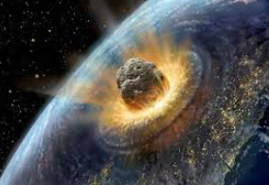
Challenges and Possible Solutions
MyOpenMath’s staff of One
Academic Senate OER Committee’s Proposal
Not advertising like publishers
CMC³, Other Discipline Groups
Maintain enthusiasm
OER Rules!

Slide 16
How Can We Do Better?

Slide 17
Larry Green: DrLarryGreen@gmail.com

