Slide 1
Opportunity for Positive Structural Change in Times of Crisis:
Implications for Hiring
Michelle Velasquez Bean, ASCCC Area C Representative (she/her/hers)
Dr. Abdimalik Buul, A2MEND Board Member, San Diego City College (he/him/his)
Mayra Cruz, ASCCC Area B Representative (she/her/ella)
Dr. Elizabeth Imhof, ASCCC Faculty Leadership Development Committee (she/her/hers)
Friday, April 24, 2020
3:00 p.m. -- 4:00 p.m.

Slide 2
Questions During Webinar
Type your questions in the Q&A box

Slide 3
Today, we will...
Provide Definitions
Share Students’ Lived Experiences
Describe Importance of Anti-racism Training
Introduce a Tool for Dialogue

Slide 4
Can people of color
be racist?
Notes:
Zoom Poll
Question: Can people of color be racist?
Response options:
Yes
No
I do not know

Slide 5
Can People of Color be Racist?
White racism vs Black racism.
Dr. Joy Degruy

Slide 6
Definitions
White Supremacy is a historically based, institutionally perpetuated system of exploitation and oppression of continents, nations, and peoples of color by white peoples and nations of the European continent, for the purpose of maintaining and defending a system of wealth, power, and privilege ( Martinez, 1998).
Racism is dynamic and ever-changing. The critical aspect of racism that we must address today is the accumulation and incorporation of long-standing racialized practices into all of our social and economic structures.
Race consciousness is the conscious knowledge that reveal and counteract manifestations of inequality and discrimination (racism) in society.

Slide 7
Definitions (continued)
Structural racialization is a system of social structures that produces and reproduces cumulative, durable, race-based inequalities.
Institutional Racism the systematic distribution of resources, power and opportunity in our society to the benefit of people who are white and the exclusion of people of color.
Racialized outcomes do not require racist actors. Focusing on individual instances of racism can have the effect of diverting our attention from the structural changes that are required in order to achieve racial justice.
Faculty and all employees need to explicitly and implicitly challenge all manifestations of racism and racialization in our work and in our organizations.

Slide 8
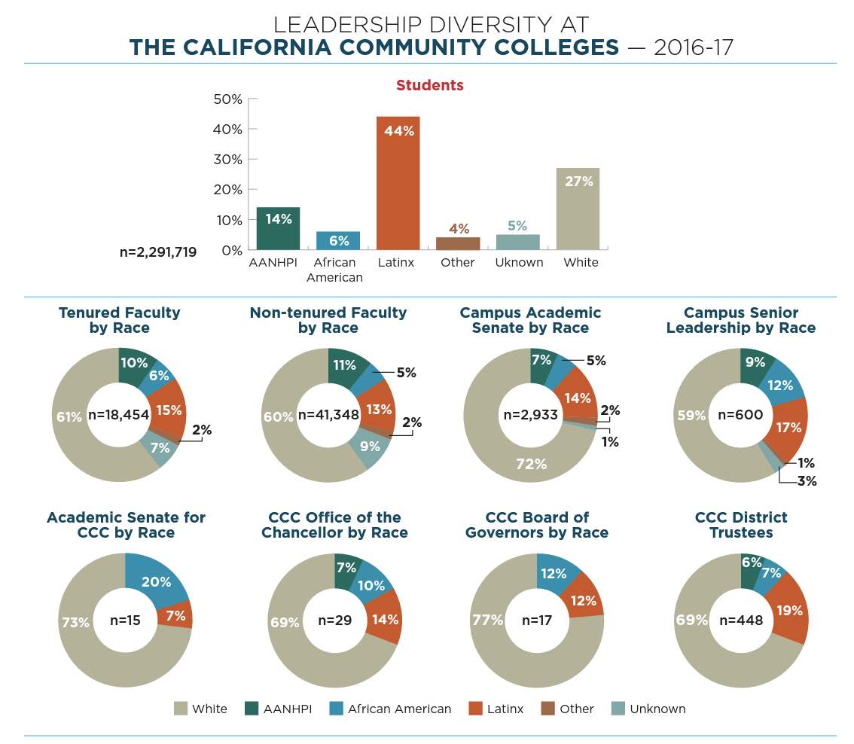
Notes:
Graphic to see the effects of systemic racism

Slide 9
Defining Anti-Racism
Racism: Any prejudice against someone because of their race, when those views are reinforced by systems of power (Oluo, 2019).
Productive conversations about race must include a power analysis.
There is no such thing as reverse racism. People from the dominant race, who benefit from the privilege of power, cannot experience racism (Oluo, 2019).
An anti-racist analysis views racism as structural and embedded into all societal structures. This means that all people are affected by racism and hold implicit bias which allows for the sustenance of racist structures.

Slide 10
Racialized Outcomes Are Created by Policy
Policy: Written and unwritten laws, rules, procedures, processes, regulations, and guidelines that govern people.
Racial inequity: When two or more racial groups are not standing on approximately equal footing.
Racist policy: Any measure that produces or sustains racial inequity between racial groups.
Anti-racist policy: Any measure that produces or sustains racial equity between racial groups.
Racist idea: Any idea that suggest one racial group is inferior or superior to another racial group in any way.
Anti-racist idea: Any idea that suggests the racial groups are equals in all their apparent differences—that there is nothing right or wrong with any racial group; Anti-racist ideas argue that racist policies are the cause of racial inequities. (Kendi, 2019, pp 18-20)
Notes:
Racist policy => racial inequities => racist ideas => uphold racist policy/self-interest/status quo
Anti-racist policy => racial equity
According to Ibram X. Kendi, at any given moment we are either anti-racist or racist. It is a matter of what policies we uphold. Policies change behaviors and thoughts, not the other way around.
Policies do not need to have racial terms to produce racial inequities. Also, many policies that supposedly protect racial discrimination continue to produce racial inequities.

Slide 11
Question:
Based on the definitions we have learned, how do you believe racism is impacting students of color during COVID-19?
Type your answer in Q&A
Notes:
Gage the audience’s understanding of the definitions. Pose a reflective question that ties the definitions and the student experience.

Slide 12
Students’ Lived Experiences
Notes:
Highlight these key points:
Explain how specifically the lack of faculty of color impacts students and over taxes faculty of color during the crisis (virtual learning)
Creating safe spaces virtually. How does COVID-19 allow students to find each other and build community.
Be empathetic: students job loss, quiet study spaces, access to computer and internet services, move back to abusive situations, balancing parenthood with classes and expectations, depression and anxiety caused by isolation

Slide 13
Treating Inequities as a Real Crisis
Racism in higher education
Structural racism exacerbates health disparities in COVID-19
Notes:
Key points:
Racist fabric of higher education
Look at the organizational structure to which you belong. If the organization is disproportionately White as compared with the student population served, you still have an institutionalized racism problem.
Take a look at the hires in your own department. If it is all White, then you may just have an institutional racism problem. In addition, if the department has hired one person of color, and claims or believes that diversity goals have been met, you still have a problem.
When you and the administration can name the one or two folks of color who are routinely asked to reside on every committee in your organization, then you might have an institutionalized racism problem. [BTW, folks of color can name the one or two “usual suspects” in their organization.
If those same folks who serve are always the same ones — the “usual suspects” — you might ask why? Often times, the “usual suspects” are chosen to serve because there are few folks of color in the organization, yet sometimes, the “usual suspects” are chosen because administrators are most comfortable with some people of color. Everyone has a unique story, biography, consciousness and reaction to oppression. In fact, those “biographies,” one’s consciousness, and or dispositionality, can resonate with those in power. In other words, the “usual suspects” will often receive nominal gratuitous rewards — appointments to menial positions, important hiring committees and some even receive “awards” for keeping their mouths shut.
-COVID-19 shines a harsh light on racial & ethnic disparities - Impact on population/students of color
(Blacks and Latinx)
living conditions/housing (more likely to live in locations and housing situations that put them at increased risk of infection from the virus)
health care inequities (access to care and treatment services; unlikely to be uninsured; immigration status is also a barrier to health insurance coverage; once Blacks and Latinx are affected with the virus; they are more likely to get very ill and ie due to underlying health conditions; populations with higher risk of chronic conditions)
socio-economic conditions and challenges (Social distancing policies required to address COVID-19 have led many businesses to cut hours, cease operations, or close altogether. People who work in certain industries, such as restaurant, hospitality, retail, and other service industries, are particularly at risk for loss of income; limited ability to absorb income declines due to more limited incomes)

Slide 14
Designing Structural Change
Be intrusive
Be relational
Be culturally relevant and affirming
Be accountable
(Harris and Wood, 2020)
Notes:
ASCCC Equity Driven Systems Paper Highlights:
Student equity is based on the theory that when the way is paved for the individuals facing the most adversity and difficulty, and when services and support are cultivated for the ones that need them most, all students will benefit.
Equity in education requires that conditions are created that eliminate the obstacles to educational opportunities regardless of race, gender, family background, language, poverty, and other factors.
(Harris & Woods 2020) Structural change requires to apply equity minded practices. These are four relevant to this session.
be intrusive- conduct an assessment of the student experience and who they are;communicate regularly
be relational- humanize the relationship with students; convey positive messages and validation; hold high expectations for performance
be culturally relevant and affirming- provide a culturally affirming student experience; connect with students and their stories; leverage cultural assets, cultural capital; mirror the student diversity in teaching and learning; equity in student outcomes is achieved thru culturally responsive practices
Be accountable- “be answerable for” student outcomes; move from a consensus culture to a culture of accountability
Reflective questions: How will you design and deliver your course to ensure disproportionately impacted students are reflected in your course content and what intrusive communication methods do you plan to employ to ensure they remain engaged and succeed in your course with full access to all course material and tools?

Slide 15
Leveraging Resources
Leverage resources (grant and SEA funds)
Add anti-racist requirements to funding request
Seek to embed equity and anti-racist requirements in all campus structures
See crisis driven planning and new structures as an opportunity to embed equity

Slide 16
Hiring Committee Training
Intentionally acknowledge real crisis
Acknowledge and address structural barriers and institutional racism
Train faculty on anti-racism and equity
Train to hire for diversity in race and approach
Begin the dialogue that goes deeper

Slide 17
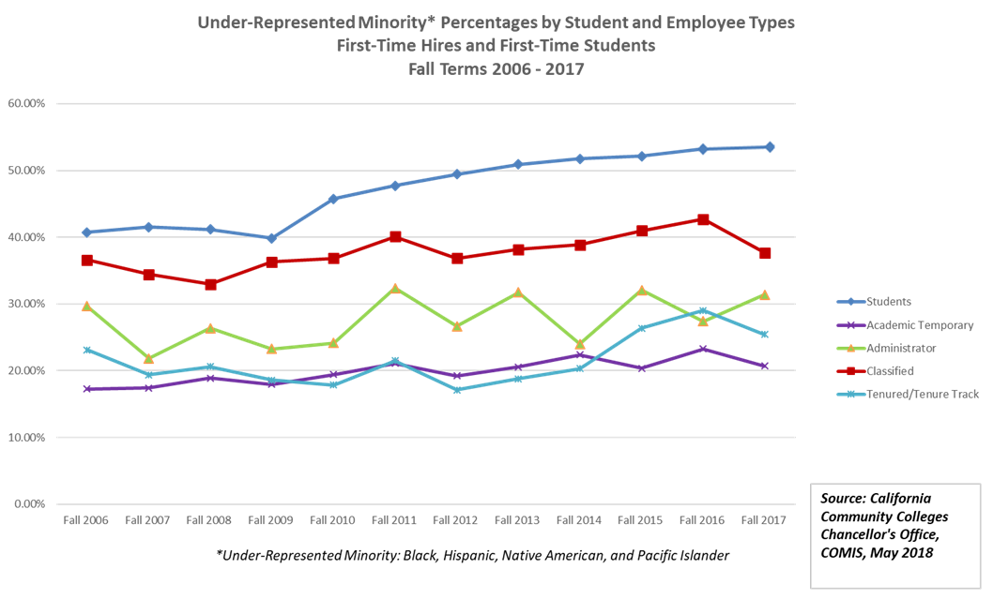
CCCCO slide

Slide 18
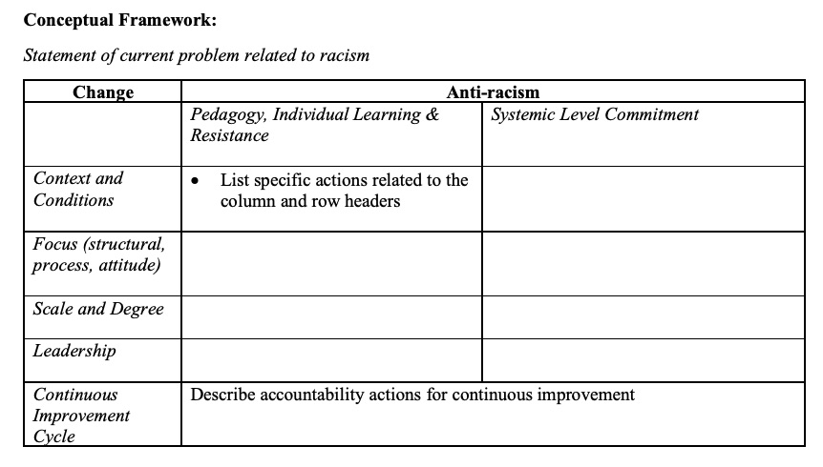
From Dialogue to Action in Addressing Systemic Bias Tool
Notes:
EDAC System bias dialogue tool
Objective of the tool: Identify an issue that is related to systemic bias and apply a systems framework to create a plan of action.

Slide 20
Resources
Academic Senate for California Community Colleges. Equity-Driven Systems: Student Equity and Achievement in the
California Community Colleges. (Fall 2019). Retrieved from https://www.asccc.org/papers/equity-driven-systems-student
equity-and-achievement-california-community-colleges
Campaign for College Opportunity. Left-Out: How Exclusion in California’s Colleges and Universities Hurts Our Values, Our
Students, and Our Economy. (March 2008). Retrieved from http://collegecampaign.org/portfolio/left-out-report/.
Kendi, Ibram. (2019). How to be an Antiracist. New York: One World.
Oluo, Ijeoma. (2018). So You Want to Talk About Race. New York: Hatchette.
Wood, Luke & Harris, F. (2020). Equity-Minded Student Services in the Online Environment. Retrieved from
https://www.youtube.com/watch?v=qGoldJP4Xl8&fbclid=IwAR1En27F0LbB7mfFFCVh-
t1zVOWmDkV45stbAdTYAHYOWc9pPOamVTqBWE.
To request a copy of the Dialogue to Action in Addressing Systemic Bias tool email cruzmayra@deanza.edu
Notes:
Additional resource:
This rubric was created using the Association of American Colleges and Universities (AAC&U) Critical Thinking VALUE Rubric. Retrieved from https://www.aacu.org/value-rubrics
Intercultural Knowledge and Competence Value Rubric.

Slide 21
For Further Information and Support
Visit the COVID-19 Faculty Resource page
Email info@asccc.org
Always ask your local Human Resources or legal council
Contact Info:
mbean@riohondo.edu
abuul@sdccd.edu
cruzmayra@fhda.edu
imhof@sbcc.edu

