Slide 1
Pierce GO DAYS

Slide 2
FACT SHEET
Occurs over 2 days during the week before the start of Fall Classes
In 2014, ~950 students attended
15 workshops offered each day plus campus tours, “Speed Majors” session and “Party with Your Professor”
All newly enrolled students are invited and encouraged to attend
All students received an “I AM PIERCE COLLEGE” t-shirt
All students who pre-register for GO Days are called by a Pierce faculty, staff or administration member as a welcome and a reminder to attend in the days prior to the event.
Over 60 faculty and staff volunteer their time to work the event
100% of students who attend GO Days say they would recommend it to other students
Pierce College GO Days
New Student Conference

Slide 3
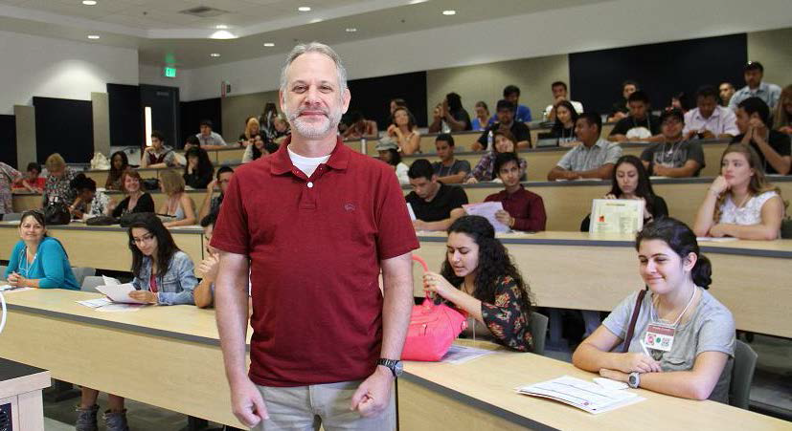
Clive Gediman, Librarian, leading a workshop
Pierce College GO Days
New Student Conference

Slide 4
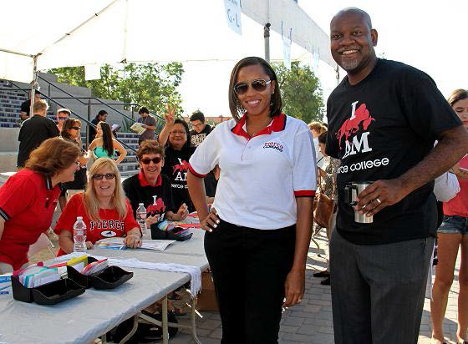
Even the administrators help out with GO Days
Pierce College GO Days
New Student Conference

Slide 5
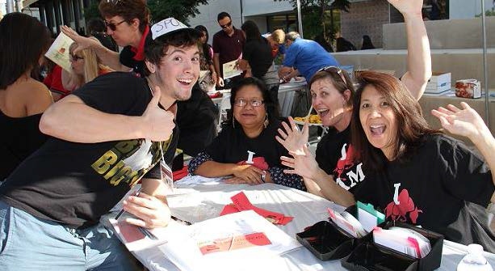
Students, faculty, staff and administrators mixing it up at GO Days.
Pierce College GO Days
New Student Conference

Slide 6
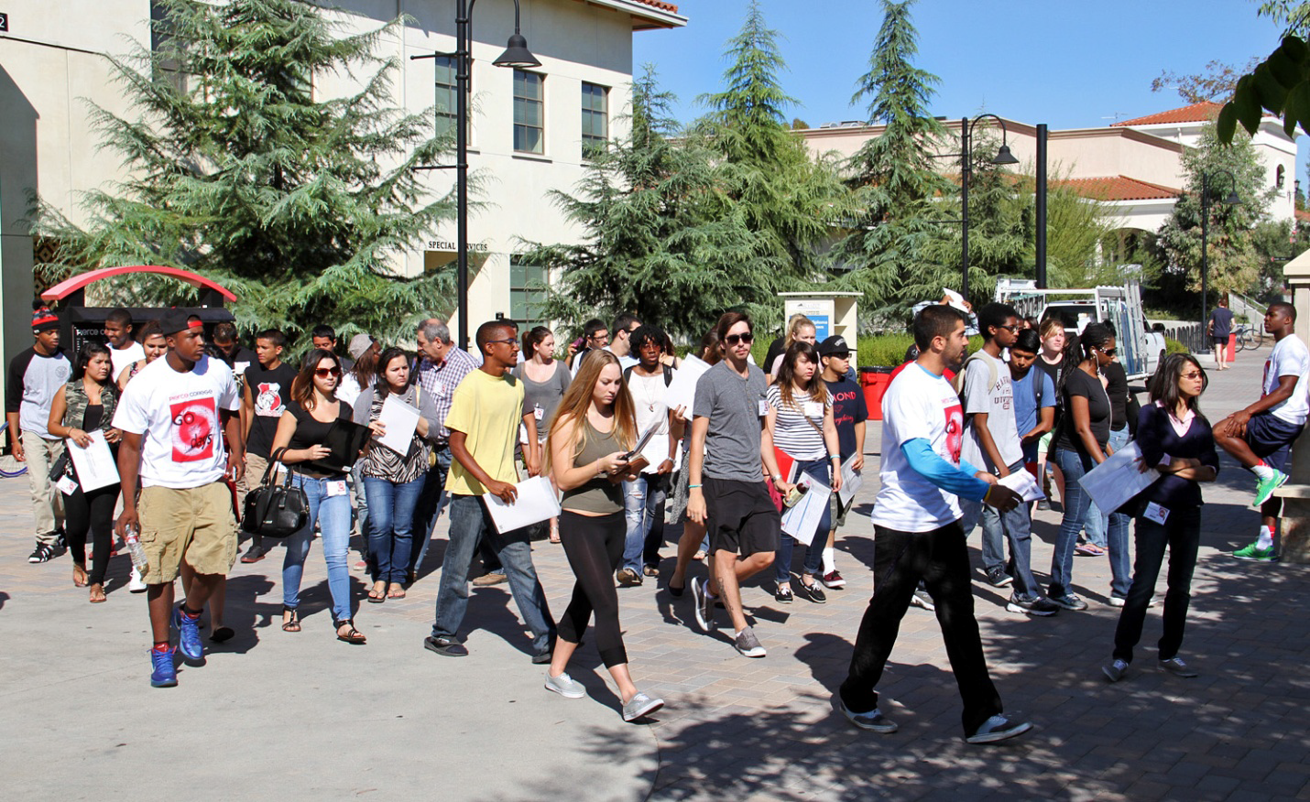
New students attending a campus tour led by a student volunteer
Pierce College GO Days
New Student Conference

Slide 7
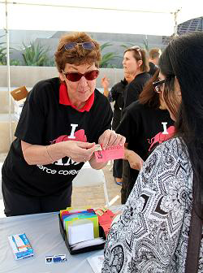
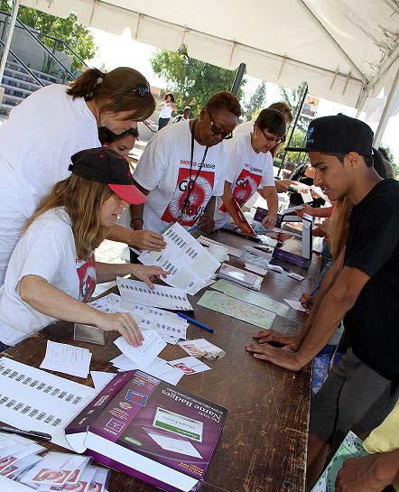
New Student checking in and receiving her t-shirt, certificate and lunch ticket
Faculty and Staff volunteers checking-in students
Pierce College GO Days
New Student Conference

Slide 8
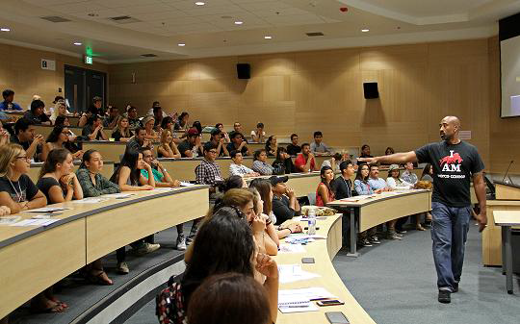
New students attending the “Top 10 Things to Avoid” workshop taught by counselor, Joseph Roberson
Pierce College GO Days
New Student Conference

Slide 9
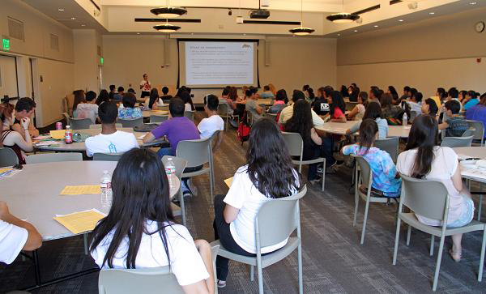
New students attending the “How to Transfer” workshop taught by Transfer Center Director, Sunday Salter
Pierce College GO Days
New Student Conference

