Slide 1
Pre-Session Breakout for Articulation Officers July 7, 2020

Slide 2
Session Description
This session is intended as a training and collaboration session for all articulation officers, new and experienced. Discussion topics will include the role of the articulation officer in the curricular process, updates on the Course Identification Numbering (C-ID) System, Associate Degree for Transfer, and Transfer Model Curriculum submissions to the Chancellor’s Office, ASSIST updates, expanding Advanced Placement (AP) policies to include International Baccalaureate (IB) and College-Level Examination Program CLEP, and competency based education and credit for prior learning.

Slide 3
Overview of our time together:
C-ID Updates, Eric Wada
Credit for Prior Learning, Benjamin Mudgett
Competency Based Education, IB and CLEP policies, Cheryl Aschenbach
Chancellor’s Office support of articulation, Bob Quinn and Devin Rodriguez
Role of the AO in Curriculum, Tiffany Tran
ASSIST Updates, Holly Demé

Slide 4
April Lonero
Overview of Pathable Platform
Poll #1: How many years of experience do you have in articulation?
ASCCC

Slide 5
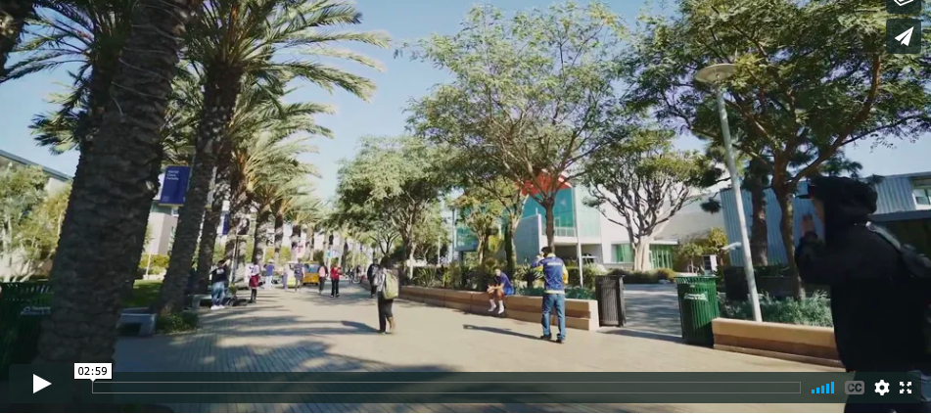
CREDIT FOR PRIOR LEARNING
at Palomar College
Helping students earn credit for what they already know and can do

Slide 6
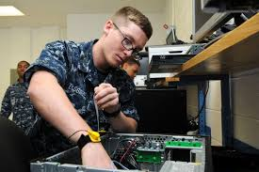
What is Credit for Prior Learning?
Credit for Prior Learning (CPL) is a faculty-driven initiative where college credit is awarded for validated college-level skills and knowledge gained outside of a college classroom.
Industry training and certification
State/federal government training
Volunteer and civic activities
Apprenticeships, internships, work-based learning, or other industry-based experiential learning
Military training

Slide 7
Credit for Prior Learning in California
In 2018, Governor Brown signed two bills that mandate Credit for Prior Learning in California Community Colleges:
SB1071 - Public postsecondary education: Chancellor of the California Community Colleges: policy to award course credit for prior military education, training and service.
AB1786 - Community Colleges: academic credit for prior military experience

Slide 8
Palomar College leads the way…
Palomar College was recently awarded a grant by the CA Community College Chancellor’s Office Foundation to begin CPL work with our faculty to develop learning assessment methods and streamline internal processes to award credit and remove the onus on students to pursue this option.
Palomar will also implement a Credit for Prior Learning BP/AP by spring 2020 to be used as a potential BP/AP for other CA Community Colleges.
Contact the Curriculum Committee CPL workgroup at cpl@palomar.edu
Ben Mudgett - Articulation Officer
Candace Rose - Curriculum Technical Reviewer & Media Studies Faculty
Nichol Roe - Associate Dean of Workforce Development and Extended Studies
Tina Barlolong - Veterans Counselor

Slide 9
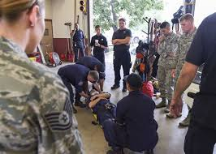
7 CPL Pilot Disciplines...
Seven disciplines that lend themselves to CPL have been identified by the Academic Senate in partnership with the Chancellor’s Office according to the following criteria:
Popularity among veteran/military and adult (age 25+) students, according to CCCCO completion data (2015-17)
Alignment with the priority sectors of the Workforce and Economic Development division, which are based on job growth and wage gains
Alignment with industry certifications and/or standardized workplace training
Administration of justice
Automotive technology
Business administration and management
Cybersecurity
Fire science
Health
Information technology

Slide 10
CPL Policy Framework
Equity: all students have equitable access to consistent opportunities to earn CPL
Philosophy and Academic Framework: grounded in the institution’s philosophical and academic framework and is consistent with institutional mission, goals, and approaches to learning.
Integrity: all stakeholders (including faculty, institutional representatives, students, and any external contributors) promote integrity in the evaluation and documentation of prior learning
Faculty Qualifications: preservation of qualified discipline faculty purview over the awarding of credit
Student Services: students have timely and continuous access to transparent information, resources, and services to guide them on CPL
Credit Management: clearly identifies how credits are organized and applied to student records
Planning, Resources, Improvement: continuous improvement and scalability of processes by providing sufficient infrastructure and data to support policy implementation and review

Slide 11
Sample CPL Inventory Worksheet

Slide 12
Sample CPL Approval Worksheet

Slide 13
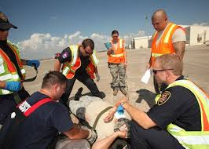
CPL Framework: Awarding Credit
Students’ educational goals should be the guiding factor in the award of credit
Students should be able to have their prior learning assessed early in their educational journey. CPL affects students’ educational planning – they should not have to plan to take a course for which they might receive CPL. Therefore, early advising is important
Students should be assessed for CPL prior to registering for a course. They should be able to access clear timelines and processes toward receiving a credit recommendation

Slide 14
CPL Framework: Awarding Credit
Faculty should be encouraged to award credit in General Education or program requirements before electives. Too much elective credit can negatively impact students’ financial aid. For veteran and military students, consider a “shadow” educational plan that contains a placeholder for the course in which CPL is anticipated; this avoids the student getting too close to the financial limits on VA benefits
Rely on existing minimum/maximum credit allowances already stipulated in transfer policy for prior learning credit
Follow accreditation requirements
If the student intends to transfer, consider the policies at their transfer destination

Slide 15
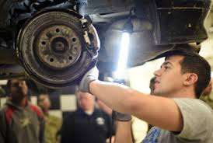
CPL Framework: Awarding Credit
Students should be advised of the recommended credit award and be allowed to accept or deny it
Students, informed by a counselor, should decide when credit is applied
Each district should decide whether its faculty will assess prior learning of potential students
Each district might consider setting a time limit for how long prior learning remains valid and eligible for assessment for credit, aligned with transfer policies

Slide 16
CPL Framework: Transcribing Credit
The system, districts, and campuses should track student outcomes related to CPL and therefore should collect data related to number of CPL units awarded each term, trends in awarding CPL credit, outcomes of students who earn CPL (parsed by number of units earned, when they were earned), and other metrics.

Slide 17
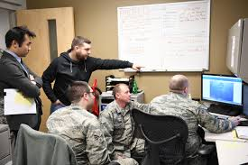
CPL Framework: Student Supports
Integrating CPL into Counseling, Guided Pathways
Counselors should be at center of informing students’ use of CPL
Student onboarding and placement processes should include methods to identify and share CPL opportunities to students
Integrate prior learning assessment advising into educational planning
CPL should be integrated with Guided Pathways. CPL should be part of the on-boarding process in Guided Pathways. Students should know in which pathways CPL is often granted – they should be able to see CPL in the pathway map based on industry certifications, military service occupations, or other common student experiences

Slide 18
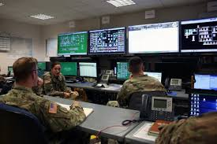
CPL Framework: Student Supports
Students should be questioned about their prior experiences in their first encounter with a counselor or advisor. Therefore, all counselors and advisors (Veterans Resource Center, Career Center, Adult Re-Entry Center, freshman orientation, etc.) need to be versed in CPL policies and practices
Consider different types of counseling appointments based on the students’ experience. For example, adult re-entry specialists, industry experience specialists, etc.
Add a question to CCCApply that will help counselors know if students might be eligible for CPL, and to provide information to students about CPL

Slide 19
CPL Logic Model Analysis
Stakeholder analysis (internal and external)
Affinity group breakouts
Academic Senate – faculty led
Collective bargaining organizations
Student Learning Outcomes
Curriculum Committee
Accreditation Liaison
Shared Governance (BP/AP)
Classified professionals (Instructional and Student Services)
Technology team (SIS and website development)
Administration
Resources
Guided Pathways
Release time?
Student Equity and Achievement (SEA)
Professional development
Faculty Champions
Council for Adult and Experiential Learning (CAEL)
American Council on Education (ACE)

Slide 20
Thank You!
Palomar College Future CPL Coordinator
cpl@palomar.edu

Slide 21
C-ID Update Eric Wada ASCCC C-ID Curriculum Director Folsom Lake College

Slide 22
C-ID Update: Newsletter
Subscribe: Curriculum listserv (and C-ID website archives)
C-ID notifications for Course Outline of Record Evaluators (COREs) and AOs
Intersegmental Curriculum Workgroup (ICW) changes for incomplete Faculty Discipline Review Groups (FDRG)
Model Curriculum Workgroup (MCW) on hiatus and new CTE descriptors finalized

Slide 23
Spring 2020 in Review
Primary Reviewer Training: How AOs can help
Prerequisite field allows information to be input
Explanations for resubmissions that were not modified
Finalized 5-year review: Biology; Economics; Nutrition
Finalized new descriptors: Dental Assistant; Electronics
Nonsubstantially revised descriptor: Child Development

Slide 24
Spring 2020 in Review
California Intersegmental Articulation Council (CIAC) Conference Planned Breakouts:
The role of AOs in Guided Pathways
Clarifying the path and ensuring learning
AO perspective in evaluating GP efforts:
English/Math pathways post-AB 705
Metamajors
Program maps
AO perspective sought on the Guided Pathways Taskforce next year
C-ID AO Subgroup

Slide 25
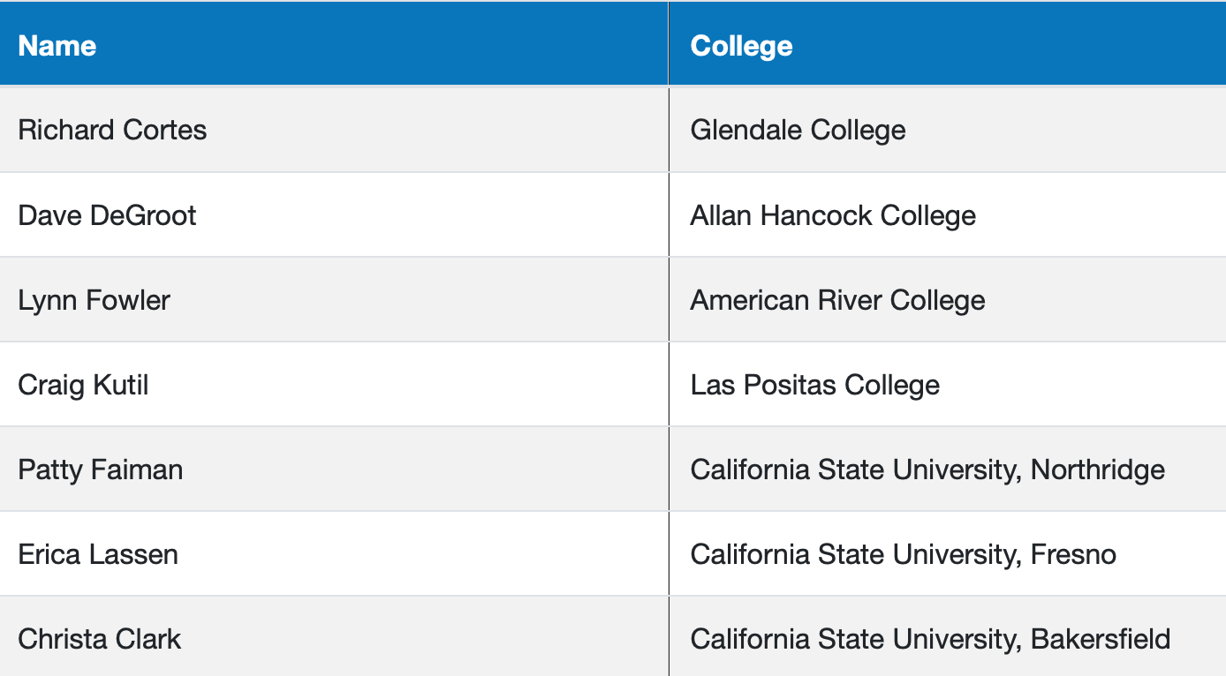
C-ID AO Subgroup Membership
https://c-id.net/articulation-officers
Roles:
Questions/concerns from the field to the C-ID office.
Provide input to C-ID on policy and procedures.

Slide 26
Looking Ahead
FDRG and CORE recruitment
Transfer Model Curriculum (TMC) and C-ID descriptors: Commence and complete in-progress reviews
UC Transfer Pathway and TMC discussions

Slide 27
Contact Information
AO networking event at 1pm
C-ID specific questions: support@c-id.net
Curriculum and Governance questions: info@asccc.org

Slide 28
Credit for Prior Learning
Polls #2 and #3:
How familiar are you with cross-walking learning outcomes?
How familiar are you with experiential learning?
Benjamin Mudgett
Articulation Officer
Palomar College

Slide 29
Cheryl Aschenbach
Expanding Advanced Placement (AP) policies to include International Baccalaureate (IB) and College-Level Examination Program (CLEP)
Competency based education (CBE) For more information on this topic, please consider attending Breakout Session 3 on Wednesday, July 8th from 1:00 p.m. - 2:15 p.m.
ASCCC

Slide 30
Support and Resources for Articulation Officers

Slide 31
Introductions
CCC Chancellor’s Office
Bob Quinn, Academic Affairs, Specialist
Devin Rodriguez, Associate Governmental Program Analyst

Slide 32
Presentation Change
Please Note:
For a detailed session on the Submission of ADTs and Double Counting, Wednesday July 9 at 2:45 p.m.

Slide 33
Vision for Success / Core Commitments
Increase credential obtainment by 20%
Increase transfer by 35% to UC and CSU
Decrease unit obtainment for a degree
Increase employment for CTE students
Reduce and erase equity gaps
Reduce regional gaps
Focus on students’ goals
Design and decide with the student in mind
Pair high expectations and high support
Evidence-based decisions
Own student performance
Enable innovation and action
Cross-system partnership

Slide 34
Call to Action for Equity
Systemwide review of police and first responder training and curriculum.
Campus leaders host open dialogue and address campus climate.
Campuses audit classroom climate and create an action plan to create inclusive classrooms and anti-racism curriculum.
District Boards review and update your Equity plans with urgency.
Shorten the time for the full implementation of the DEI Integration Plan
Engage in the Vision Resource Center “Community Colleges for Change.”

Slide 35
Our Responsibilities
Represent the Chancellor's Office on statewide policy development committees as related to supporting transfer and articulation objectives
Provide leadership on statewide, intersegmental projects that support and further develop transfer and articulation activities
Administer technical assistance to the colleges in the areas of transfer and articulation
Promote an established communication network of transfer and articulation personnel to foster two-way communication between the colleges and the Chancellor's Office

Slide 36
Examples of Support We Provide
Transfer-related policy information or clarification
Annual New AO training, a two-day session each September
Transfer data support
Annual reporting and dissemination of college articulation activities
Committees and Advisories, including the state-level AO Regional Representatives committee
Intersegmental transfer-related support

Slide 37
Additional Support Contacts
Articulation officer statewide regional representative - Your regional representative is a great resource for questions, and can keep you in the loop regarding upcoming regional meetings to attend. If you do not know your regional representative please contact us.
The ASSIST Coordination Site at help@assist.org – Request training and Subscribe to the ASSIST Resource Center News to receive the latest updates.

Slide 38
COVID-19 Updates Related to Transfer
Be sure to check the link below often for new information and updates about transfer programs during the crisis.
A Degree with a Guarantee
Transfer FAQ’s
https://www.cccco.edu/About-Us/Chancellors Office/Divisions/Communications-and-Marketing/Novel-Coronavirus/students/transfer

Slide 39
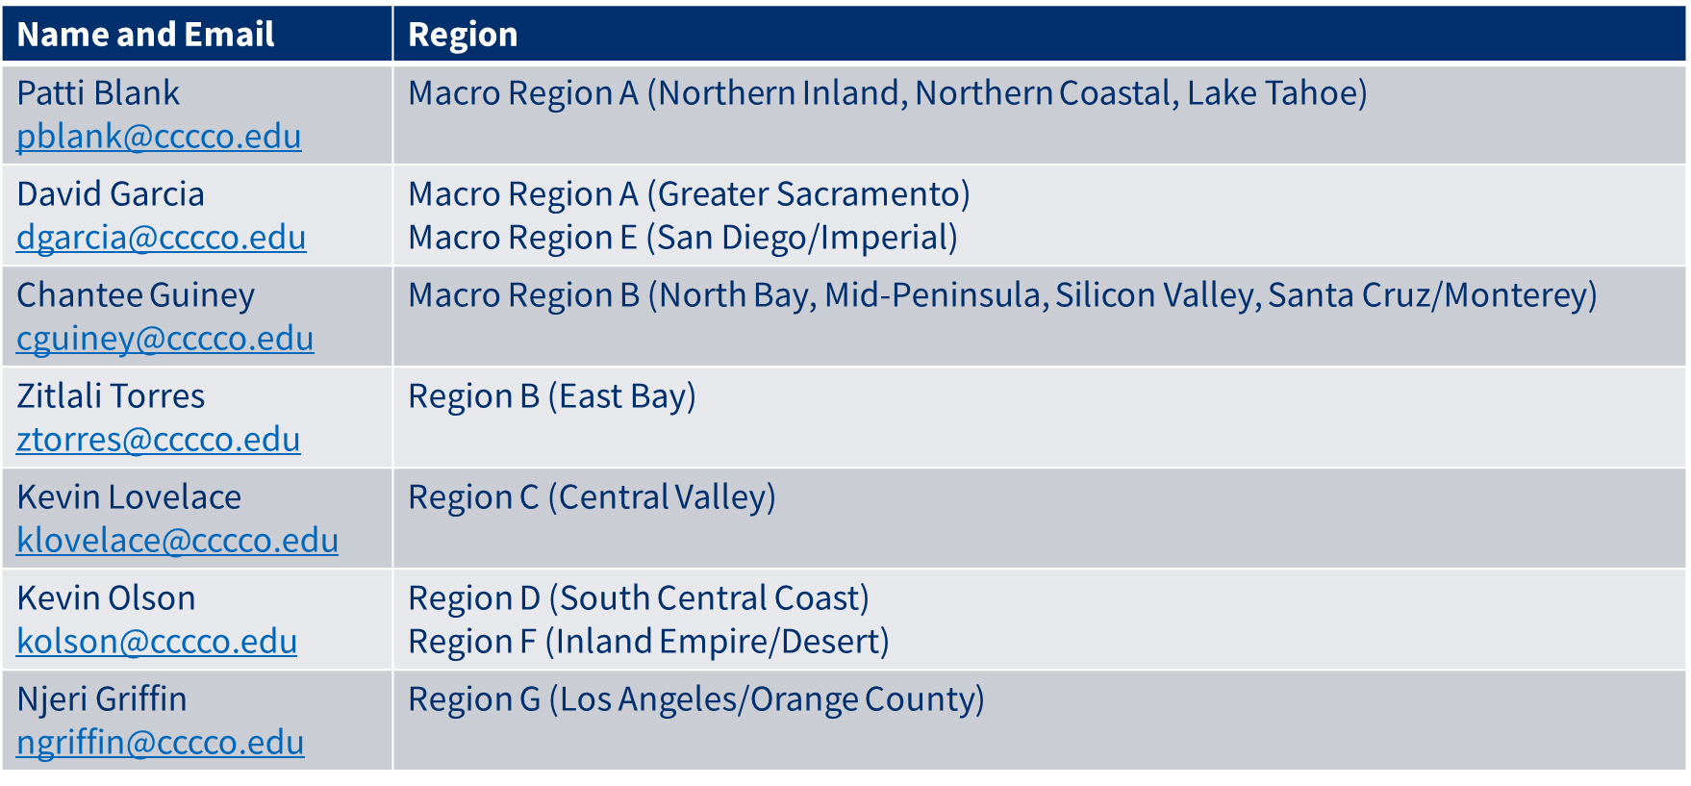
Curriculum Team by Region

Slide 40
We are here to support you
Noncredit – Chantee Guiney (cguiney@cccco.edu); Neil Kelly (nkelly@cccco.edu)
ADT Submissions – Kevin Olson (kolson@cccco.edu); Njeri Griffin (ngriffin@cccco.edu)
Financial Aid – Gina Browne (gbrowne@cccco.edu)
Apportionment - Wrenna Finche (wfinche@cccco.edu)
Articulation & Transfer – Bob Quinn (bquinn@cccco.edu); Devin Rodriguez (drodriguez@cccco.edu)
Competency Based Education – Chantee Guiney (cguiney@cccco.edu)
Credit for Prior Learning – Chantee Guiney (cguiney@cccco.edu)

Slide 41
CCC Chancellor’s Office Contact Information
Bob Quinn Academic Affairs, Specialist
bquinn@cccco.edu
Devin Rodriguez, Associate Governmental Program Analyst drodriguez@cccco.edu

Slide 42
Articulation Officer Role in Curriculum Tiffany Tran Irvine Valley College Counseling Faculty/Articulation Officer

Slide 43
Definition of Articulation
Articulation is the process by which community college courses are granted appropriate credit at other higher education institutions.
Articulation is faculty and curriculum driven.
Successful articulation creates an academic pathway that eases students’ transitions.

Slide 44
ASCCC Resolutions
Number: 04.01 Fall 1992
Articulation Officer serve as a resource to curriculum committee.
Articulation Officer be a campus priority, including with clerical assistance.
Number: 04.01 Fall 1998
Articulation Officer and Transfer Center Director be faculty positions.
Articulation Officer and Transfer Center Director be full-time or, in cases of smaller colleges, at least a fifty percent assignment.

Slide 45
Role of Articulation Officer

Slide 46
Key Team Members
UC articulation officers and staff from UC Office of the President
CSU articulation officers and staff from CSU Chancellor’s Office
Discipline faculty
Private schools and out-of-state articulation officers
Counselors
Curriculum Chair and Curriculum Committee members
Evaluators
Publications
Matriculation staff
Transfer Center staff
District-wide articulation
Regional articulation officers
California Community Colleges Chancellor’s Office
Deans, VPI and VPSS
Academic Senate executive officers, local and statewide

Slide 47
Programs
ASSIST.ORG
C-ID (Course Identification) Number
ADT (Associate Degree from Transfer) and TMC (Transfer Model Curriculum)
CPL (Credit for Prior Learning)
IB (International Baccalaureate) and CLEP (College Level Examination Program) Policies
CBE (Competency Based Education)

Slide 48
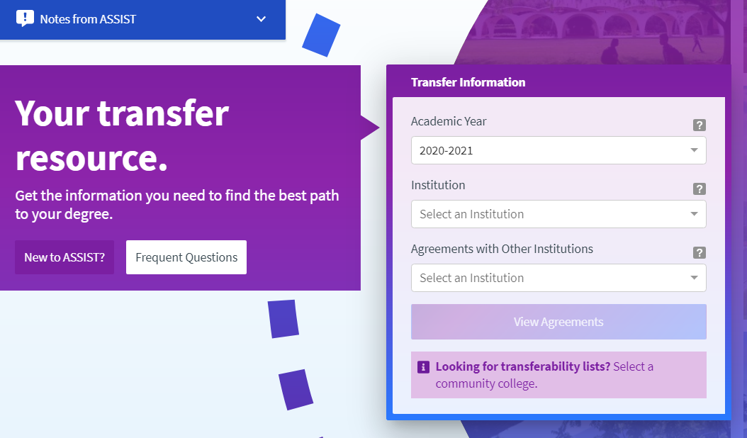
ASSIST.ORG
Manage Yearly updates
IVC changes
Other institutions curriculum changes
Submit UC and CSU requests
UC Transfer Course Agreement
General education: IGETC and CSU GE
Major and Departmental articulation
Complete back-up data for feeder schools

Slide 49
Steps to take:
www.c-id.net
Log-in information - Miguel Rother
Inventory – Approved, Denied, Conditional, or Need to Submit
New Descriptors: Dental Assistant and Electronics
Back-up data
CSU/UC articulation
Request articulation for approved C-ID (UCI for majors in Engineering)
Curriculum changes
Provide C-ID descriptors to faculty
Major changes need to resubmit

Slide 50
ADT CSU - Steps to take:
Templates for Approved Transfer Model – Must have most updated template
Progress Report
Program Course Approval Handbook
Discipline faculty, C-ID (approved or Submitted 45 days), ASSIST documentation, assist with template and narrative, and CSU AO
TMC – Steps to take:
Business – upcoming changes. Notify business, math, and counseling faculty. Assist with updating template and narrative.

Slide 51
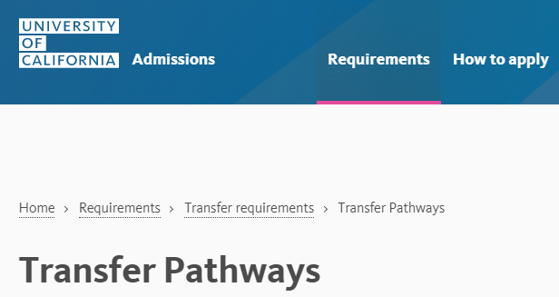
UCTP
Chemistry – Associate of Science in Chemistry for UC Transfer
Physics – Associate of Science in Physics for UC Transfer
Steps to take:
Inform Curriculum Chair and members
Inform discipline faculty
Mandated or not
Compare with local degree
C-ID courses

Slide 53
On the horizon….
ADT and UCTP Alignment
Anthropology
Business
Economics
History
Mathematics
Philosophy
Sociology

Slide 54
CPL (Credit for Prior Learning)
Title 5 section 55050 Credit for Prior learning
Credit by exam/assessment for prior experience or learning – If possible, awarding IGETC, CSU GE and local general education requirements
Evaluation of joint Services Transcripts
Evaluation of student-created portfolios
Evaluation of industry-recognized credential documentation
Evaluation of standardized exams
Steps to take:
Update Board Policy and Administrative Regulation
Inform Curriculum Committee chair and members, CE faculty and Veterans Office, Counseling and Admissions and Records
Check-in with four-year universities

Slide 55
CPL Pilots in seven disciplines
Seven disciplines
Administrative of Justice
Automotive Technology
Cyber Security
Business Administration and Management
Fire Science
Health
Information Technology
Steps to take:
Inform: Curriculum Chair and members, Faculty (CE), Veterans Office, Admissions and Records, and Counseling
Check-in with four-year universities on granting of credit

Slide 57
IB and CLEP
Steps to take:
Review/update catalog
IGETC - IB
CSU GE - IB and CLEP
Local ??
Inform Curriculum Committee chair and members
Work with discipline faculty
Inform counselors and Transfer Center staff
Notify Admissions and Records to annotate on students’ transcripts

Slide 58
Competency-Based Education
Competencies are identified and students are frequently assessed
Students are not allowed to continue until they have demonstrated mastery of the identified competencies

Slide 59
Tiffany Tran
ttran76@ivc.edu
(949)451-5324

Slide 60
ASSIST Updates
When will the missing CSU GE/IGETC/UCTCA courses be added to the public reports?
When will a Workflow print and/or download feature be made available for decision saving?
When will all maintenance reports that were available in the legacy system be available/working in the new system?
What is the status of the re-institution of Explore Majors?
When will new features be available such as the display of multiple major agreements at one time for comparison or the availability of a “pinboard” feature on the public site, etc.?
Holly Demé
ASSIST Program Manager

Slide 61
Poll #4
How many years do you plan on working in articulation?

