Slide 1
Looking in the Rear View Mirror: Leadership Wisdom for the Road Ahead
John Freitas, Los Angeles City College, Area C Representative
Michelle Grimes-Hillman, Mt. San Antonio College, South Representative,
James Todd, Modesto Junior College, Area A Representative
Faculty Leadership Institute
San Jose Marriott
June 11-13, 2015

Slide 2
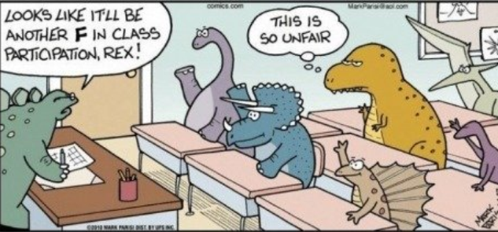
Encourage Participation

Slide 3
Getting Things Done!

Slide 4
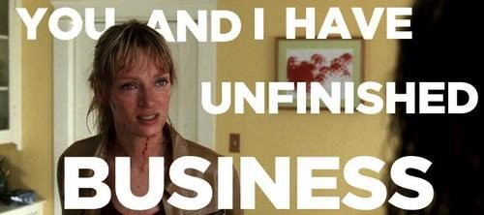
Or Not…

Slide 5
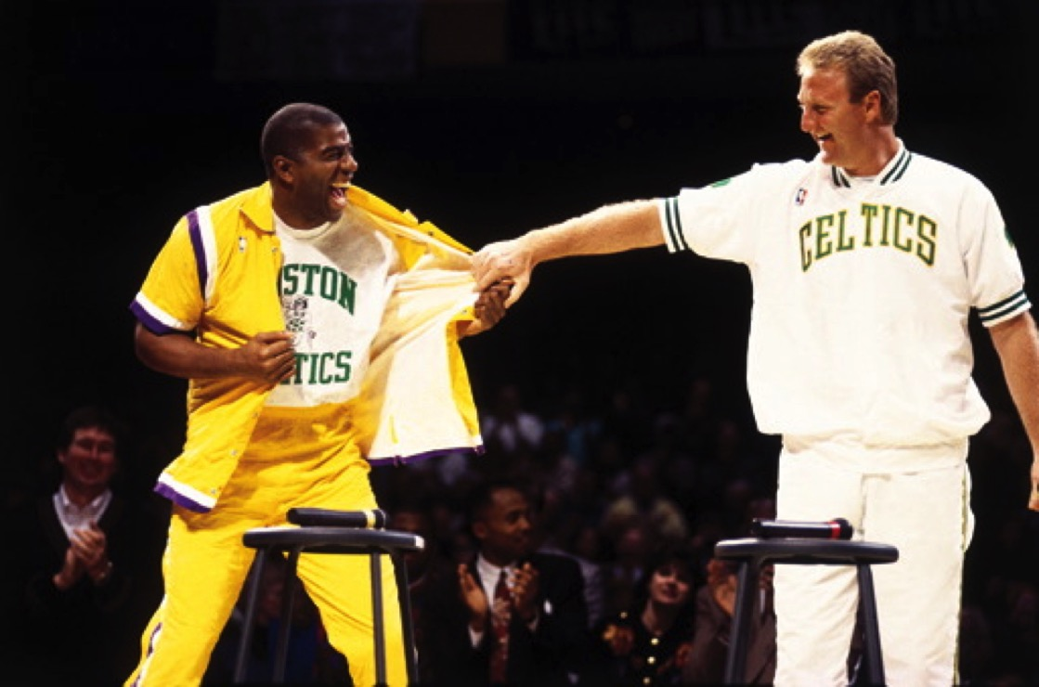
Build Relationships

Slide 6
Don’t Do Everything Alone

Slide 7
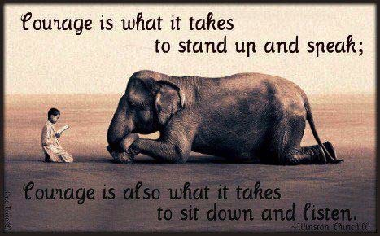
You Can’t Lead if You Don’t Listen

Slide 8
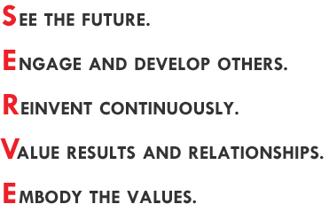
Leadership is Service

Slide 9
Leadership Is Not That Complicated
Drew Dudley “Everyday Leadership”
(TED Talk video)
http://www.ted.com/talks/drew_dudley_everyday_leadership?language=en

Slide 10
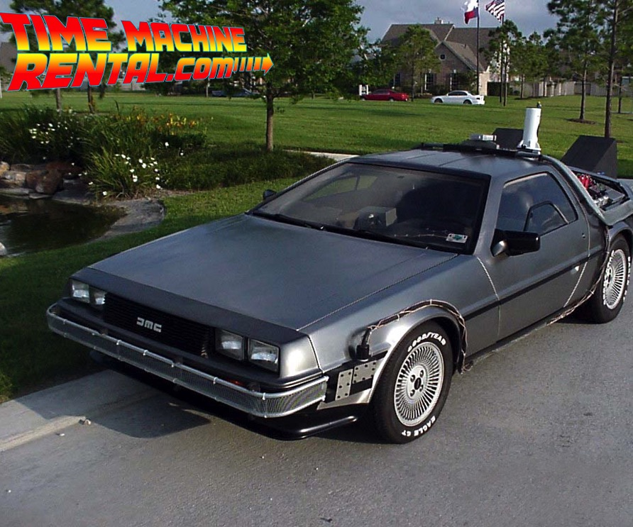
“If only I had it to do over again…”

Slide 11
At Your Service…
John Freitas
freitaje@lacitycollege.edu
Michelle Grimes-Hillman
mgrimeshillman@mtsac.edu
James Todd
toddj@yosemite.edu

Slide 12
Questions?
Thank You!

