Slide 1
Representing our Communities and Student Voices in the Accreditation Process

Slide 2
Presenters:
Karla Kirk, ASCCC North Representative
Robert L. Stewart Jr. , ASCCC Area C Representative

Slide 3
Our Session Today
As each college engages in the self-evaluation process, we reflect on our ability to meet our institution’s mission of serving our communities and supporting our students. Where do we have the student and community voice in the accreditation process? Join this session where we will collectively explore various creative and engaging strategies to get our students and our communities authentically involved in our local accreditation work.
Notes:
Robert

Slide 4
Today’s Topics
Mission, Vision and Values in Action
Creating Space for your Students
Engaging Your Community
Validating Stakeholders

Slide 5
Mission, Vision and Values in Action
Who is your community? How are your students and community reflected in your institutions?
Mission Statement
Vision Statement
Values Statement
Notes:
KARLA
Reflecting on our ability to meet our institutions mission of serving our communities and supporting our student

Slide 6
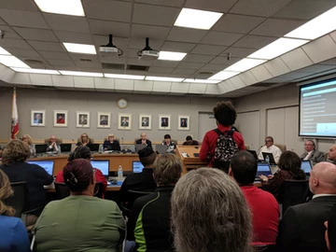
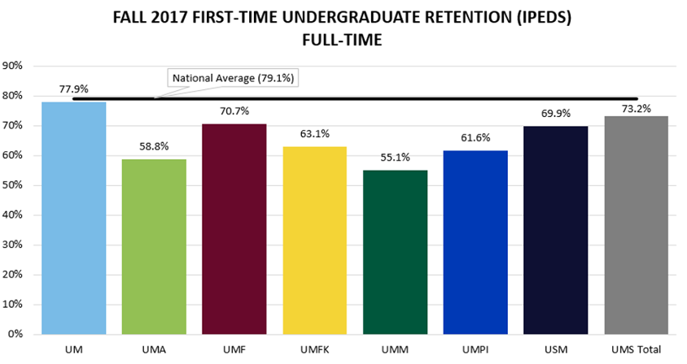
Data and Your Community
Community Service Area Data becomes important to make sure that the Accreditation effort reflects and serves the surrounding community of the college.
Notes:
ROBERT:
Service Area Data
Maybe show example of ICER

Slide 7
Creating Space for your Students
Student Involvement in the Accreditation Process
Accreditation and Program Review
Student-Centered Program Review
Notes:
Section introduction slide

Slide 8
Student involvement in the Accreditation Process
Why do we need to invite students into the process?
Student is mentioned 119 in the standards
Governance bodies - how many are identified?
Focusing on Standard IV
§ 51023.7 Students.
(a) The governing board of a community college district shall adopt policies and procedures that provide students the opportunity to participate effectively in district and college governance.
Notes:
ROBERT

Slide 9
Standard IV: Leadership and Governance
uStandard IV: “Through established governance structures, processes, and practices, the governing board, administrators, faculty, staff, and students work together for the good of the institution.”
uStandard IV.A.1: Institutional leaders create and encourage innovation leading to institutional excellence. They support administrators, faculty, staff, and students, no matter what their official titles, in taking initiative for improving the practices, programs, and services in which they are involved. When ideas for improvement have policy or significant institution-wide implications, systematic participative processes are used to assure effective planning and implementation.
uStandard IV.A.2. The institution establishes and implements policy and procedures authorizing administrator, faculty, and staff participation in decision-making processes. The policy makes provisions for student participation and consideration of student views in those matters in which students have a direct and reasonable interest. Policy specifies the manner in which individuals bring forward ideas and work together on appropriate policy, planning, and special-purpose committees.
Notes:
ROBERT

Slide 10
The Vital Link between Accreditation and Program Review
Traditional Approaches to Program Review
Envisioning a Student-Centered Program Review
Breakout Room Activity!
Notes:
Section Introduction slide

Slide 11
Standard Program Review…Our traditional approach.
Key performance indicators (KPIs) provide signals for how efficient and effective the programs are meeting the mission of the college and support student success
Notes:
ROBERT
Traditional measures have relied on measures of efficiency such as productivity, enrollments, and program completions
It is more than just this with an equity-minded, student-centered informed Program Review
How can these be made more meaningful and truly address a student focused goal?

Slide 12
Imagine Student-Centered Program Review
Who are the students entering my program?
Who and how many declared a program of study?
Who and how many are enrolled in program coursework but not in the declared program?
Why did students drop?
How are students progressing through the courses in each program…both major and in general education courses?
What are actual student course taking patterns?
Are students completing the appropriate math course within one year?
What are the completion outcomes for students?
Do students see value in the education they received?
How does the college ensure learning?
How long are students taking to complete the program? Average number of units?
Notes:
KARLA

Slide 13
Student-Centered Program Review
How can student voice be included?
In the Program Review process [student membership on committees (if they exist)]
In evaluating programs (with chair, surveys, etc)
How do you learn about student educational goals and assess programs to see that their goals are being met?
How are disaggregated data used to identify and address equity gaps?

Slide 14
Breakout Room Activity
You will be placed in a breakout room to share and discuss the topics below. You will have access to a Google Doc to capture the information from your group to share.
Share some practices of what your college does to include students in the accreditation process and/or work.
Share the important role/responsibility students have with College Committees and Governance, and how students have been included in the evaluation of programs
Share what role the students play in the site visit.
Notes:
KARLA AND ROBERT
Use Google Doc to collect information from breakout rooms

Slide 15
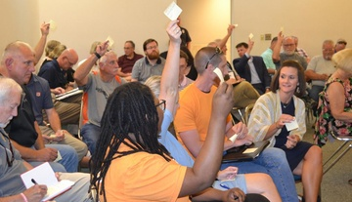
Engaging Your Community
ICER Document review ( service area data)
Community focus groups
Surveys
Disaggregated Data
Notes:
KARLA

Slide 16
Validating Stakeholders: Call it Out!
How are you collecting, cataloging, and/or utilizing your community input?
Do you have a procedure in place to let the community know that their input has been received?
What about if their input or suggestions are not included? How do you let the community know?
Notes:
KARLA:
What is the feedback loop? How does the community see the value of their contributions?
Community buy-in

Slide 17
Breakout Activity
In your breakout rooms, your group will discuss the questions below, and collect information on the Google Doc (link in Pathable!)
How has your institution engaged feedback from your community in past cycles?
How successful were your efforts to engage your community?
How are you using Service Area Data?
Notes:
Create breakout rooms for discussion and reflection (10 minute activity)

Slide 18
Call and Response
Please share something discussed in your breakout.
Notes:
Share out from breakout

Slide 19
Closing Thoughts/Q&A
Notes:
Robert and KARLA (10 minutes)
Consider an alternative discussion question or an activity in case there are not a lot of questions.

Slide 20
Resources
ACCJC Policy on Social Justice
ACCJC Guide to Institutional Self-Evaluation, Improvement and Peer Review

Slide 21
THANK YOU!

