Slide 1
Resolutions Make Us Stronger…
Dolores Davison, Foothill College
John Stanskas, San Bernadino Valley College
Leadership Institute, June 11, 2015

Slide 2
Why Does the Academic Senate Use Resolutions?
Our Constitution Requires It!
From the ASCCC Constitution…
Powers and Duties:
The power of the Academic Senate is derived from Title 5 and implemented through its resolution process. This resolution process shall be the sole method by which policies of the Academic Senate are adopted.

Slide 3
Resolutions are the Official Vehicle for Senate Actions
Resolutions are the official Senate vehicle for:
Establishing statewide positions on matters of concern related to academic and professional matters
Directing the work of the Academic Senate through its committees and task forces
Adopting position papers, Senate resources and revisions to the disciplines list
Granting Senator Emeritus status ☺
Academic Senate positions inform discussions with the Board of Governors, Chancellor’s Office and system partners
Academic Senate positions can inform the work of your local senates

Slide 4
Writing Academic Senate Resolutions
Identify a relevant topic:
Through local senates
Through Academic Senate committees
Through Academic Senate area meetings
As an individual (you don’t have to be a delegate!)
In the lounge during a plenary session (don’t laugh!)

Slide 5
Writing Academic Senate Resolutions
Consider feasibility and appropriateness:
If it gives the organization direction (writing a new paper, conducting a study, etc.), can the work be done in a timely manner?
If it takes a position, will it reflect well on the organization if it passes?
Is this an issue that is statewide, or does it just impact one college or district?

Slide 6
Writing Academic Senate Resolutions
Do your homework!
Current events, looming policy changes, educational and political trends
Research past Senate resolutions and papers
http://asccc.org/resources/resolutions
http://asccc.org/publications/academic-senate-papers
Note: Senate positions are also established when the body approves position papers.
Research Ed Code and Title 5
http://oal.ca.gov
And don’t forget to cite your sources!

Slide 7
Writing Academic Senate Resolutions
Make them clear!
Limit of four whereas and four resolved statements
Resolved statements describe the actions/positions proposed
Tip: write the resolved statement(s) first.
Whereas statements are important
Delineate the arguments in support of the resolved statements
If adopted by the body, whereas statements become the official supporting arguments of the Academic Senate, so they need to be logical and accurate!

Slide 8
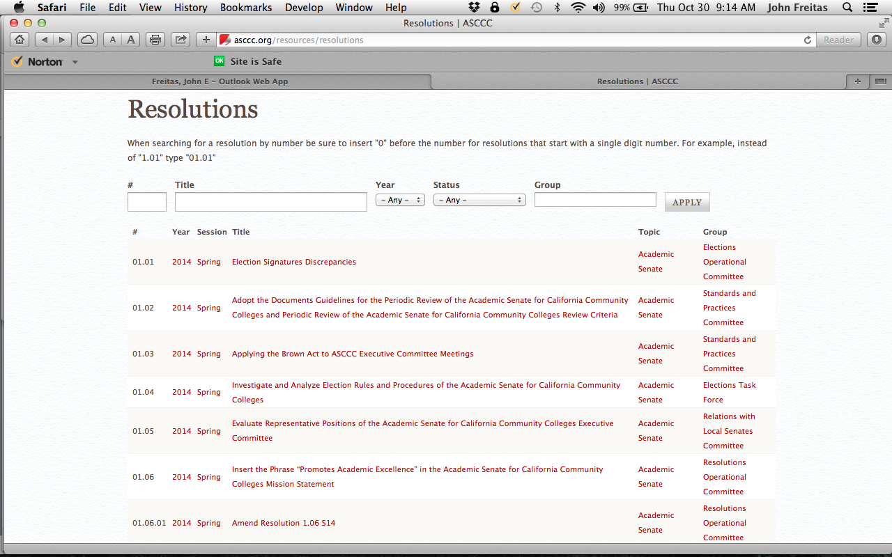
Resolutions on the ASCCC Website
Great tools allow you to search by subject, author, specific resolution number, etc.
http://asccc.org/resources/resolutions

Slide 9
Resolutions and Amendments at Session
Requires 4 seconds signed by delegates!!! (You do not have to be a delegate to submit a resolution)
Electronic copy requested, but you still must submit resolutions form along with hard copy with:
Your signature
Your seconders’ signatures
Resolution/Amendment title
Resolution/Amendment body (if no electronic file exists)
Session contact information…cell phone preferred!

Slide 10
Resolutions Consent Calendar
Resolutions are placed on the consent calendar by the Resolutions Committee if:
Noncontroversial
Do not potentially reverse a previous position
Do not compete with another proposed resolution
Consent Calendar is adopted at the start of voting on Saturday
Consent Calendar items may be pulled without explanation by:
Any faculty attendee at an Area meeting
Any registered attendee before voting begins at 8:30 AM on Saturday
When the resolutions voting session begins at 8:30 AM on Saturday before the Consent Calendar is adopted. The President will ask one last time if anyone wants to remove any resolutions from consent.

Slide 11
The Resolutions Committee
Resolutions and amendments are reviewed by the Resolutions Committee to ensure that they:
Are not duplicative
Do not reverse a position previously taken by the ASCCC (unless that is the intent)
Are properly moved and seconded
Are in order
Make sense as written
Notes:
Feasibility?

Slide 12
Before Voting on Saturday
Resolutions are discussed by delegates at the pre-plenary Area meetings, by local senates on home campuses, and at the session Area meetings.
Amendments can be added to clarify resolutions (requires four seconds by registered delegates!)
When the Saturday of plenary session rolls around, it is time for debate…
Notes:
To “perfect” resolutions…or neuter them

Slide 13
Okay, It’s Not QUITE This Bad…

Slide 14
Saturday is Voting Day!
Resolutions are debated and voted…anyone can debate
Arguments are made at the pro and con mics.
Debate continues until no one is at a mic, or until time for debate expires (15 minutes)
Parliamentary mic is for making motions, parliamentary inquiries to the chair, etc.
Votes are voice votes…only delegates vote!
If voice vote inconclusive, division of the house is done
If division of the house inconclusive…serpentine vote!

Slide 15
Saturday is Voting Day!
The body debates the resolutions and votes on them
It possible for the body to refer the resolution to the Executive Committee for perfection, research, or other actions.
It is possible to divide resolutions.
Resolutions which change an existing position require a 2/3rd majority.
Amendments are not taken from the floor.

Slide 16
Referring Resolutions
Resolutions can be referred to the Executive Committee for the following reasons:
More information or clarity is needed
More time to debate the issue on local campuses is needed
May be worthy of consideration for adoption but is written in a manner to make it unclear as to the intent
The maker of the motion to refer must be clear about:
Reason for referral
Instructions for addressing the referral
The date to return to the body.
A resolution cannot be referred to direct the Executive Committee to accomplish what the resolution seeks to do.

Slide 17
A Modest Proposal
If a resolution is unclear, even with amendments, perhaps it should be voted down instead of referred.
(The author can rewrite it and bring it to the next plenary!)

Slide 18
Dividing Resolutions
Motion made at the parliamentary mic to consider parts of a resolution as separate motions
Requires second and majority vote
If motion to divide passes, each resulting part is debated and voted on separately
Reasons for dividing motions include:
To consider proposed positions/actions between or within resolved statements separately
To remove whereas statements that may be incorrect, unsubstantiated or do not support the resolved statements

Slide 19
After Plenary: What Happens Next?
Resolutions Committee prepares the adopted resolutions
Renumbers resolutions (passed, referred, failed, moot)
President reviews and then Executive Director distributes to the field
Disposition depends on what the resolution calls for:
Action by the president is taken directly by the ASCCC president
Other resolutions are given to committees or task forces for completion, which is then reported at the bottom of the resolution on the website
Some resolutions are deemed infeasible due to lack of resources or other issues

Slide 20
Are You Feeling Overwhelmed? Check out The Resolutions Handbook!
Single publicly available document
Compilation of all the existing internal and external resolutions process documents
http://asccc.org/sites/default/files/resolution-handbook_1.pdf
Information about all the specifics of resolutions…it makes a great Christmas gift!

Slide 21
Resources
Your 2015-2016 Resolutions Chair: John Stanskas
Your Resolutions Committee: Julie Adams, Randy Beach, Kale Braden,
Your area representatives: Someone cool from Area A; Dolores Davison, Area B; John Freitas, Area C; and Craig Rutan, Area D.
http://asccc.org/resources/resolutions
All adopted Senate resolutions are posted here. Check this first before writing resolutions!

Slide 22
Questions?
Thank You!

