Slide 2
Student Success and Equity Committee
Academic Academy Presentation
March, 2015

Slide 3
How it all began
Discussions began spring of 2014
SSSP Workgroup formed – IT, Dean of SSR, Counseling Dept.
Policy
Procedures
IT data collection/reporting
Committee vetted through all shared constituency groups and College Council/IPC in early 2014.
Student Success and Equity Committee was finalized in Feb. 2014 and convened its first meeting in March.

Slide 4
Student Equity

Slide 5
Writing the plans ( A Summer Break Adventure )
Offered faculty flex credit for summer workshops to develop plans
Broke into groups responsible for different parts of the plan.
Reconvened to pull it all together in Sept. 2014

Slide 6
What We Have Accomplished
Student Success and Support Program (SSSP)
Communication with college community
Presentations across the District: Campus buy-in/ownership, (Academic Senate, IPC, EPCC, DCC)
PDA workshop, New Faculty Orientation and other professional development activities related to SSSP

Slide 7
Action Research (SSSP Planning: Data Driven, Student Centered)
Research to identify service gaps
What data have we already collected that might help the college make better decisions?
What do the data tell us?
What are reasonable benchmarks based on the research and data?
What action should we take based on what the data tell us?
What interventions or strategies do we need to deploy in order to “move the needle”?
Notes:
Discovered we were doing well in assessing students and providing orientations but large gap in comp. ed plans

Slide 8
What We Have Accomplished
Established exemption criteria
Only new to college, non-exempt students will be required to fulfill SSSP steps
Exemptions at SRJC:
AA or higher degrees
High school concurrent students
Ed goals categories are: Maintain Certificate or License, Pursue Educational Development (intellectual, cultural), Complete credits for high school diploma or GED
(Exempt students do not automatically gain registration priority; however, they may partake SSSP services to earn registration priority.)
Notes:
Transitional ed plans

Slide 9
What We Have Accomplished
Student Success and Support Program (SSSP)
Developed Student Success Theme –
Steps for New Students | Admissions & Records
Revised policies/procedures related to SSSP
SSEC Website

Slide 10
What We Have Accomplished
Reviewed and aligned SRJC orientation to state requirements
SRJC Offers three types of orientation:
COUNS 270: Introduction to College (8 hours, .5 units) This is the most comprehensive.
“Mini” orientation – 1.5 hours.
Online orientation – includes video links to special programs
Students who complete COUNS 270 persist from fall to spring 91% vs. the District average of 70%

Slide 11
What We Have Accomplished
Design/implement an intervention system
Student Drop Survey implemented / data collected
Revision of Student Success Referral form
Early Connection Program for faculty to follow-up and make referrals
Pilot program launched in spring 2014
Roll-out in fall 2014

Slide 12
What We Have Accomplished
Technology Solutions
Modification of Education Plan module
Programming in SIS
Student Success Steps / SSSP completion status
Priority registration
Implement policies/procedures on placement assessment
SARS Message system
Reviewed Counseling education plan module and modified to conform with State standards
Notes:
Retest once per semester after initial placement, Transitional ed plans. Text messages

Slide 13
What We Have Accomplished
Education Plan Development
New students develop an abbreviated (1-2 semesters) plan either in the Coun. 270 or in an initial meeting with a counselor.
Continuing students are encouraged to meet with a counselor to develop a more comprehensive plan.
As an incentive, students who have completed fewer than 42 SRJC units can earn a higher registration priority (Early Bird).

Slide 14
What We Have Accomplished
Education Plan Development
Continuing students with 15 degree-applicable units receive email nudges and phone calls to meet with a counselor to discuss their goals and develop a comprehensive plan

Slide 15
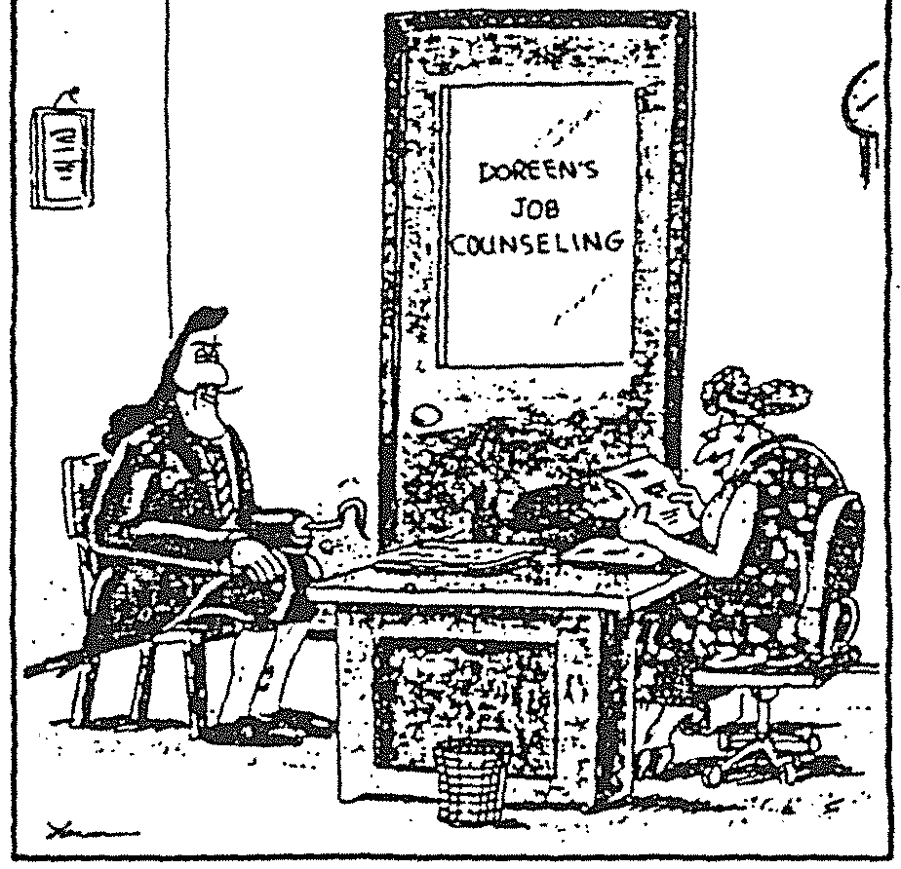
OK. Mr. Hook. Seems you're trying to decide between a career in pirating or massage therapy. Let’s see if I can’t help you narrow it down

Slide 16
What We Plan to Do: SSSP
Orientation
Assessment
Education Planning
Follow-up
Communication to Students
Increase SSSP Core Services Capacity
SSSP Mandates Begins Spring 2015
Technology Solutions
Research and Evaluation
SSP Professional Development

Slide 17
What We Plan to Do – SSSP
Communicate SSSP requirements to students
Increase service capacity to meet SSSP service needs at Santa Rosa and Petaluma Campuses: counselors, assessment and evaluation staff, support staff
Mandate SSSP requirements to first-time students spring 2015 term
Investigate and implement technology solutions
Research and Evaluate program effectiveness
Continue professional development related to SSSP
Notes:
Via email nudges,

Slide 18
How Will SRJC Mandate
SRJC began mandatory requirements starting spring 2015
In fall 2014, all new students were notified of SSSP requirements in their first welcome letter after application
Notifications and nudges continue through each semester till requirements are met
If SSSP requirements are not met prior to summer/fall 2015 registration: students will not earn registration priority

Slide 19
Questions?

