Slide 1
Setting the Agenda for your Academic Senate Presidency
Silvester Henderson, ASCCC At-Large Representative
Carrie Roberson, ASCCC North Representative
Nathaniel Donahue, ASCCC At-Large Representative
Sheraton Grand Sacramento Hotel 1230 J Street, 13th And J Street Sacramento, Ca 95814 June 13-15, 2019
[Date]

Slide 2
Presentation Highlights
What are the key responsibilities of the Senate President to the Campus Senate”?
Develop Tools for Leadership Success: Leaders vs Boss.
Seek “Input” from the Senate Council – Promote “Team Work”
Become an “Effective Communicator & Leader” via Research & Knowledge
Academic Acumen – High Level Communication Skills- Diplomacy
Practice Cultural Sensitivity & Diplomacy
Setting the Agenda: Review By-Laws, Constitution, Committee Appointment Guidelines, Senate Budget, Roles of Senate Clerical Assistant vs Secretary & etc.
Promote Academic Innovation: “Educational Presentations”
Publish Agenda – Follow all “Brown Act” Guidelines & Rules.
Questions & Comments
Is the concept of building “Diversity” and individual person or a way of thinking?
Can “Diverse Leaders/” inspire “Workplace Equity”?
Marketing Tools for building a diverse team of Senate Leaders.
Questions and Comments?

Slide 3
What are the key responsibilities of the Senate President to the Campus Senate?
Protect and honor the participation of faculty in institutional decision making regarding academic and professional matters as defined by Title 5 Regulations. (10 + 1)
Inspires “New” and “Active” Leadership – Create a space for growth.
Support “Positional Equality”.
https://www.asccc.org/sites/default/files/local_senates_handbook2015-web.pdf

Slide 4
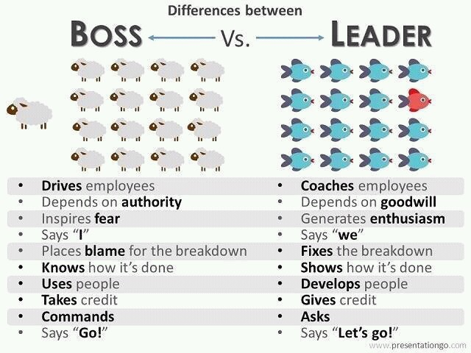
Develop the tools to become a “Successful” Academic Leaders: Leaders vs Boss.
Know your college.
Remember to be a “Leader” and not a “Boss”.
Create a “Diversity Leadership Team” – Promote Honesty!
Promote Equity Mindedness and Race-Conscious conversations!
Remain “Humble” & “Wise”
Promote “Inclusion” – Love!

Slide 5
Seek “Input” from the Senate Council – Promote “Team Work”
“Good teamwork helps to build morale in the workplace, which makes workers more productive and ultimately improves profits. For organizations that have excellent teamwork, problem-solving is easier – since people with different skills and knowledge will work together to produce a creative solution”.
https://biz30.timedoctor.com/teamwork-in-the-workplace/
“Leadership has to empower leaders both vertically and laterally for Consultation to work well”.
https://www.asccc.org/content/strengthening-leadership

Slide 6
Become an “Effective Communicator & Leader” via Research & Knowledge
Four Basic Communication Styles:
1). Passive: Individuals who use the passive communication style often act indifferently, yielding to others. Passive communicators usually fail to express their feelings or needs, allowing others to express themselves.
3). Passive-Aggressive: Passive-aggressive communication style users appear passive on the surface, but within he or she may feel powerless or stuck, building up a resentment that leads to seething or acting out in subtle, indirect or secret ways.
2). Aggressive: The aggressive communication style is emphasized by speaking in a loud and demanding voice, maintaining intense eye contact and dominating or controlling others by blaming, intimidating, criticizing, threatening or attacking them, among other traits.
4). Assertive: Thought to be the most effective form of communication, the assertive communication style features an open communication link while not being overbearing.
https://online.alvernia.edu/articles/4-types-communication-styles/ (2018)

Slide 7
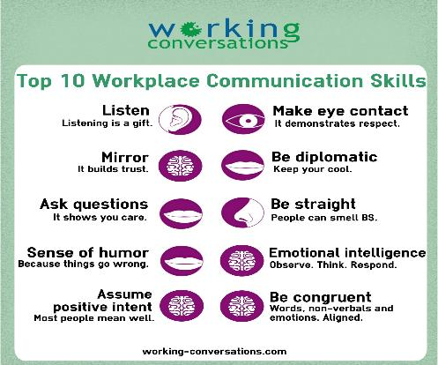
Academic Acumen – High Level Communication Skills- Diplomacy

Slide 8
Practice “Cultural Sensitivity & Diplomacy” -
Cultural Diplomacy:
:
“The Institute for Cultural Diplomacy, ICD, has declared that the ultimate goal of cultural diplomacy is promoting peace and stability through intercultural relations”.
https://www.e-ir.info/2013/01/03/definitions-ideas-visions-and-challenges-for-cultural-diplomacy/

Slide 9
Setting the Agenda: Review By-Laws, Constitution, Committee Appointment Guidelines, Senate Budget, Roles of Senate Clerical Assistant vs Secretary & etc
“To lead effective meetings, your most important task will be to communicate to faculty members that their deliberations will further a common goal and influence the outcomes that they care about.”
ASCCC GOAL AGENDA ITEMS:
Four Areas (2018-2019)
A: CCC Guided Pathways Award Program B: AB 705 Update* C: Faculty Diversification
D: Strong Workforce Program Recommendations
TIPS FOR SETTING THE AGENDA:
Create your agenda early. ...
Clearly define your meeting objective – based on “Yearly Goals”
Prioritize agenda items. ...
Break down agenda topics into key points. ...
Allow adequate time for each agenda item.
https://www.insidehighered.com/advice/2016/04/14/tips-making-academic-meetings-valuable-and-productive-essay
https://www.asccc.org/executive_committee/meetings

Slide 10
Promote Academic Innovation: “Educational Presentations”
“Innovation in education is stepping outside of the box, challenging our methods and strategies in order to support the success of all students as well as ourselves”.
Steps for Innovations
1. Focus on Purpose
2. Calibrate Approaches
3. Designate an Academic Driver 4. Remove Barriers
5. Engender Patience
Example
“Educational Presentations”
https://education.cu-portland.edu/blog/classroom-resources/educational-innovations-roundup/

Slide 11
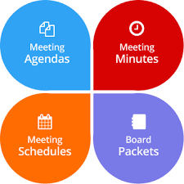
Publish Agenda – Follow all “Brown Act” Guidelines & Rules.
The Ralph M. Brown Act is an act of the California State Legislature passed in 1953 that guarantees the public's right to attend and participate in meetings of local legislative bodies. It’s been updated multiple times since its original drafting, and now includes a website posting requirement for agendas. While it has always been required to physically post agendas a minimum of 72 hours before upcoming regular meetings, it now requires that those agendas also be posted on the agency’s website, if they have one.
Additionally, a bill passed in 2016 (AB 2257, Maienschein) adds additional requirements that go into effect January 1, 2019: there must be a link to the most recent agenda of the main governing body directly on the home page; and the agenda must be in a format that is “retrievable, downloadable, indexable, and electronically searchable by commonly used Internet search applications, platform independent and machine readable.”
https://www.getstreamline.com/blog/brown-act-website-requirements

Slide 12
Questions & Comments
Please feel free to contact each of us for more information.
Silvester Henderson Shenderson@losmedanos.edu
Carrie Roberson robersonca@butte.edu
Nathaniel Donahue donahue_nathaniel@smc.edu

