Slide 1
Solutions That Solve Problems-Networking & Collaboration As a New Senate Leader
Silvester Henderson, ASCCC At-Large Representative
LaTonya Parker, ASCCC South Representative
ASCCC Fall 2018 Plenary Session
Irvine Marriott

Slide 2
Agenda
Onboarding Faculty and Creating a First Year Engagement Experience
Building a Strong Senate Membership
10 + 1 Rules: District/Senate Agreement
Faculty Networking/Strategies for Campus/District Engagement
Training New Leaders/Succession Making/Opportunities
Senate Operational Methodology
Administration - Senate Leadership and Campus Advocacy
Good Leader create more Leaders – “Succession Plan”!
Questions?

Slide 3
Onboarding Faculty and Creating a First Year Engagement Experience
ASCCC Website: www.asccc.org
Academic Exploration
History of the Academic Senate
Community College & the Academic Senate
Visit other Senate Meetings & Observe
Research & Knowledge

Slide 4
Building a Strong Senate Membership
Why is it important to engage all faculty regarding understanding the meaning of “Academic and Professional Matters?
Why is it important?
Discuss what could be accomplish from a “Strong Team”

Slide 5
10 + 1 Rules – Title V § 53200 “Academic and professional matters” means the following policy development and implementation matters
curriculum, including establishing prerequisites and placing courses
within disciplines;
(2) degree and certificate requirements;
(3) grading policies;
(4) educational program development;
(5) standards or policies regarding student preparation and success;
(6) district and college governance structures, as related to faculty roles;
(7) faculty roles and involvement in accreditation processes, including self
-study and annual reports;
(8) policies for faculty professional development activities;
(9) processes for program review;
(10) processes for institutional planning and budget development; and
(11) other academic and professional matters as are mutually agreed upon between the governing board and the academic senate.

Slide 6
Faculty Networking/Strategies for Campus/District Engagement
Visit Faculty Department Meetings
Educational Presentations
Create District Senate Projects
Create District “Plenary”
Be Innovative! Encourage “New Ideas”

Slide 7
Training New Leaders/Succession Leadership Opportunities
Define “Leadership” respectfully via collegial interactions.
Speak about the “Value” of and role of the Senate in regards to its impact on Student Success
Uphold the values of the collective voice!
Openly recognize successes and challenges!
Honor the “Voice” of Faculty!

Slide 8
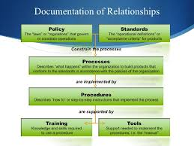
Senate Operational Methodology
Encouraged consistent Senate Policies operational practices and procedures
Solve problems via agreed upon processes!
Voice budgetary concerns with the administration
Take input!

Slide 9
Administration - Senate Leadership and Campus Advocacy
Respect the “Collegial Process”
Empower your faculty
Develop and study effective “Language Acumen”
Remember you job is to honor the 10 + 1 Rules!
Use “Hope” to respond to ineffective surroundings
Seek continual knowledge and leadership development.
Good Leaders attract New Leaders!
Become an agent for Academic Social Justice!

Slide 10
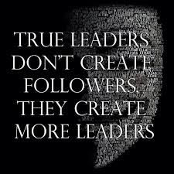
Good Leader create more Leaders – “Succession Plan”!

Slide 11
QUESTIONS?

Slide 12
Silvester Henderson
SHenderson@losmedanos.edu
LaTonya Parker
LaTonya.Parker@mvc.edu

