Slide 1
New Delegate Information Session, Plenary Orientation
Cheryl Aschenbach, ASCCC North Representative
Geoffrey Dyer, ASCCC Area A Representative
LaTonya Parker, ASCCC At-Large Representative

Slide 2
Session Description
Are you a new senate leader seeking to understand the Academic Senate for California Community Colleges (ASCCC) plenary culture? This session will provide an overview of the aspects of the ASCCC plenary session and processes . This integrated learning session will focus on the resolution process, from where resolutions originate to specific style requirements . Presenters will also discuss the requirements and obligations for delegates, the process by which resolutions are brought forth at plenary sessions, and the voting process used on Saturday .

Slide 3
Attending your first Academic Senate for California Community Colleges plenary session with hundreds of colleagues from the 114 colleges in the system may seem overwhelming. To a new attendee, plenary can feel like a foreign land where one must decode the language, purpose, and procedures without a guidebook. However, a little understanding of history and some preparation for the event can enrich the plenary experience.

Slide 4
Session Agenda
Who Are You? Why are You Here?
ASCCC Mission
ASCCC Purpose
Define the Role of the ASCCC & Plenary
Develop a breakout session attendance plan
Resolutions, Voting and Discussion: Who participates in each?
Overview of Resolutions Process
ASCCC Awards
Notes:
Cynthia

Slide 5

Notes:
Cynthia

Slide 6

A great resource

Slide 7
The 50 Years Mission of ASCCC
The Academic Senate for California Community Colleges fosters the effective participation by community college faculty in all statewide and local academic and professional matters; develops, promotes, and acts upon policies responding to statewide concerns; and serves as the official voice of the faculty of California Community Colleges in academic and professional matters. The Academic Senate strengthens and supports the local senates of all California community colleges.
Notes:
Julie Bruno

Slide 8
Academic Senate Purposes
It shall be the purpose of the Academic Senate to
1. Represent the faculty of the California Community Colleges in the formation of statewide policies on academic and professional matters.
2. Make recommendations on statewide matters affecting the California community colleges.
3. Promote the implementation of policies on matters of statewide concern.
4. Strengthen local academic senates or other equivalent faculty organizations in the California Community Colleges.
5. Assume responsibilities as may be delegated by Members Senates or by the Board of Governors of California Community Colleges.
6. Initiate policy positions relevant to California Community Colleges and their role in higher education.
Notes:
Julie Bruno

Slide 9
What is Plenary?
In 1969, the Academic Senate for California Community Colleges held its first meeting, bringing together local academic senate leaders from throughout the state to discuss policy and issues of common concern. Plenary sessions have continued to be held on at least a bi-annual basis since that initial event. In 1988, the Commission for the Review of the Master Plan for Higher Education reinforced the role of academic senates in governance as delineated in AB 1725 (Vasconcellos, 1988). This legislation gave substantial new responsibilities to local senates, and these responsibilities are now codified in Education and Title 5. No other educational system in the nation grants this type of influence on institutional governance to faculty. However, with that influence come responsibilities and a need for guidance for both new and experienced local leaders.

Slide 10
What is Plenary?
ASCCC plenary sessions provide such guidance by bringing together the leaders of California’s diverse system of locally controlled colleges to consult on common interests, to receive leadership training, and to make recommendations on important issues like minimum qualifications or curriculum standards. Plenary sessions are designed with a vision to create a truly representative and democratic governance venue for faculty colleagues to meet and collaborate through a resolution-driven decision process. The resolutions determine policy and action which help guide and support individual colleges and their faculty members. See ASCCC history at http://www.asccc.org/papers/brief-history-academic-senate-california-community-colleges

Slide 11
Purpose of Plenary
“The Spring Plenary is a time to assess the progress of the academic year and envision the future of next year through dialogue, debate, and action.”
--John Stanskas

Slide 12
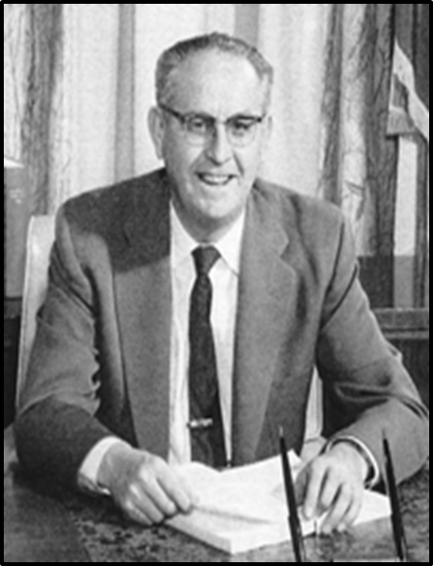
Plenary: Keeping with the Brown Act Openness and Transparency
“ The people, in delegating authority, do not give their public servants the right to decide what is good for the people to know and what is not good for them to know.” California Government Code §54950
Ralph M. Brown 1959
Photo courtesy The Modesto Bee

Slide 13
I’m a new delegate…
“My first plenary, I was sure I was on another planet. I felt like everyone else was clued in and I was lost. I admired people involved in the very structured and weird style of debate, but I admit I was often pre-occupied with all the rules, objections, and what seemed like secret understanding about the pro and con microphones. Don’t even get me started on the serpentine voting – I counted off wrong! Eventually, I learned the procedures and I began, like an anthropologist, to decode the culture of the plenary. I learned rich insights to take back to my senate.” Janet Fulks
Notes:
Rochelle

Slide 14
What is expected from you at Plenary?
Attend your college’s area (A, B, C, & D) meeting at plenary
Read session resolutions packets…they are updated daily.
Represent your local senate’s positions on resolutions and debate
Ask questions
Part of a team? Spread yourselves around to different breakouts
Network!
Get to know your Area Representative and the entire Executive Committee…we’re here to help!
And remember – have fun!

Slide 15
Session Attendance Plan
Review program
Come as a team? Divide and conquer!
Note important deadlines for resolutions and amendments . . .

Slide 16

Saturday is Voting Day - Resolutions
Resolutions: the process
Discussion: at the microphone
Voting: who votes
Election process and positions
Notes:
Rochelle

Slide 17
Resolutions & Amendments Timeline
Resolutions can be pulled from consent until 8:20 on Saturday of Plenary

Slide 18
Required for Contacts Submitting Resolutions
All resolutions and amendments are to be submitted electronically to resolutions@asccc.org by 4:30 today
Signature pages are to be submitted during session to the Resolutions Committee Chair – with signatures from four (4) delegates
Contacts must attend afternoon sessions at plenary to address conflicts

Slide 19
Requirements for Resolutions
Four is the limit for Resolved and Whereas statements
Action must be within ASCCC purview
Facts needed in Whereas statement
Check Resolutions website for previous positions
More specific requirements: https://asccc.org/sites/default/files/07_Resolution_Writing_Advice_0.pdf

Slide 20
Resolutions, Voting & Discussion
Resolutions are debated and voted…anyone can debate
Arguments are made at the pro and con mics.
  Debate continues until no one is at a mic
  or until time for debate expires (15 minutes)
Parliamentary mic is for making motions, parliamentary inquiries to the chair, etc.
Votes are voice votes…only delegates vote!
  If voice vote inconclusive, division of the house is done
  If division of the house inconclusive…serpentine vote!
Notes:
Rochelle

Slide 21
Important Senate Resources for Delegates
About the Academic Senate - http://www.asccc.org/about
“Roles and Responsibilities for Delegates”:
  http://www.asccc.org/sites/default/files/Senate%20Delegates%20Roles%20%26%20Responsibilities_0.pdf
Resolutions Handbook: http://www.asccc.org/papers/resolution-handbook
  Senate resolutions web page (searchable): http://asccc.org/resources/resolutions
Session Resources: https://asccc.org/events/2018-11-01-150000-2018-11-03-210000/2018-fall-plenary-session
ASCCC Bylaws: http://asccc.org/about/bylaws
Notes:
Rochelle

Slide 22
ASCCC Awards
Exemplary Program Award
  Recognizes outstanding community college programs. Applications due early November. Theme for 2018: Environmental Responsibility. Theme for 2019 TBD
  https://asccc.org/events/exemplary-program-award-0
The Hayward Award
  Honors outstanding community college faculty who have a track record of excellence both in teaching and in professional activities and have demonstrated commitment to their students, profession, and college. Deadline mid-December:
  https://asccc.org/events/hayward-award-0
Stanback-Stroud Award
  Honors faculty who have made special contributions addressing issues involving diversity.
  Deadline early February:
  https://asccc.org/events/stanback-stroud-diversity-award-0

Slide 23
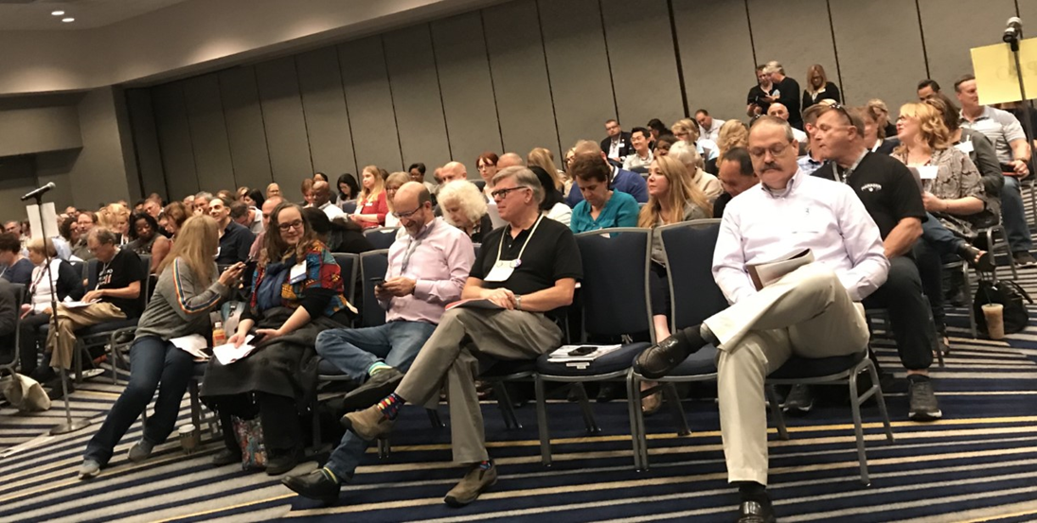
Questions?
Thank you, and have a great plenary session!
Notes:
Facilitate the questions and answer

