Slide 1
State of the Senate Plenary Session Fall 2016

Slide 2
The ASCCC Community
Sage members: 6+years?
Seasoned members: 4-5 years?
Experienced members: 2-3 years?
Novice members: 1 year or less?

Slide 3
Or what you need to know if you don’t attend the breakout. In 60 seconds or less (perhaps).
Where we’ve been.
Where we are.
Where we’re going.

Slide 4
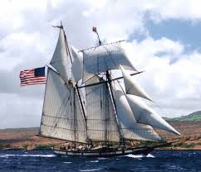
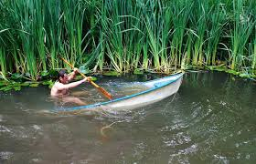
Being academic senate president…

Slide 5
Legislation

Slide 6
Legislation
Where we’ve been…
End of the 2 year cycle
Where we are…
Continue to track legislative activity (10+1)
Passed legislation
AB 1741 (Rodriquez) College Promise Innovation Grant Program
AB 1985 (Williams): Advance Placement
SB 906 (Beall): Priority enrollment for foster youth, EOPS, and DSPS
Notes:
AB 1985: AP Credit - Adoption and implementation of a uniform policy on awarding AP credit for general education requirements

Slide 7
Legislation
Where we’re going…
AB 1985
ASCCC Survey
CO Workgroup
Local Implementation by Fall 2017
Advocacy
ASCCC Legislative Agenda
ASCCC Advocacy Day
Legislative Liaisons
Legislation Newsletter
NEW!

Slide 8
Budget

Slide 9
Budget Proposal 2017-2018
Where we’ve been…
Budget proposal prepared by CO
Input from constituency groups
Where we are…
Adopted by Board of Governors
Where we’re going…
Advocacy for budget items
Full time Faculty Hiring
Part time Faculty support
Mental health Services
Veterans resource centers
Pathways to Community College Teaching program

Slide 10
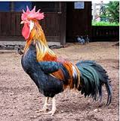
Curriculum
Where we’ve been…
System Advisory Committee on Curriculum (SACC)
Chancellor’s Committee On Curriculum (CCOC)
California Community College Curriculum Committee (5C)
X

Slide 11
Curriculum
Where we are…
Local approval, regional recommendation, state level chaptering
CIO and Curriculum Chair Certification (Memo 11/01/2017)
Collaboration with system partners
Continue to streamline CO procedures
C-ID for CTE

Slide 12
Curriculum
Where we’re going…
Workshops on local approval
Team approach
Late fall, early spring
Resources
Program and Course Approval Handbook December 2016
Revision of ASCCC Course Outline of Record paper Spring 2017
Spring Regional meetings

Slide 13
Curriculum
Where we’re going…
Transfer Opportunities
UCTP
Conversations with UC Academic Senate
Define benefits for students
Model Curriculum and Awards
Improve portability for CTE programs

Slide 14
Accreditation

Slide 15
Accreditation
Where we’ve been…
Accreditation Task Force Reports
Where we are…
Workgroups I and II
Where we’re going…
Remain accredited
Work with ACCJC to improve current process
Determine best solution for our system
Executive Committee Letter to USDE
Testify before NACIQI in February

Slide 16
Strong Workforce Program
Where we’ve been…
Basic Skills, Transfer, Student Success and Support, and Equity
Board of Governors Task Force on Workforce, Job Creation and a Strong Economy
25 Recommendations and 74 Sub-recommendations
Where we are…
Implementing Recommendations
ASCCC leading 10+1 recommendations
Partnering and advising on others

Slide 17
Strong Workforce Program
Where we’re going…
Regional and Local
Attend Regional Consortia
Local Share Plans Due January 2017
Consultation with local academic senate and CTE faculty
CTE Data Unlocked
Partnering to align TOP codes
Accurate comparison of programs
Training with an ASCCC and CTE DU experts

Slide 18
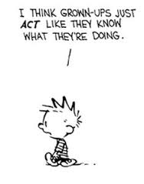
MQs and Equivalency

Slide 19
MQs and Equivalency
Where we’ve been…
Discipline’s List Process 2 years
Strong Workforce Task Force - industry professionals in the classroom
Where we are…
Ensuring qualified faculty
Reviewing and improving equivalency processes without compromising standards
Fall Regional workshops

Slide 20
MQs and Equivalency
Where we’re going…
Resolution for yearly review of the Disciplines List
CO MQ Advisory Committee
Partner with IEPI
Team approach
Share strategies and processes
Publish effective practices

Slide 21
Professional Development
Where we’ve been…
Commitment to Professional Development
Where we are…
Continued Commitment
Partner with IEPI
Sponsor professional development
Where we’re going…
Additional professional development opportunities
Part Time Faculty Summer Conference 2017
Stronger partnerships with CIOs, ACCE, 3CSN and ACCCA

Slide 22
Faculty Needed
Volunteer for Statewide Service
We need faculty who are…
CTE
Part time
Articulation Officers
Counselors
We are not above begging.
But please don’t let it come to that.

Slide 23
Upcoming Events
Formerly Incarcerated Students Regional Meetings
November 18 and November 19
Contextualized Teaching and Learning Regional Meetings
December 2 and December 3
www.asccc.org

Slide 24
Change is here…again!

Slide 25
Dream big.
Think big.
Do big.

Slide 26
Thank you!

