Slide 1
STATE OF THE SENATE
ASCCC Leadership Institute 2015

Slide 2
The Education Technology Initiatives
Online Education
Common Assessment
Educational Planning

Slide 3
The Community College Baccalaureate Degree
15 pilot colleges have been chosen
ASCCC has formed a task force that will work with the pilot colleges to address various issues that fall under Academic Senate purview:
Upper division definition
Upper division general education
Minimum qualifications
Necessary Support Services
CSU is unhappy
Do not be surprised to see it expand

Slide 4
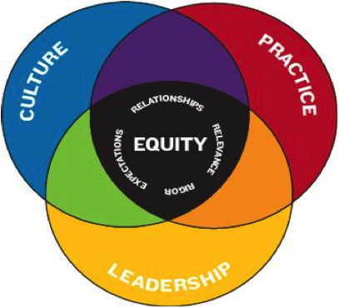
Equity and Diversity
Student Equity Plans
The Student Success and Support Program (SSSP)
Increasing faculty diversity
Academic Academy in Spring 2016

Slide 5
C-ID and ADTs
Expansion of C-ID
CTE
Basic Skills
Transfer degrees
SB 440 and BoG Mandates
UC Transfer?

Slide 6
Task Force on Workforce, Job Creation, and a Strong Economy
Extension of 2011 Student Success TF
Expected to focus on topics such as the following:
job creation
alignment of K through higher education career pathways
responsiveness to industry
collaborative use of resources
Recommendations to be completed by fall
Notes:
S

Slide 7
Budget
A strong budget for the CCC System
Funds for hiring full-time faculty
1.02% COLA is state determined
A lot of pet projects
Basic skills
Collaboration with CSU on remediation

Slide 8
Legislation
AB 288 (Holden): Dual enrollment
AB 626 (Low): Hiring of full-time faculty, part-time office hours, noncredit FT ratio
AB 770 (Irwin): Basic Skills Innovation
AB 798 (Bonilla): Open Educational Resources
SB 42 (Liu): Commission on Higher Education Performance and Accountability

Slide 9
Accreditation
A lot of controversy over several years
CCSF and Compton situations
ASCCC Resolutions
Consultation Council Taskforce

Slide 10
Professional Development
General stress on professional development statewide
A focus of Workforce Task Force, Board of Governors
Professional Development College
Pilot Module: Faculty Leadership
An ongoing training program over the course of a year rather than a one-time event.
Plan to expand into other modules next year

Slide 11
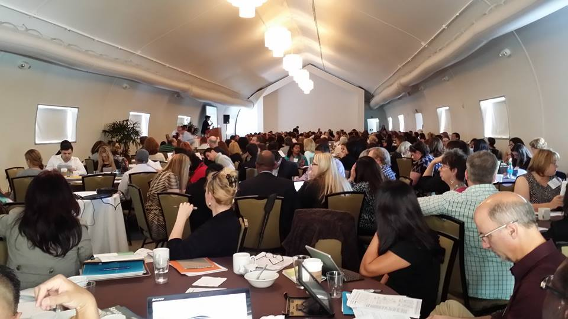
Upcoming ASCCC Events
Curriculum Institute: July 9-11, Anaheim
Fall Plenary Session: November 5-7, Irvine
Spring Plenary Session: April 21-23, Sacramento

Slide 12
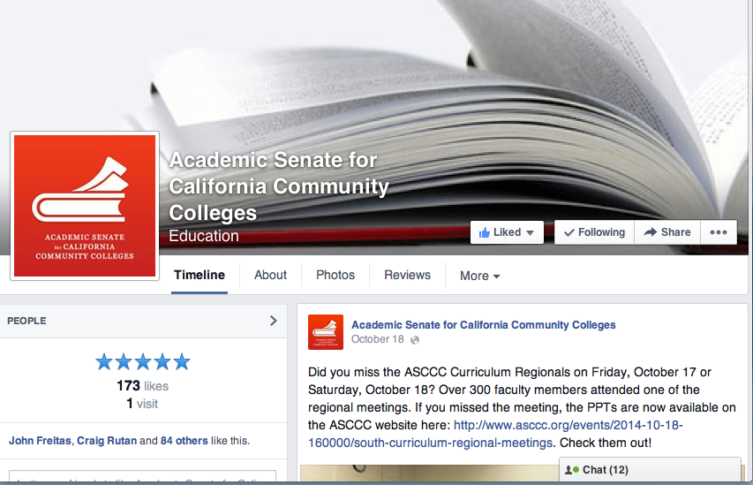
THE ASCCC Facebook Page

Slide 13
We Need Your Help
Get involved---volunteer to serve
Talk with Executive Committee members about serving on an ASCCC committee
As local leaders, make sure your local faculty is informed about statewide issues so that you can provide us with feedback

Slide 14
Thank You for All You Do to Represent Faculty
Enjoy the institute and let us hear from you

