Slide 1
State of the Senate

Slide 2
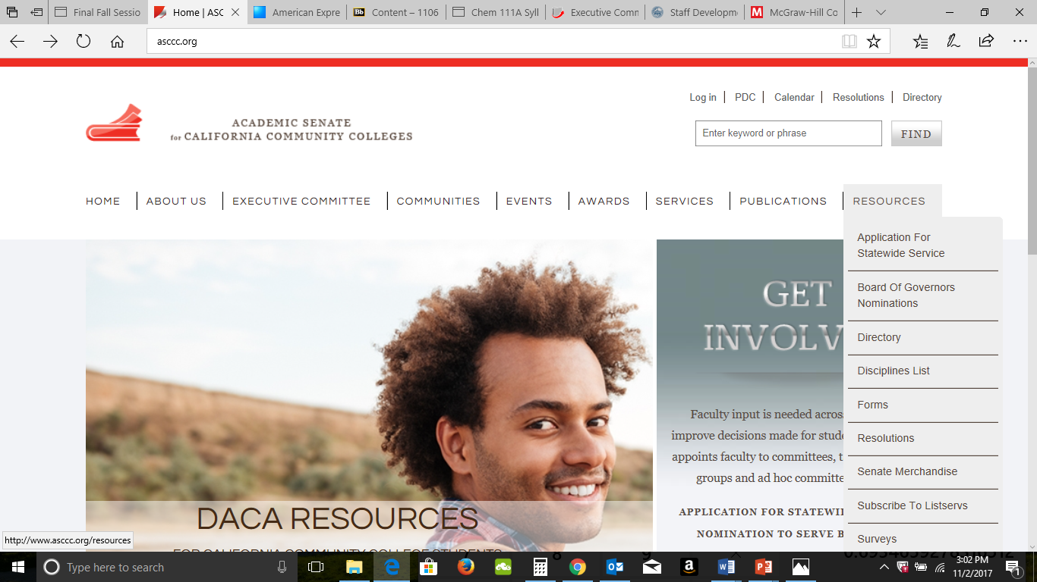
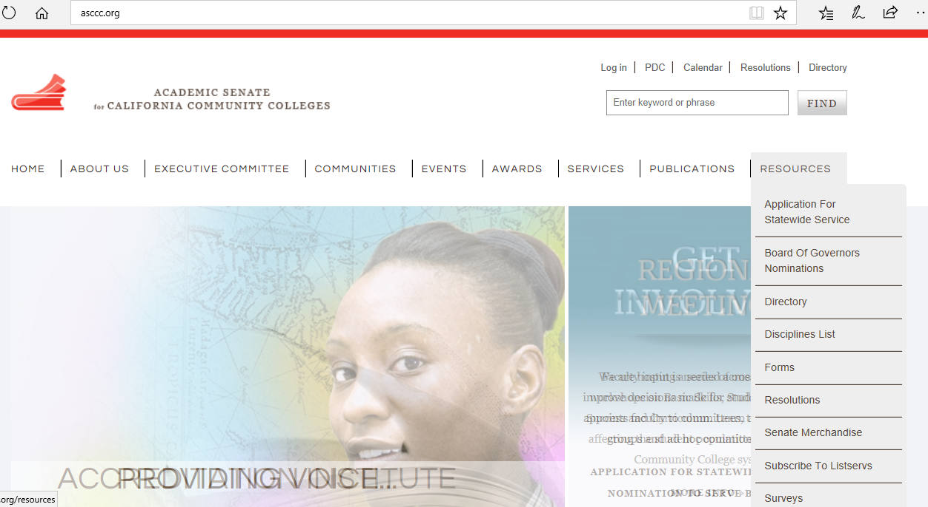

Slide 3
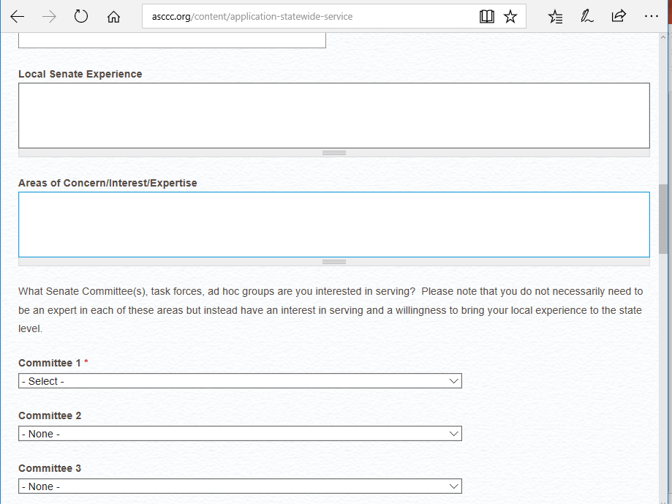

Slide 4
Updates
Budget
Legislation
Online College District
Funding Formula
Open Educational Resources
Governance
4 Areas of work with the Chancellor’s Office
Other Areas of Emphasis
Upcoming Events

Slide 5
2018-19 Budget
$28.4M Deferred Maintenance and Instr. Eq.
$269M New Funding Formula
$173M, 2.71% COLA
$120M Online Community College
$60M Enrollment Growth
$46M College Promise Programs
$32.9M Financial Aid Expansion
$2M CCCCO Staffing
Prop98 Split 10.93%

Slide 6
2018-19 Budget
$35M OEI
$50M Part-time Faculty (one time)
$50M Full Time Faculty (ongoing)
$10M Legal Services for undocumented students, faculty and staff
Stabilization money for all colleges based on 2017-18 apportionment + COLA
$685k for C-ID
$6M Open Educational Resources

Slide 7
2018-19 Budget Community College Funding Formula
60% based on FTES apportionment
20% based on pell grant / promise grant
20% based on performance metrics including
ADT attainment
AA/AS attainment
Transfer
Short term (9 units) CTE certificate
18+ unit CTE certificates
Completion of transfer level math/English

Slide 8
2018-19 Budget Fully Online College District
Board of Governors serves as the Board of Trustees
Must have students enrolled by Fall 2019
Competency based educational offerings targeting 24-35 year olds with a high school diploma and little or no college
No differential fees
Non-duplicative of current CCC offerings

Slide 10
2018-19 Budget Open Educational Resources Initiative
ASCCC OER Task Force recommendations
Evaluation of all current and past efforts in the system
Identify gaps and how to create quality materials for students

Slide 11
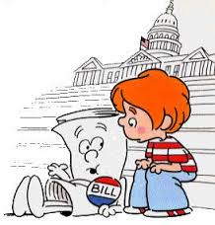
Legislation to Fix Us
AB 1805 (Irwin) Community College Placement Policies
AB 1935 (Irwin) Tutoring
SB 1406 (Hill) Baccalaureate Degrees
AB 3101 (Carillo) Revise CCCApply

Slide 12
Legislation about Food Insecurity, Student Services, Financial Aid
AB 2933 (Medina) Educational Liaisons
SB 968 (Pan) Mental Health Counselors to Student Ratio
AB 1037 (Limón) Cal Grant B Service Incentive Grant Program.
AB 1887 (Medina) Undocumented Students
AB 1952 (Mayes) Student Hunger
AB 2785 (Rubio) Lactation Accommodations

Slide 13
ASCCC Advocacy Agenda 2017-18
ASCCC Legislative Agenda
Full time faculty hiring and faculty diversity
Audit Fee
Permanent and sustainable funding for C-ID
Dedicated professional development resources
Wrap-around student support including mental health services and direct aid for food and housing insecurity.

Slide 14
Governance
Consultation at System Level
Shore up Local Governance Structure
Ensure collegial consultation and effective participation
Review and strengthen policies and processes
Work with Union leadership to unite faculty
Create partnerships with administration, classified staff, and students
Build trust and goodwill
“When they go low, we go high.”
“If you want to go fast, go alone;
if you want to go far go together”

Slide 16
Four Areas: Guided Pathways
Chancellor’s Office Efforts
Collaboration with system partners
ASCCC Efforts
Webpage under construction
Guided Pathways Liaisons
Local visits
Speakers
Presentations
Regional meetings
Resources
GP Road Show – 10+1
Academic Academy – Guided Pathways

Slide 17
Four Areas: AB705 Implementation
AB705 – Reformation of remedial education and assessment for placement
Academic and Professional Matter
Guidance memo for English and Mathematics/Quantitative Reasoning
Guidance memo for ESL
FAQs
Professional Development for faculty

Slide 18
Four Areas: Strong Workforce Recommendations
CTE Minimum Qualification to ensure more industry experts are incorporated into instructional programs
Equivalency Toolkit
Subdiscipline Dialog
Professional Development for faculty

Slide 19
Four Areas: Faculty Diversification
Longstanding priority for ASCCC
September: Five regional workshops through IEPI aimed at Human Resources Depts. and recruitment protocols
Messaging to Senate Presidents, CIOs, CEOs, Trustees
Late January/February regional workshops aimed at faculty serving on hiring committees

Slide 21
CCC Regulation Workgroup
Sacred Cows
Faculty Obligation Number (FON) and 50% Law
Resume work that began Spring 2016
Updated proposal
Planned progress toward 75% Goal for every college
Advocate for FT funding
Track and publish progress to 75%
Include noncredit
Annual report
50% Law to include direct instructional costs
Counselors, librarians, tutors, and reassigned time
Redetermination of percentage
Updated proposal supported at Consultation Council

Slide 22
UC Transfer Pathways
MOU between UCOP and CCCCO
UC Academic Senate and ASCCC
Request recommendation from UC Academic Senate
Guarantee admission to the system
Complete a UCTP (with required GPA)
Other admission possibilities
Students completing ADTs that meet or exceed UCTP
Possible expansion of TAG agreements and removal of one TAG per student restriction
Creation of a System Guarantee Pool
Develop associate degrees based on UCTP (60 units)

Slide 23
Upcoming Events
Academic Academy (Guided Pathways), September 14-15 South San Francisco
Fall Plenary Session, November 1-3, Irvine
Spring Plenary Session, April 11-13, Burlingame
Career and Noncredit Institute, April 25-27, San Diego
Accreditation Institute with ACCJC, April 29-May 3, Burlingame
Faculty Leadership Institute, June 13-15, Sacramento
Curriculum Institute, July 10-13, Burlingame
Part-Time Faculty Leadership Institute

Slide 24
Upcoming Events
Regional Meetings
Equivalency and Minimum Qualifications
Curriculum Regionals
EEO and Implicit Bias Regionals
Part-Time Faculty Regional Meetings

Slide 25
Thank You

