Slide 1
Statewide technology systems
Holly Demé, ASSIST Program Manager
Craig Rutan, ASCCC Secretary
Rachel Stamm, Curriculum Systems Consultant, CCC Tech Center

Slide 2
ASSIST
Holly Demé
ASSIST Program Manager
July 13, 2018

Slide 3
Today’s Topics
What is ASSIST?
Why the need for a new system?
Where are we now?
Next Steps?

Slide 4
What is ASSIST?

Slide 5
ASSIST is…
An online student transfer information system
The official repository for CCC, CSU and UC articulation information
Intersegmentally structured and funded

Slide 6
The Mission of ASSIST
To facilitate the transfer of California Community College students to California public four-year universities by providing accurate articulation information.

Slide 7
A Critical Tool for Transfer
Nearly 16 million articulation agreements and transferability lists have been generated for more than 1 million unique users
Number of successful transfers for Fall 2017
More than 53,000 CCC students to CSU
More than 18,000 CCC students to UC

Slide 8
Who uses ASSIST?
CCC, CSU and UC Campuses
Articulation officers
Transfer center and campus staff
Students
System Offices
Course review
Application systems

Slide 9
Why the need for a new ASSIST system?

Slide 10
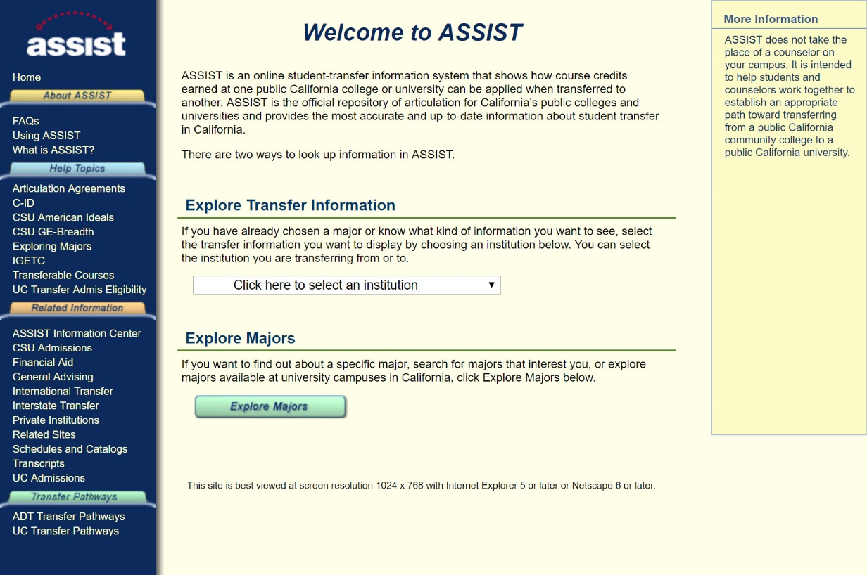
The Legacy ASSIST System
Last major software update to the current ASSIST site was in the mid-1990s
Utilizes outdated, unsupported software
Does not meet current accessibility standards
Legacy ASSIST

Slide 11
The Project Scope
Create one streamlined system to support all curriculum and articulation functions
Centralize course CSU and UC transferability review process
Provide Ad Hoc reporting capability and ability to downstream data via Web Services
Re-design the ASSIST public website

Slide 12
Challenges Developing New ASSIST
Legacy ASSIST
Shortage of requirements
Use of free text
Numerous types of users with varying needs
Need for implementation during or between review cycles

Slide 13
Challenges Developing New ASSIST
Software development approach
Missed deliverables
Code base and quality assurance
Overall project management
RFP to identify a new vendor

Slide 14
Where are we now?

Slide 15
ASSIST Development: Partner Resources
The Fairway Technologies Team
Understanding the system and user needs
Iterative, agile approach
Providing strong user experience expertise and testing capabilities
Project management excellence

Slide 16
ASSIST Development Accomplishments
Reconfiguration of the Course Review Process Workflow
ASSIST Public Site Redesign
Hosting and Infrastructure Migration
Completion of the Course Transferability Tool

Slide 17
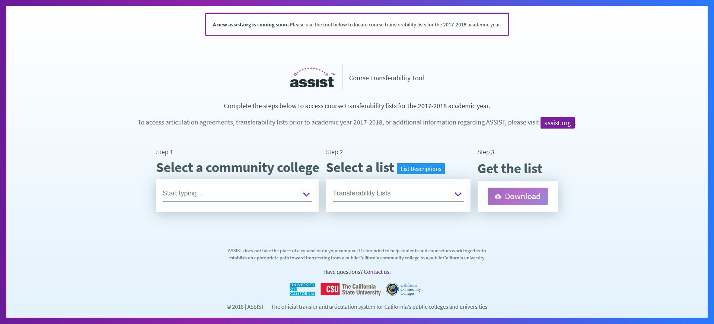

Slide 18
ASSIST Development Accomplishments
Numerous complex issues resolved by Fairway Technologies
Web Services/API reporting analysis for segment needs
Extensive articulation officer support by the ASSIST team
Development of Terms of Use and Licensing Agreements
ASSIST Resource Center Site (resource.assist.org)

Slide 19
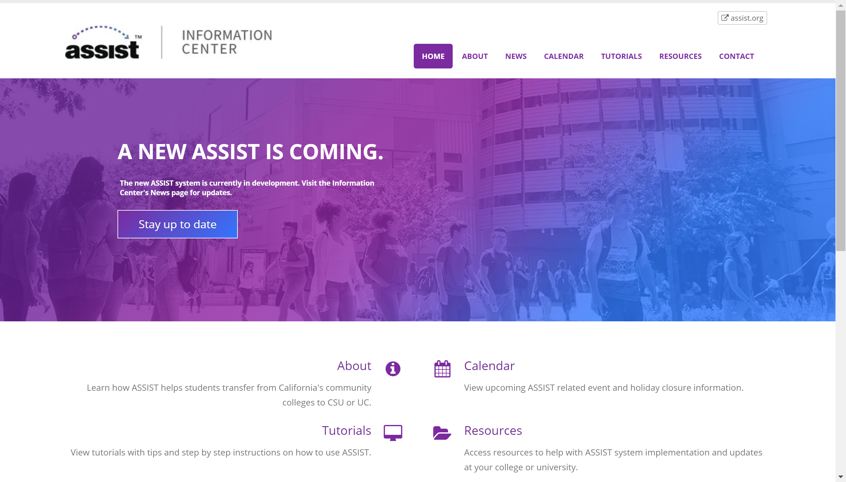
ASSIST Resource Center
News and information about ASSIST is now available at resource.assist.org
Contact us: help@assist.org

Slide 20
ASSIST Development: Current Focus
Focused on Critical Priorities
Ensuring data integrity
Data cross-checking
Meeting Critical Deadlines
CSU GE/AI/IGETC/UC TCA Review Cycle Support
UC TCA Footnotes

Slide 21
Next Steps

Slide 22
ASSIST Upcoming Activities
Additional curriculum and articulation management system development
Release of the temporary Course Transferability Tool
Release of the new ASSIST public website
Dependent on data cross-checking and resolution process completion

Slide 23
The New ASSIST System
Updated, intuitive design
Easily searchable database
Meets all web accessibility standards (WCAG 2.0 AA)
Enhanced data sharing
New ASSIST System

Slide 24
Phases of Public Launch
Phase 1: Core functionality of new ASSIST system
Transferability lists and articulation agreements
Data extracts and reports
Redesigned public site
Subsequent Phases: Iterative Releases
Explore Majors
Compare Courses by Majors
Web Services

Slide 25
Meanwhile…
What do we do for now?
Segment Specific Approaches
UC - Monica Lin, monica.lin@ucop.edu
CSU - Karen Simpson-Alisca, ksimpson-alisca@calstate.edu
CCC - Raul Arambula, rarambula@cccco.edu

Slide 26
Next Steps
Legacy ASSIST
New ASSIST System

Slide 27
C-ID 2.0
Craig Rutan, ASCCC Secretary

Slide 28
What is C-ID?
Course Identification Numbering System
Faculty driven process under the Academic Senate for California Community Colleges
C-ID began its focus on intersegmental curriculum to provide the CORE courses for transfer model curriculum (TMCs) – which are associated with Associate Degrees for Transfer (ADTs).
C-ID has since transitioned to include intra-segmental courses, such as CTE and basic skills.
C-ID structure and processes used to address the need for development of model curricula for degrees and certificates.

Slide 29
What does C-ID do?
Provides a numerical “tag”, a C-ID designation, for courses that match developed descriptor
Provides a means of identifying comparable courses and of ensuring course portability within the CCCs
Addresses the need for “common course numbers”
When a college submits a COR to obtain a C-ID designation, they are agreeing to accept other courses with that C-ID designation in lieu of their native course

Slide 30
What does C-ID do?
Provides a process for one-to-many articulation
Any college can opt to articulate C-ID descriptors, effectively granting articulation to all colleges that have a course matching a given descriptor
“descriptor-based” articulation
Offers a quality control and model for required courses in Model Curricula

Slide 31
C-ID 2.o Technology
Where can I find the C-ID website?
The C-ID website can be accessed via www.c-id.net
Why a new C-ID website?
Since 2014, the ASCCC, in partnership with the CCC Tech Center, worked together to bring about the new C-ID 2.0 website.
The existing website was designed to fit under the umbrella of the Ed Planning Initiative, with the goal of integrating technology systems across the CCC, including C-ID, OEI, COCI, CCCMyPath, and eTranscripts.

Slide 32
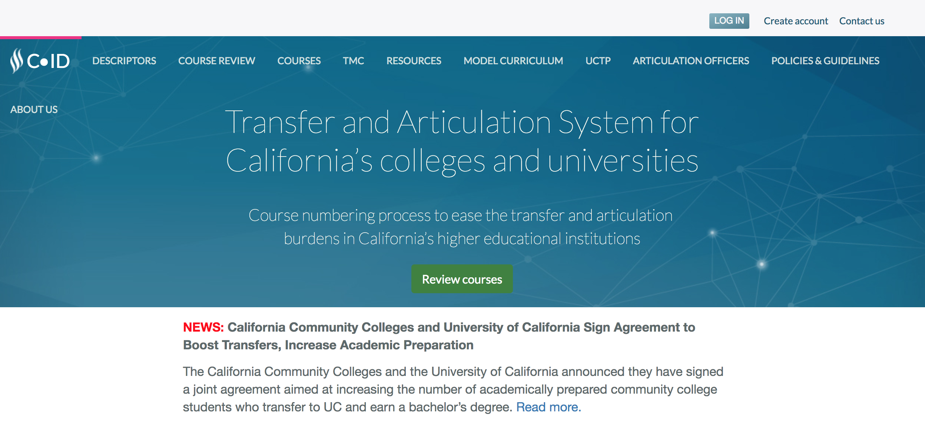
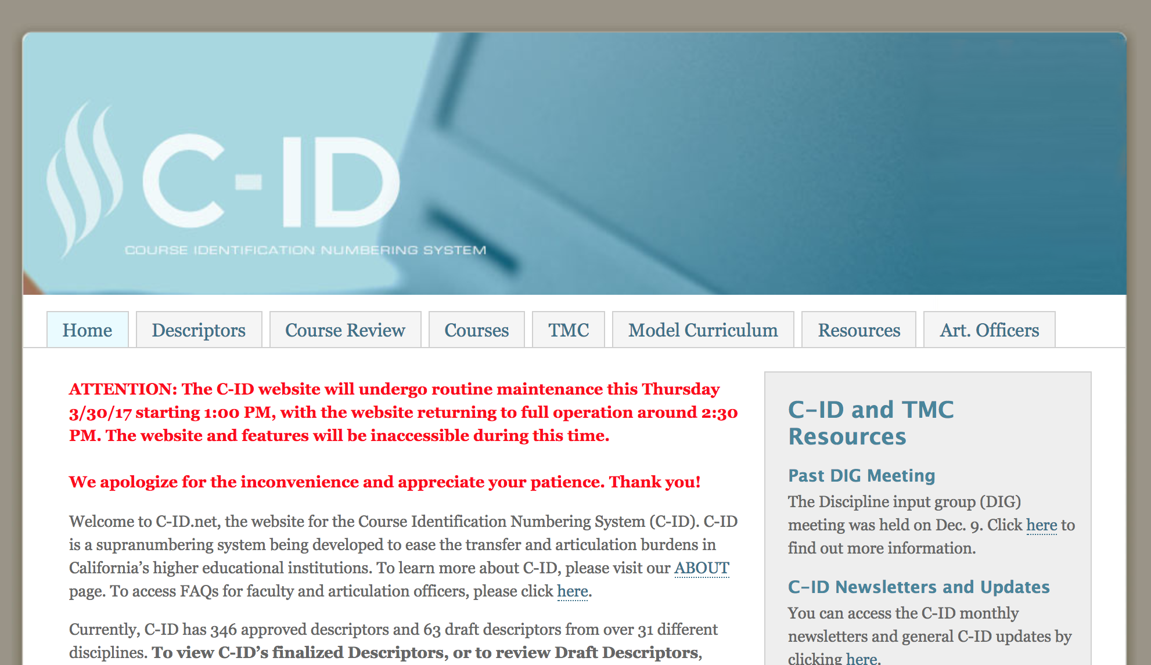
Technology - Where are we Now?
The C-ID website migrated from the “old” website to the new website in April 2017.
Over the last year, many issues were identified and addressed within the new 2.0 website.
OLD WEBSITE
NEW WEBSITE

Slide 33
Approved Courses - Public

Slide 34
College Approved Courses

Slide 35
Descriptors

Slide 36
AO New Course Submission

Slide 37
AO New Course Submission

Slide 38
AO Submitted Courses

Slide 39
Technology - Where are we Now?
2.0 Issues found:
Approved courses from 1.0 not appearing on the public site, and missing from the AO queue.
AO ability to revise approved submissions with non-substantive changes.
AO download all courses in Excel
A number of different error messages that users have received and that have since been resolved.
C-ID descriptors were not showing the suffix correctly. This is now resolved (with the exception of the ENGL descriptors that show the CAN numbers as a result of the fix)
Variation in the appearance of the website depending upon the browser being used.
Search functions did not previously work.
Email alerts are not sent when a course receives a determination.
It appeared that there were multiple submissions when a sequence was submitted.

Slide 40
Technology – What’s Next?
The following are a few enhancements for the C-ID 2.0 website:
*Implemented! - Honors approvals – the 2.0 system now allows the Primary Reviewer to expedite the review if the non-honors is approved.
Course history will be accessible on the courses tab of the public site.
Appeals will occur entirely within the application.
The AO will be able to filter by discipline and status in their queue and a download will be available for only what was filtered instead of downloading all submissions.
The AO queue will show the submission date as well as the date that the submission entered its current status.

Slide 41
The Chancellor's Office Curriculum Inventory System: Summer 2018 Update
Presented by Rachel Stamm | updated 07/08/2018

Slide 42
Todays Topics
COCI’s Function
Why we have a COCI application
Curriculum Owners
Year 1 by the Numbers
Releases
Bugs
Features
Webinars &Trainings
New and Modified Submissions
Growing Pains
Challenges this First Year
Process Improvements
Application Improvements
Carry Over to Year 2

Slide 43
COCI’s Function
Why we have a COCI application
Curriculum Owners

Slide 44
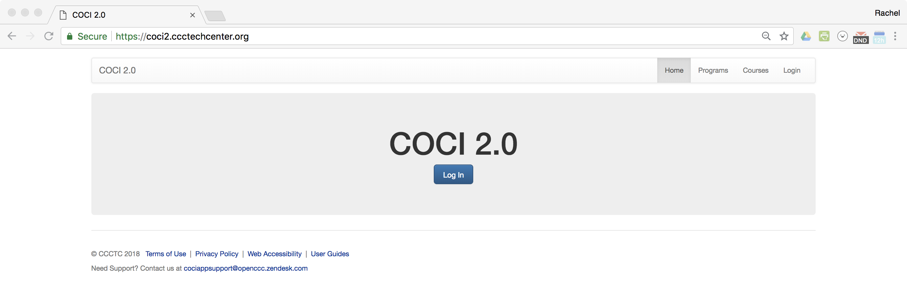
COCI 2.0
The Curriculum Inventory of today exists to provide Colleges and the Chancellor’s Office with a web-based method of submitting, reviewing and approving curricula once it has been locally approved.

Slide 45
Who Owns Curriculum
The College.
The content of Courses and Programs in COCI belongs to the College and the College is responsible for its completeness and alignment with the standards in the PCAH.
The College is responsible ensuring the Control Number assigned matches the correct version of the Course or Program.
The College is responsible for maintaining data parity between with curricula approved locally and curricula in the inventory.

Slide 46
The Role of the CCCCO
The Chancellor’s Office reviews the content of Courses and Programs (using both human and automated processes) to validate its completeness and alignment with the standards in the PCAH.
The Chancellor’s Office is responsible for assignment of a unique Control Number for all Courses and Programs that successfully validate.
The Chancellor’s Office is responsible for maintaining an inventory of all validated curricula across California Community Colleges.

Slide 47
The Role of MIS
MIS consumes Course and Program data from COCI and is responsible for generating a unique CCN for Courses after a final set of validations are completed.
MIS is the owner of the Data Element Dictionary and is responsible for the field integrity checks on CB data elements to be in alignment with the PCAH and CCCCCO Curriculum policies.

Slide 48
Year 1 by the Numbers
Releases
Bugs
Features
Webinars &Trainings
New and Modified Submissions

Slide 49
Software Updates in Year 1
23 Production Updates in FY1
1 Major Releases
7 Minor Feature Releases
9 Maintenance Release
5 Hotfix Releases
344 Development Tickets Closed
185 Bugs
Stories

Slide 50
Webinars and Trainings
49 Informational Sessions
8 Release Webinars
4 Product Roundtables
37 Trainings
830 Unique RSVPs

Slide 51
Submissions
37,776 Course Submissions in Year 1
34,368 Modified and New Credit Course Submissions
3,398 Modified or New Non Credit Course Submissions
6,735 Program Submissions in Year 1
2,510 Modified and New Degree Programs
1,143 Modified and New ADT Programs
2,525 Modified and New Certificate Programs
547 Modified and New Non Credit Programs

Slide 52
Growing Pains
Challenges this First Year
Process Improvements
Application Improvements
Carry Over to Year 2

Slide 53
Challenges
Year 1 was hard.
Completeness of Legacy Data
Duplicated and Deleted Proposals
CCN Generation Backed Up
PCNs not Syncing to MIS
Sub-Change Flags
Attachments
Approval Letters

Slide 54
Process Improvements
CCCCO and 5C Driving Product Roadmap

Slide 55
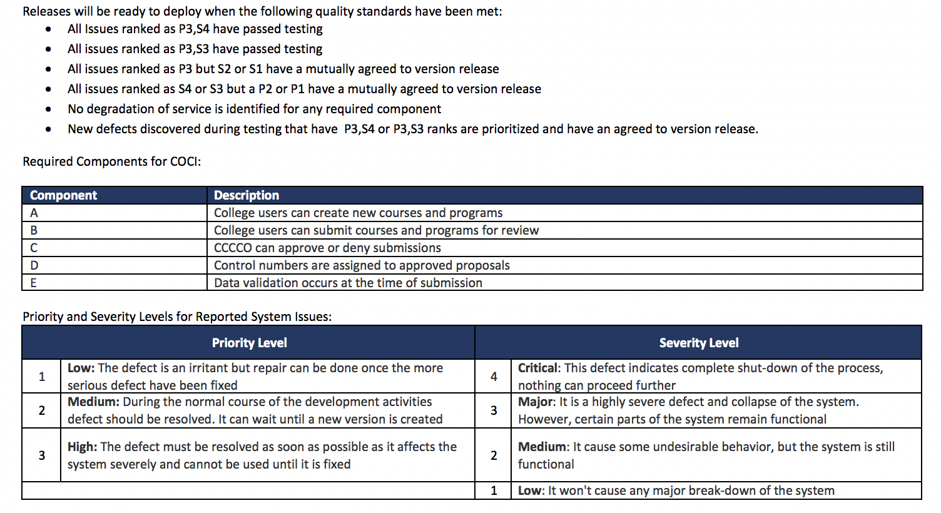
Process Improvements
Entry and Exit Criteria for Testing and Releases

Slide 56
Application Improvements
Finished
In Progress
To Do

Slide 57
Finished

Slide 58
In Progress

Slide 59
Finished
In Progress

Slide 60
To Do

Slide 61
In Progress

Slide 62
To Do

Slide 63
Looking Ahead and Lessons Learned
None of these systems are fully functional yet, but every team has had previous discussions about possible integrations in the future.
Those discussions were premature because the most important requirement for a piece of technology is that it function as expected.
For example, right after the 2017 Curriculum Institute, meetings began about how to allow local curriculum management systems to directly upload information. While that is a wonderful goal, it can’t happen until COCI is fully functional!
The primary goal for all systems is to be fully functional as stand alone systems.

Slide 64
Is Integration Dead?
There are possibilities for integration between the three systems because of the need for articulation agreements and C-ID approvals when submitting ADTs, so those discussions could happen in the future.
There is communication between representatives from all three systems and everyone is open to discussing what might be possible.
But, anything you might have heard about how one system might link to another is not guaranteed.
We all want these systems to work as efficiently as possible, but we need them to work first and discuss efficiency afterwards.

