Slide 1
The Maximized Professor - Designing a Career for Job Security as a Curricular Expert and Scholar
Dolores Davison, ASCCC Vice President Silvester Henderson, ASCCC At-Large Representative
Part Time Faculty Institute
The Westin San Francisco Airport
August 2-4, 2018
,

Slide 2
Presentation Highlights
What is the definition of a “Maximized Designed Academic Professor”?
Career Goals – “How to create an inventive employment plan”?
What “Unique” skills do Academic Curricular Innovators possess?
Could innovative “Ethno – Relativist” curricular structures creating academic employment for Professors? If so, how?
Questions and Comments?

Slide 3
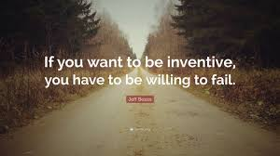
What is the definition of a “Maximized Designed Academic Professor”?
Maximized – to increase something as much as possible.
Design – to plan and make decisions about something that is being build or created.
“Maximized/Designed Academic Professor” – an instructor who can imagine and create unique and corporatize curricular idea that are subject and academically relevant, imaginative, but not generally part of the typical college curriculum.
Practice “Inventiveness” – the ability to think of new ideas and methods: creative or imaginative.
http://www.designorate.com/creativity-innovation-in-education/

Slide 4
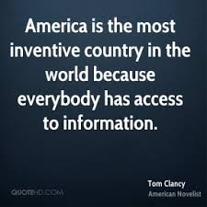
Career Goals – “How to create an inventive employment plan”?
Evaluate your abilities, creativity and instructional skills.
2. Speak to campus students about the proposed curricular idea within your specific discipline.
3. Meet with your Department Chair and discuss your “Special” academic contribution.
4.Design and present an innovative and unique course – “Get it approved”.
5. Present your idea to local colleges outside of your present service area.
6. Corporatize and share your skills with other
leaders outside of your district(s).

Slide 5
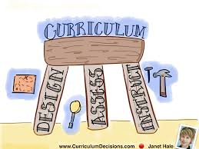
What “Unique” skills do Academic Curricular Innovators possess?
Curricular innovators are skilled in the following:
− identifying compelling reasons for change
− building shared goals and setting direction
− creating a climate of professional inquiry
− empowering and developing others
− being imaginative and systematic
− embedding and sustaining change
Source:
http://apps.nationalcollege.org.uk/resources/modules/curriculum/Leadership/Entries/2013/1/1_Why_Curriculum_Innovation_Matters.html

Slide 6
Could innovative “Ethno – Relativist” curricular structures create academic employment for Professors? If so, how?
Innovative Scholar – Create Employment (Steps)
“Rethinks” – expand the curricular representation; offer to create innovative courses that promotes “Intercultural Sensitivity”.
“Reshape” – create new specialize courses that will bring positive exposure to your department and your college. Example: “The Cell Phone” (Stem – CTE & Humanity Faculty)
Redesign: - corporatize/own the same course/program at various community colleges and districts. Become an “Innovative Curricular Specialist & Expert”. This creates
employment!
Design your own employment!
Ethno-relativism - A belief that all groups, cultures, or subcultures are inherently equal. Based on deep and heart-felt respect for other.
https://prezi.com/cdg0mff5m0ua/ethnorelativism/

Slide 7
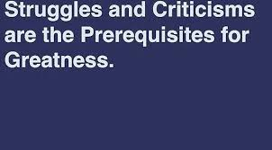
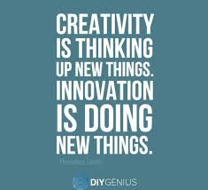
Questions & Comments
Please feel free to contact each of us for more information.
Dolores Davison davisondolores@fhda.edu
Silvester Henderson Shenderson@losmedanos.edu

