Slide 1
The College Tapestry: The Local Senate Role in Transforming Campus Culture General Session: Friday, April 16 at 9:00 a.m.--10:30 a.m.

Slide 2
Session Description
Many of us have participated in local and national campus climate surveys to engage in institutional change. As faculty and senate leaders, we have the opportunity to study and impact campus climate change by interrogating and analyzing data to get us to a place of “real talk.” We know the data, and we know the story: Higher education was designed with White architecture. As educators we should be asking: Are we serving our students well? How do we disrupt the system and provide opportunities for students of color to thrive? Join this interactive session to hear from a powerful panel of equity-minded leaders and practitioners on how to transform campus culture.

Slide 3
Panelists
Katherine Squire, Vice President of Student Senate of California Community Colleges
Dr. Darla Cooper (she/her/hers), Umoja Community Board President & RP Group Executive Director
Dr. Elvin Ramos, DeAnza College Dean of Social Science and Humanities
Dr. Jennifer Taylor-Mendoza, Skyline College Vice President of Instruction
Dr. Erin Vines, Antelope Valley College Vice President of Student Services
Adrienne Brown (she/her/hers), LACCD Guided Pathways Coordinator, LA Harbor College Articulation Officer, and ASCCC Legislative & Advocacy Committee
Chisa Uyeki (she/her/hers), Mt. San Antonio College Senate President & Librarian
Mayra Cruz (she/her/ella), ASCCC Treasurer
Michelle Velasquez Bean (she/her/hers), ASCCC At-large Representative
Notes:
(Michelle--1 min) Quick intros and land acknowledgment:
We begin today by acknowledging that we are holding our gathering on the land of the Nisenan Nations, the location of the ASCCC Office on One Capitol Mall, Sacramento, and the Tongva Nations, where I am currently located in what is now called La Mirada. We recognize the sovereign people who have lived and continue to live here. We recognize the Nisenan and Tongva Nations and their spiritual connection to the ocean and the land as the first stewards and the traditional caretakers of these areas.
As we begin, we thank them for their strength, perseverance, and resistance. We also wish to acknowledge the other Indigenous Peoples who now call these areas their home, for their shared struggle to maintain their cultures, languages, worldview, and identities in our diverse cities.
We invite you to research your area by texting this number (907 312 5085) with your city and state to see the Indigneous tribes and information about land acknowledgment or find your area at https://native-land.ca.

Slide 4
Today, we will . . .
Provide Overview of Campus Climate Traditions
Review Calls to Action and Define Terms
Moderate Panel Questions
Take Q&A from Participants
Reflect and Commit to One Action
Notes:
(Michelle--1 min)--music in background
Remind:
Open Pathable in separate window for CHAT.
Closed caption available.
Use Q&A for questions throughout.
Open window for Padlet

Slide 5
Cultural Change Definition CCCCO DEI Glossary
Refers to the stages of development or new patterns of culture that occur as a response to changing societal conditions. Within an organization, cultural change is a new method of operating and a reorientation of one’s role and responsibilities in the organization. Effective cultural change in an organization involves moving the organization toward a new vision or desired state.
This change is influenced by many factors including effective leadership in all aspects of the change process, intentional alignment of structures, systems and policies with the new culture, ensuring staff and stakeholder participation, clear and frequent communication regarding the cultural change, obtaining feedback and evaluating progress, and managing any emotional response to the change.
Notes:
Mayra (3 minutes)
Kanter, R.M., Stein, B.A., & Jick, T.D. (1992). The challenge of organizational change. The Free Press. Wuthnow, R. (1992). Cultural Change and Sociological Theory. In Haferkamp, H. and Smelser, N.J. (Eds.), Social change and modernity (pp. 256-277). University of California Press.
Padlet Activity (Wall): Cultural Change Definition- What are 1-2 changes that have happened in your college to create a new culture? Definition-One action

Slide 6
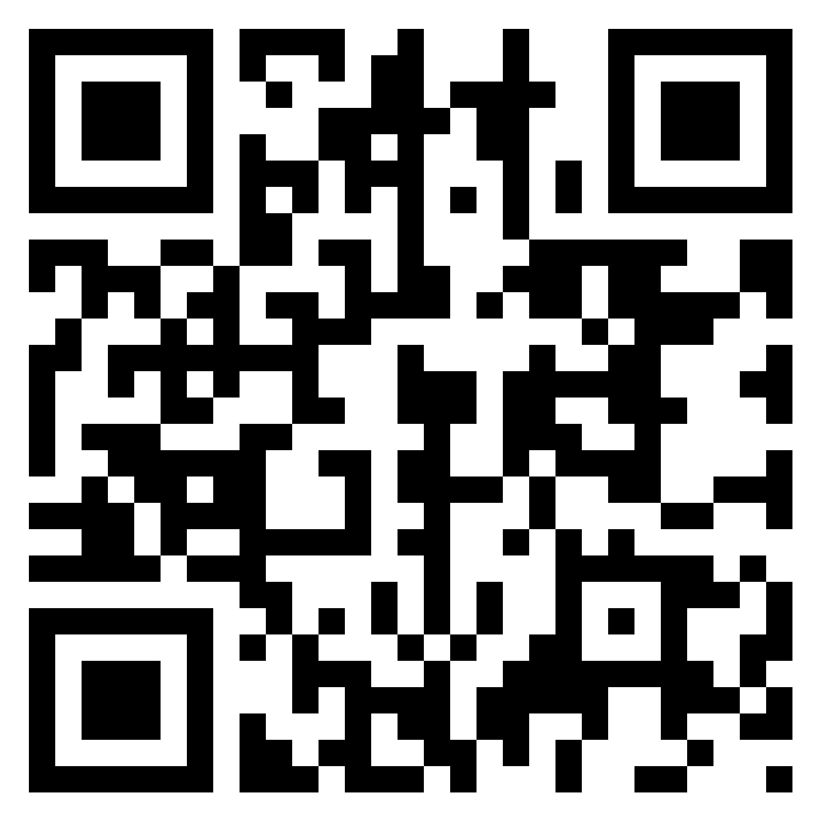
Use Padlet
QUESTION
What are one or two changes that have happened at your college to create cultural change?
Notes:
Michelle (5 minutes)
Scan the QR code with your phone--give it a second to load.
USE THE PLUS SIGN to add your comment to the Padlet.
Padlet link for CHAT: https://padlet.com/ProfessorBean/l9o53ry8jno027mz

Slide 7
Cultural Campus Change “Traditions”
College Values and Beliefs
Actualization of Values and Beliefs
Master Plans
Governance Structures
Frameworks--Guided Pathways
Assessment--Campus Climate Surveys
Guiding Principles and Common Values
For what are the surveys used?
Are you doing anything with survey data?
How does the data reflect the college’s values, mission, and vision?
Is the college breaking down system barriers and addressing antiracism and decolonization?
Notes:
Mayra--real talk! (3 minutes)

Slide 8
CCCCO Call for Action on June 5, 2020
Campus leaders must host open dialogue and address campus climate. The murder of George Floyd, ongoing violence projected in the news, increased unemployment, poverty and inequality impact every single community. Now more than ever, our students, faculty, staff and administrators need to feel a sense of agency and must have open and honest conversations about how we come together as an educational community to keep building inclusive and safe learning environments.
Our campuses already use surveys, focus groups, and town halls to address campus climate, but building community virtually requires new strategies and tools. This work must be led by our campus CEOs/Presidents in partnership with district trustees, campus police, chief student service officers, campus student leaders, and their community.
Notes:
Michelle (1 min)
https://www.cccco.edu/-/media/CCCCO-Website/Files/Communications/dear-california-community-colleges-family

Slide 9
ASCCC Call for Action on June 2, 2020
Make an agenda item that includes a discussion of anti-racism/no-hate education. Remember, you do not have to have an answer to start a conversation.
Prioritize culturally responsive curricular redesign with your curriculum committee.
Acknowledge, without assigning blame, that the structure of the college houses the biases and prejudices of its founding time. Those biases have privileged some and disadvantaged others, particularly African-American and Latinx communities.
Prioritize the evaluation of hiring and evaluation processes.
Request services from the ASCCC.
Evaluate your academic senate and find the voices among your faculty missing in governance. Find ways to empower those voices.
Work with your administration and students to find constructive ways students can express themselves about the deaths [stemming from racism] and the structural and historical biases that exist.
Notes:
Michelle (1 min)

Slide 10
Panelists Questions
Share your story.
What have you learned from conducting climate surveys?
In your role, how have you disrupted the system and contributed to culture change in California Community Colleges?
Describe any challenges or roadblocks to implementing change to serve students well?
What final word would you say to this virtual room of leaders?
Notes:
40 min (Michelle and Mayra--prelude each question with short example).
Share your story--your personal and professional experiences. Who are you? (2 minutes or less what you want to share with everyone- on how we landed in your social justice, anti-racism, and cultural transformational work) (Katherine, Adrienne, Chisa, Elvin, Darla, Jennifer, Erin) MAYRA TO ASK
What have you learned from conducting climate surveys? In what ways have you interrogated the data? (Jennifer, Erin, Darla to start) MAYRA TO ASK
In your role, how have you disrupted the system--meaning DECENTERING WHITENESS--and contributed to culture change in California Community Colleges? For inclusion, diversity, equity, and antiracism. (Adrienne, Chisa, Elvin, Darla, Jennifer, Erin, Katherine) MICHELLE TO ASK
Describe any challenges or roadblocks to implementing change to serve students well--particularly BIPOC students. (Darla and Elvin to start) MICHELLE TO ASK
With an opportunity for “real talk,” what final word would you say to this virtual room of leaders? (Katherine, Adrienne, Chisa, Elvin, Darla, Jennifer, Erin) MICHELLE TO ASK

Slide 11
Transforming: Name it, label, and address it!
Educate yourself
Call out systemic racism
Decenter Whiteness and name terrorism hate and violence where it is found
Be pro Black
Don’t wait for the bandwagon--stand with, support, and defend AAPI community
Love and embrace BIPOC, Latinx/a/o; Asian, Asian American, Pacific Islander, Native American and Indigenous, and African American and Black students colleagues, and communities
Call in passive dissenters
Be an ally and allow space for the work
Be a co-conspirator to disrupt and interrogate; expect discomfort
Be an accomplice to act to build and advance the work
Notes:
25 min (2-min each question) Michelle to moderate.
Provide a sentence or a resources for “educate yourself” (examples):
Educate yourself (Darla).
Call out systemic racism (Jennifer).
Decenter Whiteness in systems and practices and name White terrorism and violence (“center” whiteness to call it out) (Adrienne).
Be pro Black (Erin). Exhaustion, taxation on BIPOC colleagues.
Don’t wait for bandwagon: Stop AAPI Hate Racism acts that perpetuate white supremacy (Chisa).
Love, embrace BIPOC Latinx/a/o, Asian, Asian American, Pacific Islander, Native American and Indigenous, and African American and Black students, colleagues, and communities. Highlight and include Address erasure of BIPOC histories (Chisa). Forcing Love in Social Justice--positive regard Umoja concept (Darla).
Call in passive dissenters (Chisa).
Be an ally and allow the space for the work (Elvin).
Be a co-conspirator to disrupt and interrogate (Erin).
Be an accomplice to act to build and advance the work (Elvin).

Slide 12
Reflection and One Action
Using Padlet:
Write ONE ACTION you will do to move your campus toward culture change.
Notes:
10 min--Mayra
Padlet link: https://padlet.com/ProfessorBean/l9o53ry8jno027mz

Slide 13
Thank you!
Email info@asccc.org
CONTACT INFO
Katherine Squire
vp@studentsenateccc.org
Erin Vines
evines@avc.edu
Darla Cooper
dcooper@rpgroup.org
Jennifer Taylor Mendoza
mendozaj@smccd.edu
Elvin T. Ramos
ramoselvin@fhda.edu
Michelle Velasquez Bean
mbean@riohondo.edu
Mayra E. Cruz
cruzmayra@deanza.edu
Adrienne C. Brown
brownac2@lacccd.edu
Chisasoto Ukeyi
cukeyi@mtsac.edu
Notes:
Closing and Resources--Michelle

Slide 14
Resources
Antiracism Education in California Community Colleges
Equity-driven Systems: Student Equity and Achievement in the California Community Colleges
Summer 2020 Rostrum
CCCCO DEI Glossary
Campus Climate Survey Results by Race
Notes:
Antiracism paper: https://asccc.org/sites/default/files/Anti-Racism_Education_F20.pdf
Equity-driven systems paper: https://asccc.org/sites/default/files/Equity_Driven_Systems.pdf
Summer Rostrum: https://indd.adobe.com/view/861210a6-c4e2-4715-b335-7fd34a456cb3
DEI Glossary: https://drive.google.com/file/d/1kK9W1QlVfdW_OlCIaA7cZEuZt_Cbi4bS/view?usp=sharing
Sample Survey by Race from USC Race and Equity Center (National Assessment of Collegiate Campus Climates)

