Slide 1
Universal design and online accessibility standards for all students
Dolores Davison, Vice President, ASCCC
Geoffrey Dyer, Area A Representative, ASCCC
Michelle Pilati, Faculty Coordinator, ASCCC Open Educational Resources Initiative
ASCCC Academic Academy, September 13, 2019

Slide 2
Session Description
Every college is required to comply with the Americans with Disabilities act but most colleges are challenged with identifying appropriate standards and resources to implement. Being mindful of accessibility requirements creates a better experience for all students. Embracing the concept of Universal Design may be a means of re-framing the accessibility conversation to moving beyond compliance to doing the right thing for all students. Join us for a discussion of the principles of Universal Design and ways they can be integrated at your college, not just for students online but all students.
Notes:
Michelle

Slide 3
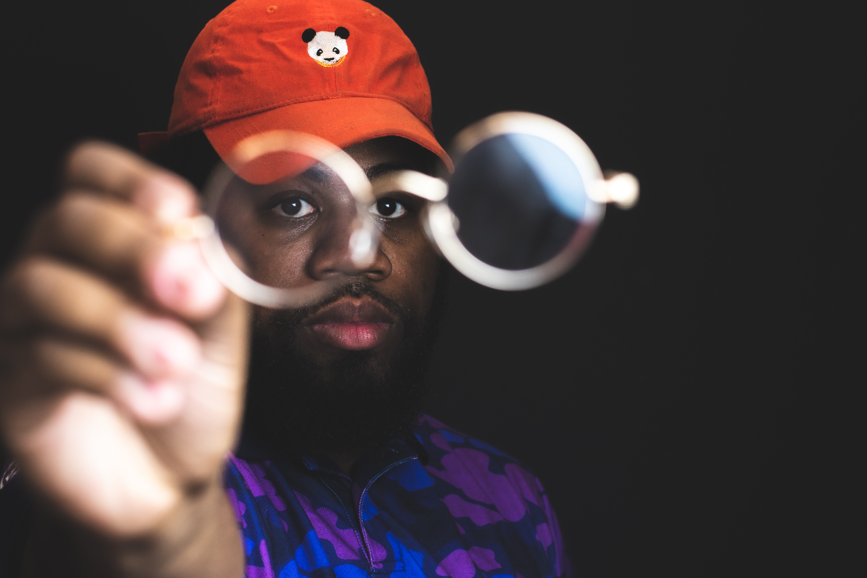
Why are you here?
Notes:
Ultimately, universal design is all about helping people to see things more clearly (and hear them) – and removing barriers… (Michelle)

Slide 4
Today’s Topics
Universal Design (UD) – What and why?
UD Vs Accommodations
How does implementing/not implementing UD affect the student experience?
Legal obligations, system-wide standards, and guidance
Support resources for implementing UD
Notes:
Michelle

Slide 5
What is universal design?
“Universal Design is the design and composition of an environment so that it can be accessed, understood and used to the greatest extent possible by all people regardless of their age, size, ability or disability. An environment (or any building, product, or service in that environment) should be designed to meet the needs of all people who wish to use it. This is not a special requirement, for the benefit of only a minority of the population. It is a fundamental condition of good design. If an environment is accessible, usable, convenient and a pleasure to use, everyone benefits. By considering the diverse needs and abilities of all throughout the design process, universal design creates products, services and environments that meet peoples' needs. Simply put, universal design is good design.”
—Center for Excellence in Universal Design (UK)
Notes:
Michelle

Slide 6
Why universal design?
“Simply put, universal design is good design.”
A UD approach ensures that resources, spaces, experiences, etc. are designed to maximize effectiveness for everyone.
Are there required elements related to accessibility that you – and your students – benefit from – even when you are not the actual “target” population?
Notes:
Michelle

Slide 7
Have you ever…
turned on the closed captions when viewing something because:
You could not understand an accent?
There was too much background noise for you to understand the dialogue?
had no clue as to the actual words of a song until you literally saw them?
Notes:
Michelle

Slide 8
Why do you think UD is important?
What if the syllabus isn’t accessible . . .
Students need accommodations but never ask or self-identify
Designing and selecting accessible course materials at the start saves time later
Notes:
Michelle—Ask audience before clicking to activate animations

Slide 9
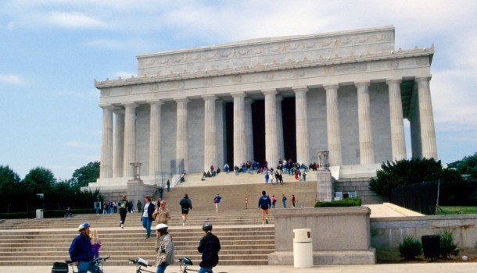
How is UD different from providing accommodations?
Graves, Justin. http://hesonwheels.com/universal-design-access/
Notes:
Michelle

Slide 10
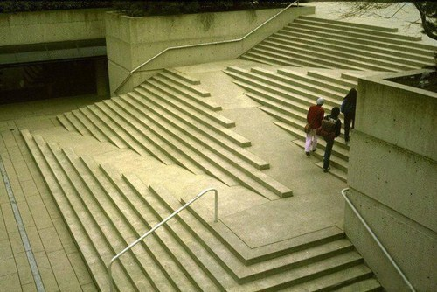
How is UD different from providing accommodations?
Graves, Justin. http://hesonwheels.com/universal-design-access/
Notes:
Michelle

Slide 11
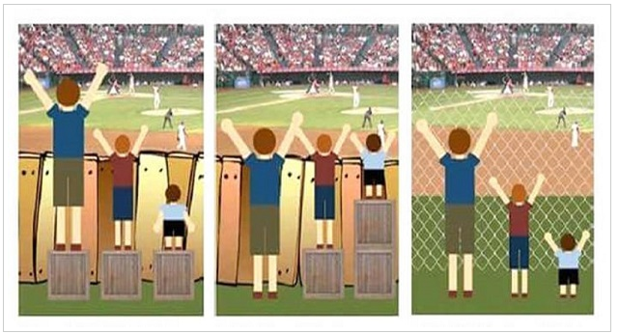
Equality Vs Equity Vs Universal Design
Three people looking over a fence – all are different heights and all are standing on boxes of the same height – this is equality
The same 3 people each standing on boxes that make them all the same height – this is equity
Removing the fence so that there is no systemic barrier – that’s UD
Notes:
Michelle

Slide 12
From Draft CCC Distance Education Guidelines:
All distance education instructional materials must be created utilizing principles of universal design to afford all students maximum opportunity to access distance education resources in an equally effective manner. . .
Difference between accessibility and accommodations: accessibility occurs on the front-end and applies to all; accommodations are individualized and designed to mitigate an educational limitation in the educational setting. Colleges must strive to provide course materials that are ACCESSIBLE, meaning that they can be used equally by any student without requiring a request for accommodation. This is as opposed to providing course materials that students with disabilities could only use with the provision of some type of ACCOMMODATION.
Notes:
Michelle

Slide 13
How Does UD/Lack of UD Impact the Student Experience?
Ability to access course materials
Ability to navigate course
Time lost while accommodations are provided
Equity issue
Concern for all courses, not just online courses
Notes:
Geoffrey

Slide 14
Quick Activity . . .
Think of a time when you were working on a project on your own, trying to meet a deadline, and you were not able to access a piece of information you were directed to or encountered serious difficulty with a software or web application.
How did you solve this?
What steps might our students take when encountering a class requirement that is not accessible?
How long might it take for an accommodation to be provided, and how might this impact their experience in a course?
Notes:
Geoffrey

Slide 15
Legal Obligations, System Standard & Guidance
Section 508 of the Americans with Disabilities Act of 1973 (“Section 508”)—Amended in 2017 to reflect advances in information and communication technology (ICT)
California Government Code section 7405 –California adoption of 508 standards
CCC ICT and Instructional Materials Accessibility Standard – Housed in Vision Resource Center
Title 5 § 56027—Requires districts to have an AP and BP for accommodations. Does your district have one?
CCLC Template for BP/AP 3725
Notes:
Geoffrey

Slide 16
Legal Obligations & System Guidance
Recent Legal Precedent: Roy Payan, Portia Mason, and the National Federation of The Blind California vs. LACCD (July 22, 2019).
Forthcoming Distance Education Guidelines include guidance for accessibility
CVC-OEI Course Design Rubric includes detailed guidance on making online courses accessible
Notes:
Geoffrey

Slide 17
National Federation of the Blind California vs. LACCD Injunction
July 22, 2019
Requires that alternative, accessible versions of inaccessible library resources, classroom materials, and technological programs (including third-party) be provided to blind students “prior or to or at the same time” as resources for sighted students or not used.
Notes:
Geoffrey

Slide 18
Support Resources for Implementing UD
Notes:
Geoffrey

Slide 19
Principles of UD
Any user can access all content
Quality of content is not diminished by design
Convenient for users
Enjoyable for users
Notes:
Geoffrey

Slide 20
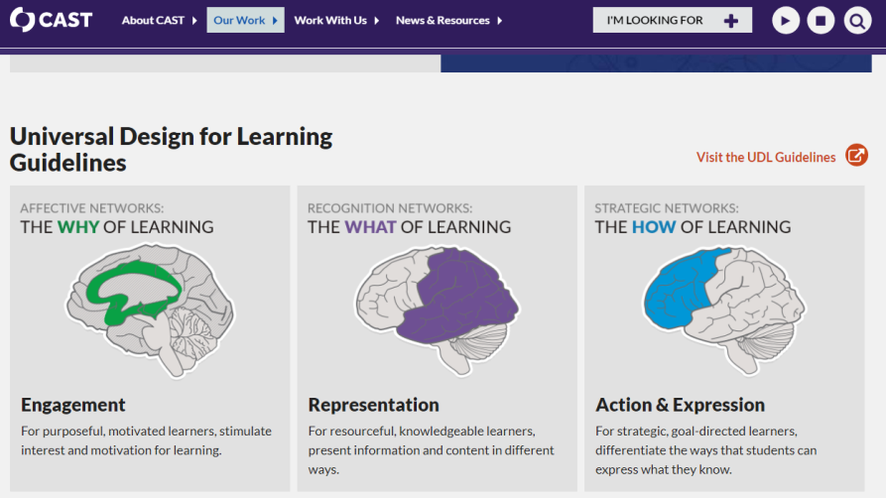
Universal Design for Learning
Center for Applied Special Technology’s Research-based Framework:
Notes:
Geoffrey

Slide 21
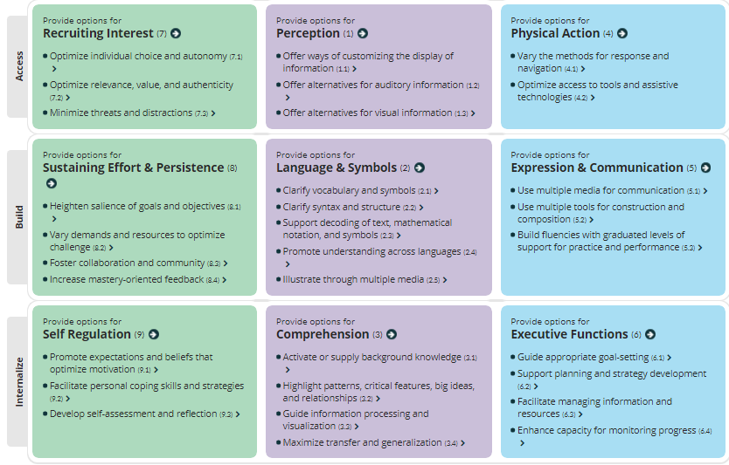
CAST’s UDL Guidelines
Intended to optimize learning for all learners
Notes:
Geoffrey

Slide 22
Accessibility Basics for All
Alt tags
Header styles
Contrast
Captioning
Links
Texts
Other Course Materials
Notes:
Dolores –These are the basic things that we should all be doing with all of our materials all of the time.

Slide 23
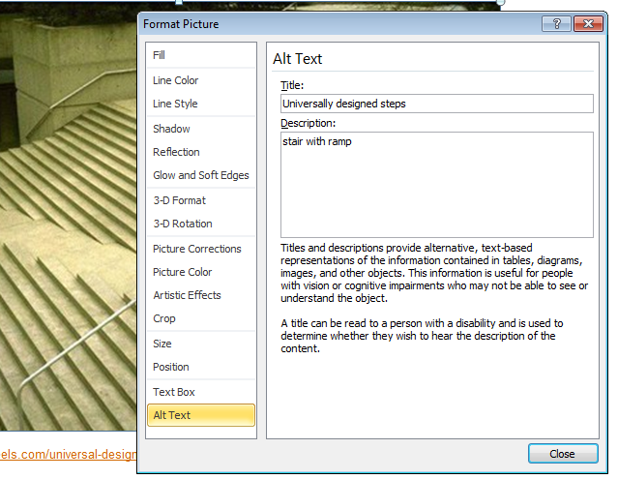
Alt Tags
Provide description of images for screen-readers
Notes:
Dolores –Example is how to add Alt Text in PowerPoint. Actual interface will differ by application but is usually available by right-clicking image

Slide 24
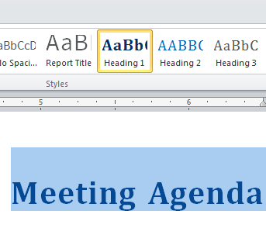
Header styles
Using appropriate header styles, as opposed to bold or enlarged font, in office applications and Canvas helps screen readers understand layout and importance of pages and documents.
Probably won’t be discernable in a .PDF that is a scan of a print resource
Pages of content are generally preferable to attachments for readability and navigation (also easier to update!)
Notes:
Dolores – Some PDFs ARE accessible, but only if they are correctly designed as such in the first place.

Slide 25
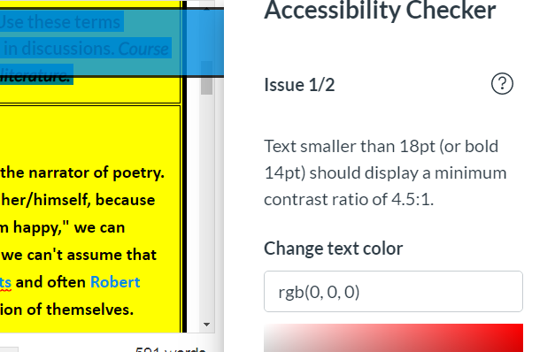
Contrast
Background and text colors must contrast sufficiently to be readability to a variety of readers.
Notes:
Dolores – This example is from the Accessibility Checker in Canvas

Slide 26
Captioning of Videos
How do you get your videos captioned?
DIY (do it yourself)
Access Distance Education Captioning and Transcription grant (DECT) resources. DECT provides CCCs with funding for live and synchronous captioning and transcription as a means of enhancing the access of all students to distance education courses. Further, the DECT promotes and supports awareness of available funding as a means to support faculty efforts to develop high-quality, media-rich distance learning courses.
Upload to 3C Media Solutions – a place to store videos AND have them captioned
Does your college have a DECT Grant? ???
For homegrown videos, YouTube’s auto-captioning is easily edited.
YouTube’s auto-captioning is not sufficient - it must be reviewed to ensure accuracy.
Notes:
DECT at College of the Canyons – https://www.canyons.edu/academics/schools/learningresources/captioning/faq.php
3C Media Solutions - https://www.3cmediasolutions.org/ Dolores

Slide 27
Hyperlinks
Hyperlinks in course content need to be regularly checked and maintained, as web content moves
The link itself should be descriptive of its content instead of the URL.
Don’t do this:
Click Here or
https://www.w3.org/WAI/standards-guidelines/#wcag
Do this: Web Content Accessibility Guidelines
Why?
Notes:
Dolores

Slide 28
What About Texts?
Why is it important that faculty submit their text orders early?
Alternative copies of course texts that are screen-reader accessible should be available
Course homework systems & ancillary materials
Districts are responsible for third-party resources
Accessible OER with appropriate creative commons license can be added as content to Canvas pages
Notes:
Dolores

Slide 29
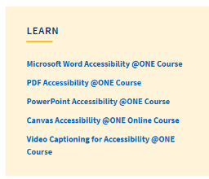
Resources
Vision Resource Center Create an account and log in to access 6 @ONE courses:
W3C Accessibility Standards Overview
CVC-OEI Course Design Rubric
Center for Applied Special Technology (CAST) Universal Design for Learning Guidelines
American Foundation for the Blind: Accessible Textbook Options for Students Who Are Blind or Visually Impaired
Notes:
Dolores

Slide 30
Fostering Institutional Change
How can faculty and students help transition colleges towards widespread universal design?
Some possible strategies:
Students: Speak up when content is not accessible!
Identify/Discuss potential BP/AP on accessibility. Work with local AS. Consider CCLC template for BP/AP 3725
Locally adopt CVC-OEI Course Design Rubric
Provide regular, high-quality professional development
Notes:
All

Slide 31
Thank you!
davisondolores@fhda.edu
gdyer@taftcollege.edu
Mpilati@riohondo.edu

