Slide 1
WSCH You Were Here Nili Kirschner, Woodland Community College, ASCCC Curriculum Committee Carlos Lopez, Moreno Valley College, CIO
2019 Curriculum Institute
cc: marinadelcastell - https://www.flickr.com/photos/95011179@N08

Slide 2
Break Out Learning Outcomes
Define types of apportionment funding, and other concepts impacted by course hours
Hours and Credit/Units
Understand how course hours and scheduling choices impact funding, staffing, and facilities
Explore other impacts
cc: cogdogblog - https://www.flickr.com/photos/37996646802@N01

Slide 3
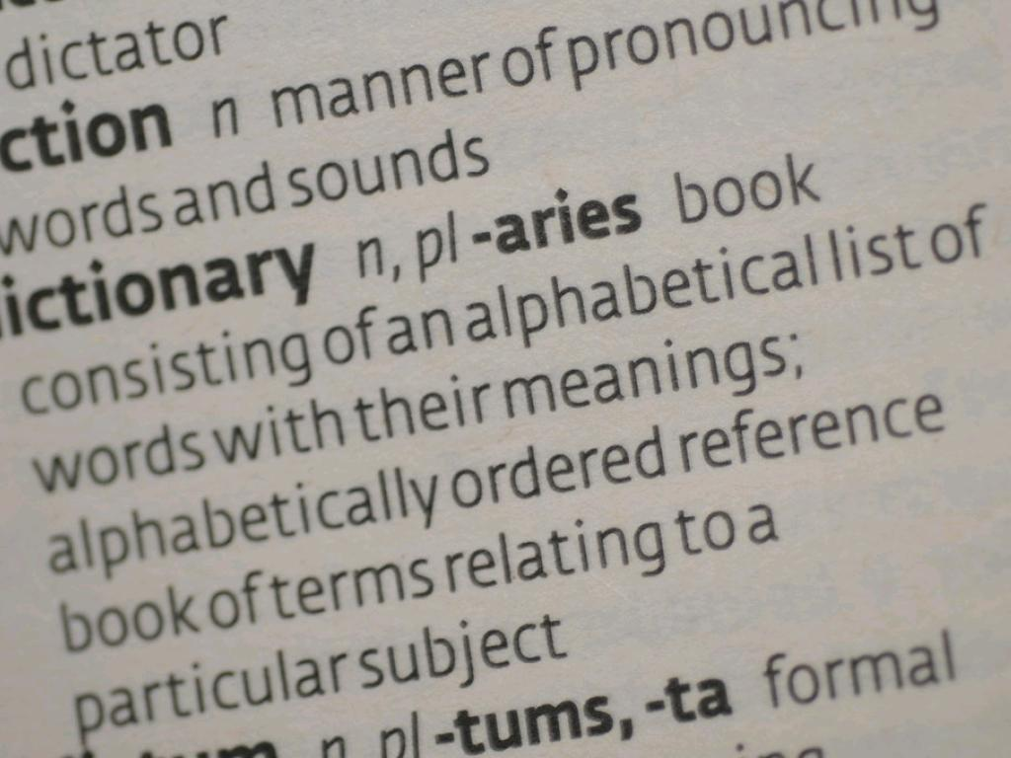
Definitions: Apportionment, Calendars, etc. as defined in Title 5, § 58003.1 & CCCCO Student Attendance Accounting Manual
cc: incurable_hippie - https://www.flickr.com/photos/49503155381@N01

Slide 4
Full-time equivalent student (FTES) One full-time equivalent student is the equivalent of one student or a group of students enrolled in 15 hours of instruction per week.

Slide 5
Basic calculation is to multiply student enrollment by class contact hours then divide by 525 hours.

Slide 6
Academic Calendar
35 weeks of instruction in two semesters or three quarters.
Traditional Calendar 175 days with two 17.5 week semesters or three 11.67 week quarters.
Compressed Calendar Less than 17.5 weeks and at least 16 weeks. No loss in instructional time with class meetings expanded to compensate.
Flexible Calendar (FLEX) Up to 15 days of non-instructional professional development with no loss of FTES.

Slide 7
Weekly Census or Weekly student contact hours (WSCH) Courses scheduled full-term, meeting the same number of days each week, and same number of hours each week.

Slide 8
Daily student contact hours (DSCH)
Courses that meet less than a full term, meet at least 5 days, and the same number of scheduled hours each day they meet.

Slide 9
Positive Attendance (PA or PAC)
Courses with irregular meeting patterns or fewer than 5 meetings, or non-credit courses. The college must track the actual hours each student attends for the entire course.

Slide 10
Alternative Accounting Method For Independent Study (IS), Work Experience (WE), and Distance Education(DE).

Slide 11
Faculty Workload - Full-Time Equivalent Faculty (FTEF), Teaching Load, Lecture Hour Equivalent (LHE), or other "Coin of the Realm"

Slide 12
Schedule Efficiency
Best way to think about schedule efficiency is how much of the general fund is invested in your class schedule?
WSCH/FTEF
FTES/FTEF
Fill-Rates
Cost per FTES
Others

Slide 13
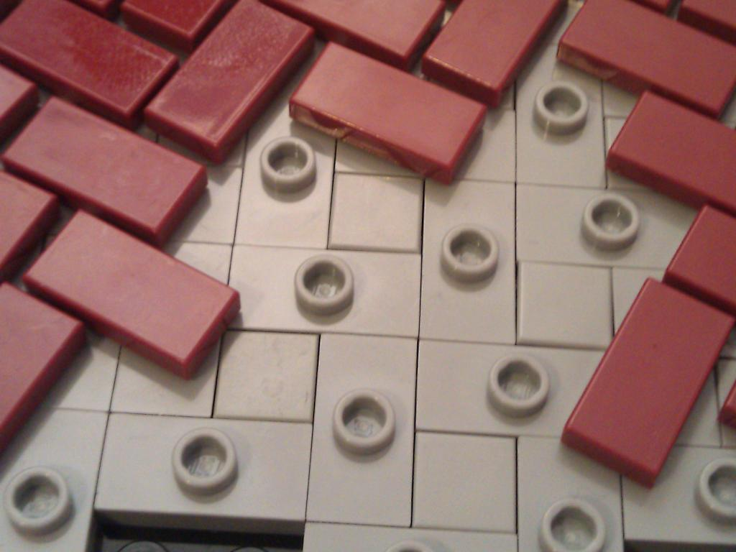
Curriculum Process is the Foundation
cc: Tek F - https://www.flickr.com/photos/37431860@N06

Slide 14
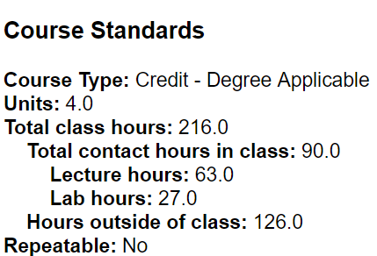
What does curriculum have to do with it?
Curriculum committee approves COR with units and hours:
Contact hours (lecture, lab, activity)
Outside of class hours
Notes:
Hoping this is close to what you had in mind. We can move this slide to wherever you want once your slides are finished.

Slide 15
What does curriculum have to do with it?
Committee has to consider academic integrity (Senate 10 + 1)
Hours needed to cover content
Appropriate ratio of contact to outside hours
Requirements/expectations from 4-years, C-ID, certifying bodies, etc.
Does your committee also consider impact on funding, facilities, scheduling, etc?
Notes:
Hoping this is close to what you had in mind. We can move this slide to wherever you want once your slides are finished.

Slide 16
Changing Course Hours and Impact on Section Scheduling
cc: Ross Findon - https://unsplash.com/@rossf?utm_source=haikudeck&utm_medium=referral&utm_campaign=api-credit

Slide 17
Why are course hours changed? What are the typical examples you've encountered? Who is involved in these decisions? Who Should be involved?
Notes:
Example: Change in English Composition to 4-hour lecture course with a reduction in cap from 35 to 25. Needed significantly more faculty to teach the same number of students. Department chair was constantly trying to fill staffing holes because of the significant increase in need for part-time faculty (rural area with faculty hard to find). The college struggled to offer enough

Slide 18
Changing course hours has a direct impact of the scheduled hours of a course section.

Slide 19
Changing a 3-unit lecture course to a 4-unit lecture/lab course (3 units lecture, 1 unit lab) Doubled the amount of time scheduled for a course 3 hours per week to 6 hours per week

Slide 20
Doubling contact time with students may improve success. What happens to you room utilization? How many sections can you now schedule? What impact will this have on the number of seats available to students? What happens if you want to schedule this course as an accelerated 8-week section?

Slide 21
Changing course hours has a direct impact on teaching load (FTEF).

Slide 22
Changing a 3-hour lecture class to a 4-hour lecture class Teaching load changes from 0.2 FTEF to 0.267 FTEF Part-time faculty who used to teach 3 sections per term can only teach 2 sections per term
Notes:
Some part-time faculty in this scenario also earned less money because they no longer maxed out at 0.6 FTEF.

Slide 23
Changing course hours impacts FTES generation (Traditional calendar with 17.5 Term Length Multiplier)
3-unit Lecture Weekly On-Campus Full-Term Class with 35 students FTES = (3x35x17.5)/525 = 3.5
4-unit Lecture Weekly On-Campus Full-Term Class with 35 students FTES = (4x35x17.5)/525 = 4.67
Title 5 states that a college can only report up to the maximum course hours listed on the COR.

Slide 24
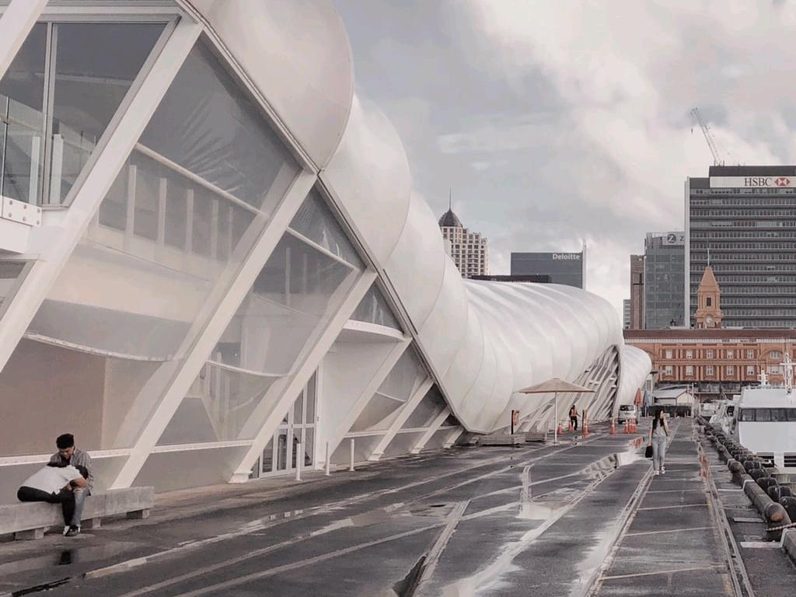
Facilities Utilization and State Facility Funding
Capacity/Load Ratio
cc: Edvinas Bruzas - https://unsplash.com/@edvinasbruzas?utm_source=haikudeck&utm_medium=referral&utm_campaign=api-credit

Slide 25
Are your coded as instructional space?
Are your spaces coded correctly?
How do you know?
How is space coding changed?

Slide 26
Capacity is the number of hours available Monday - Thursday to schedule in classrooms and labs on campus
Load is the actual number of hours scheduled Monday - Sunday in classrooms and labs

Slide 27
Cap/Load = 1.0 implies a college is using 100% of its space from the states perspective
Cap/Load > 1.0 implies a college has unused its instructional space
Cap/Load < 1.0 implies a college is overusing its instructional space

Slide 28
Other Impacts
cc: Matthew Sleeper - https://unsplash.com/@mjsleeper?utm_source=haikudeck&utm_medium=referral&utm_campaign=api-credit

Slide 29
Pathway Impacts
Articulation with 4-year institutions
ADTs and other degree/certificate pathways

Slide 30
Financial Aid
Other elements of the Student Success Funding Formula?

Slide 31
Questions or Comments?
cc: Veronique Debord - https://www.flickr.com/photos/41497284@N00

