Slide 1
WELCOME General Session 1 Friday February 25, 2022 ǀ 9:00am – 10:15am

Slide 2
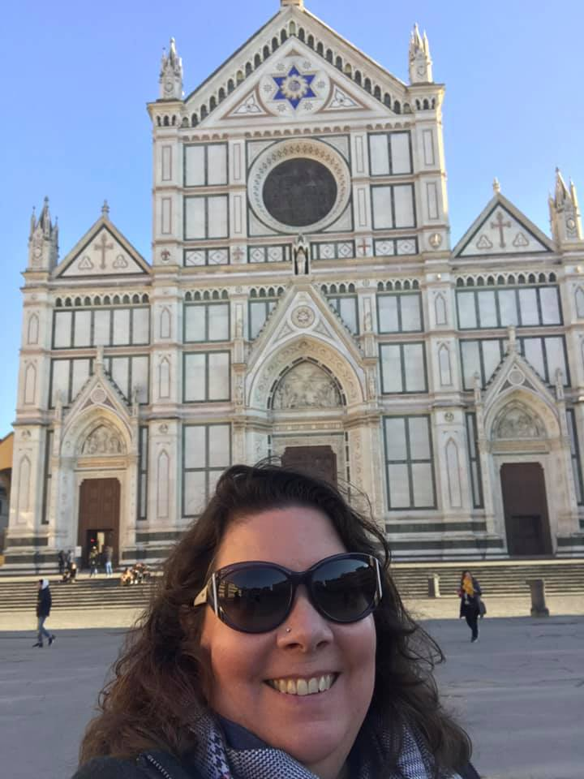
Welcome – ASCCC President
Dolores Davison

Slide 3
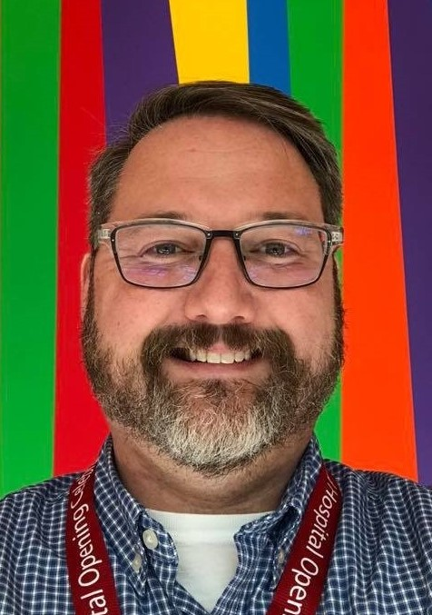
Welcome – ASCCC Accreditation Committee Chair
Christopher J. Howerton
Notes:
Introduce myself:
Ask attendees in Pathable to complete the following 3 poll questions:
Q1: For those of you associated with a specific CA Community College, Where are you on your local accreditation cycle?
1. We are working on our Self-Study/ ISER
2. We have submitted our self-study and preparing for an accreditation visit
3. I’m not sure
4. Other
Q2: What role would best describe you?
1. Faculty
2. Administration and/or ALO
3. Other
Q3: How would you most closely describe your feelings/perception about accreditation?
1.I am an accreditation fanatic – Love accreditation!
2. I have a strong respect and appreciation for the role of accreditation
3. Accreditation is a requirement
4. not a fan, It’s probably unprofessional for me to tell you what I think of accreditation.
Chat-Fall: This is where you type a word and wait until I give you the instruction to post.
Q: What word do you associate when you think of accreditation. – Put you word in the chat, but don’t hit “enter” until instructed
Welcome Message: The them of the institute really represents our desire to continue to improve how we meet our mission while things around us (often out of our control) continues to change.
Planning for this institute: Originally hope for f2f, then hybrid, then virtual (came from our goal to increase participation, accessibility, and have a meaningful event) Not easy conversations, a lot of work by our committee had to be redirected, and in some cases scrapped to make plans for something new. FLEXIBILITY has been our mantra.
In addition, it was important for our planning committee to highlight collaborations. To achieve synergy as a system we must work in an interconnected way. Locally accreditation is not done by one faculty member, or on the shoulders of one administrator. At it’s core it is a collaborative self-examination and partnership.
(tell story of my recovering SLO Coordinator and when we were doing SLO work and it was said that it was “my dog” – how I responded and took the metaphor to expand to all our work)
During this institute we are pleased to partner with ACCJC, the CIOs, the Chancellor’s Office, and the RP Group to bring this institute to a reality. You will see many of our session representatives from various groups presenting together.
Later today, our next General Session will highlight the focus of continuous improvements that are being made by ACCJC and the role of the ASCCC in this effort. We will be joined by a panel of ACCJC VPs and ASCCC executive members to share updates about ACCJC, the new formative/summative comprehensive Review process, and the creation of updated accreditation standards.
Other changes in California continue to force our community colleges to reexamine our curriculum, modes of delivery and even legislation that allows the expansion of baccalaureate degree programs houses in our community college system gives us an opportunity to demonstrate innovation
Our final General session tomorrow will allow you, our participants/attendees to share with us emerging and continued needs to support accreditation efforts.
I would like to take this moment to Thank a number of people …

Slide 4
Thank you
ASCCC Accreditation Committee
Christopher Howerton, Chair
Laura Adams
Kevin Bontenbal, ACCJC Liaison
Jeff Lamb, CIO Liaison
Jamar London
Alicia Robles López
Van Rider
Carrie Roberson
Robert Steinberg

Slide 5
Thank You
ASCCC Executive Committee
Dolores Davison, President
Virginia “Ginni” May, Vice President
Cheryl Aschenbach, Secretary
Michelle Bean, Treasurer
Stephanie Curry, Area A Rep.
Karen Chow, Area B Rep.
Robert L. Stewart Jr, Area C Rep.
LaTonya Parker, Area D Rep.
Karla Kirk, North Rep.
Christopher Howerton, North Rep.
Amber Gillis, South Rep.
Manuel Vélez, South Rep.
Juan Arzola, At-Large Rep.
Carrie Roberson, At-Large Rep.
Notes:
The input from the ASCCC Executive Team, and many who you will see in sessions during the institute.

Slide 6
Thank You
ASCCC Staff
Krystinne Mica, Executive Director
Tonya Davis, Director of Administration
Edie Martinelli, Events Manager
Miguel Rother, Program Manager
Megan Trader, Programs Coordinator
Alice Hammer, Director of Finance
Selena Silva, Program Manager
Emily Nicol, Administrative Assistant
Melissa Marquez, Executive Assistant
Katie Nash, Visual Designer
Kyoko Hatano, Administrative Assistant
Gina Lam, Research Associate
Notes:
These are the true MVPs! Working behind the scenes to make sure our event is a success.

Slide 7
Thank You
Partnerships/ Collaboration
ACCJC
CCCCO
CCCIOs
RP Group
Presenters & Attendees
Notes:
I would also on behalf of the ASCCC Accreditation Committee thank the following organization.
Transition and thank Dr. Miles, Interim President of ACCJC for being with us and provide an opportunity for her welcome of support.

Slide 8
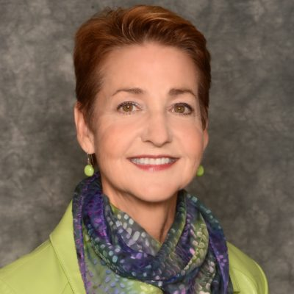
Welcome – ACCJC Interim President
Dr. Cindy Miles
Notes:
After this Welcome, Introduce Dr. Siria Martinez and share highlights of her bio – next slide

Slide 9
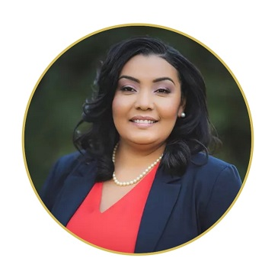
Keynote Presentation
Dr. Siria Martinez
Assistant Vice Chancellor of Student Equity and Success
Notes:
Siria S. Martinez, Ph.D, who has dedicated her career to eliminating educational inequality, will lead the Institutional Effectiveness Partnership Initiative (IEPI) in deploying professional development and technical assistance aimed at advancing equity and success strategies. She comes to the Chancellor’s Office from Woodland Community College, where she served as Dean of Student Success & Institutional Effectiveness and Interim Dean of Student Services and where she co-led an 11-person interdisciplinary Student Success Committee overseeing the development of a three-year Student Equity Plan.
A Los Angeles native raised in Compton who was the first in her family to attend college, Martinez began her higher education career at the University of Southern California where she served as assistant director in the Office of Admissions and Associate Director of Academic Affairs in the Computer Science Department. She was recruited in 2007 to work for UC Riverside’s Bourns College of Engineering as its Graduate Student Affairs Manager, then worked for nearly two years at Palomar College as its Title V/Hispanic Serving Institution Project Supervisor providing leadership in supporting the retention and academic success of Hispanic and low-income students at the San Marcos campus.
In 2011, Martinez returned to her alma mater, UC Davis, as Director of the Ronald E. McNair Scholars program guiding first-generation and low-income students to pursue doctorate degrees in their respective fields. While working with first-generation students, Martinez conducted research during her doctoral program that examined student experiences in community college developmental learning communities.
Martinez holds a bachelor’s degree in rhetoric and communication from UC Davis; a master of education, postsecondary administration and student affairs, from USC; and a Ph.D. in higher education from Claremont Graduate University.

