Slide 1
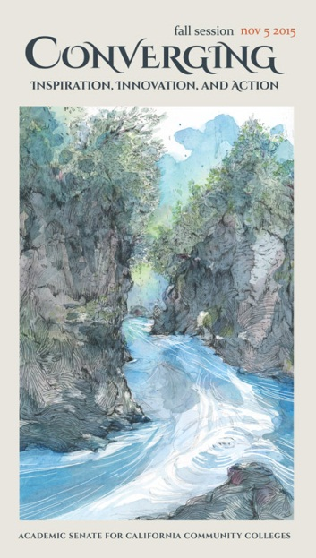
What is the Standard for Baccalaureate Level Quantitative Reasoning? Starting the Intersegmental Conversation
Ginni May, ASCCC Executive Committee
John Stanskas, ASCCC Executive Committee
Fall 2015 Plenary Session – November 5-7 – Irvine Marriott

Slide 2
Outcomes
Be informed of the California community college graduation requirement for math as stated in Title 5 and the history behind it;
Be apprised of the “happenings” regarding The CSU General Education Area B4-Quantitative Reasoning as well as emerging pathways in the California community colleges;
Engage in lively discussion regarding the ASCCC promise to encourage colleges to consider alternatives to intermediate algebra and the expectations for citizens holding a baccalaureate degree.

Slide 3
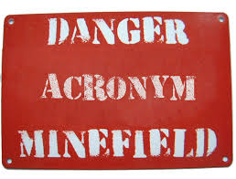
Acronym Tutorial
ASCCC – Academic Senate for California Community Colleges
CCC – California Community Colleges
CSU – California State University
UC – University of California
CCCCO – California Community Colleges Chancellor’s Office
BOG – Board of Governors
GEAC – General Education Advisory Committee (to CSU Chancellor)

Slide 4
History – CCC Math Requirement
Associate Degree Requirements increased to Freshman Composition and Intermediate Algebra in the CCC System:
Adopted by the Academic Senate in Spring 2005
Approved the Board of Governors in September 2006
Effective for all students admitted to CCC beginning Fall 2009

Slide 5
History – CCC Math Requirement
Title 5 § 55063
Competency in mathematics shall be demonstrated by obtaining a satisfactory grade in a mathematics course at the level of the course typically known as Intermediate Algebra (either Intermediate Algebra or another mathematics course at the same level, with the same rigor and with Elementary Algebra as a prerequisite, approved locally), or by examination;

Slide 6
History – CCC Math Requirement
In addition the Title 5 language includes…
The competency requirements for written expression and mathematics may also be met by obtaining a satisfactory grade in courses in English and mathematics taught in or on behalf of other departments and which, as determined by the local governing board, require entrance skills at a level equivalent to those necessary for Freshman Composition and Intermediate Algebra respectively.

Slide 7
History – CCC Math Requirement
Alternative courses are permitted (encouraged) by Title 5:
Leading up to the 2006 vote, many on the Board of Governors were reluctant to approve the change in graduation competencies because they feared it would simply become another barrier to students (especially CTE).
The Academic Senate for California Community Colleges made a commitment to the Board of Governors that it would actively encourage, support, and promote alternative courses;
That is, courses with content different from the traditional Intermediate Algebra curriculum may also be acceptable.

Slide 8
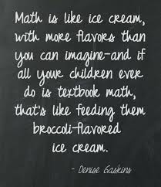

Slide 9
Efforts to increase Completion
RP Group released Basic Skills as a Foundation for Success in California Community Colleges in 2007 – AKA
The Poppy Copy http://rpgroup.org/content/poppycopy
Prepared by a team of researchers, faculty, and administrators
Lots of experimentation in the system
Bridge Programs
Compressed or Accelerated Learning
Contextualized Basic Skills
Two projects in Acceleration Emerged (among many)
Statway (Carnegie Foundation Model)
CAP (California Acceleration Project-3CSN)
Both involve fulfilling Quantitative Reasoning G.E. through Statistics

Slide 10
History – CSU GEAC
The Statway project reported back to GEAC in
2014 – data set too small
2015 – better data, social science degrees
Statway now charges $25000 one-time fee to college adopters
GEAC also acknowledged that CAP was using existing Title 5 waiver of prerequisite forms for alternative pathway to statistics
Notes:
John, you need to do this one, I am unfamiliar with where this info came from

Slide 11
History – CSU GEAC
CSU Executive Order 1065 and 1100 – Explicit Prerequisite Requirement of Intermediate Algebra for Transfer level Mathematics
Executive Order 1065- September 2011
Executive Order 1100- February 2015
Exemption to Executive Order 1065
Waiver for 5 districts to offer a Statway model to transfer granted in 2010, a 6th district was added later
Track students through transfer and baccalaureate graduation
http://www.calstate.edu/app/GEAC/documents/2015/sept-2015/06-Statway-presentation.pdf

Slide 12
History – CSU GEAC
The CSU Council of Math Chairs reported to GEAC
Statway at the CSU does not prepare students for college level courses
Not scalable
Poor outcomes
Study results of other remediation completers ELM scores versus Statway completer scores
Indicated Statway completers performed significantly lower on ELM than student body at large or other forms of remediation
ELM – Entry Level Mathematics Test for all Freshmen at CSU
Arithmetic, geometry (area and volume), and beginning algebra skills
CSU Council of Math Chairs’ Statement on Entry Level Mathematics and Statway 30 April 2015

Slide 13
Recent History – CSU Academic Senate
At the request of GEAC, the CSU-AS passed Resolution AS-3230-15 http://www.calstate.edu/acadsen/Records/Resolutions/2015-2016/documents/3230.shtml
Establishing a Task Force on the Requirements of CSU General Education Mathematics/Quantitative Reasoning (B4) Credit
Recommends including UC, CCC, K-12, discipline experts in math, and a representative from CAP

Slide 14
Recent History – CSU Academic Senate
On the recommendation of GEAC, the CSU authorizes temporary recognition of statistics pathways curriculum in satisfaction of the Quantitative Reasoning requirement for transfer admission and completion of lower-division coursework in general education.
http://www.calstate.edu/app/geac/documents/statistics-pathways-in-csu-quantitative-reasoning-fall2015.pdf
Expires at the beginning of fall term 2019
Monitor efficacy of statistics pathways
Inform subsequent revision of permanent policy

Slide 15
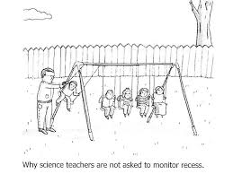
Humor Slide to Cut the Seriousness

Slide 16
Recent History – CCCs
Simultaneously, community college faculty have worked to identify pathways to associate degree and transfer level mathematics…
The Academic Senate has made it clear that they will encourage discipline faculty to identify, design and/or implement pathways, but will not take a position on any particular pathway…
The Academic Senate encourages faculty to work with discipline experts and organizations such as AMATYC and CMC³ to help determine effective and appropriate pathways.
CMC³ – California Mathematics Council of Community Colleges
AMATYC – American Mathematics Association of Two Year Colleges

Slide 17
AMATYC – Position Statement
The Appropriate Use of Intermediate Algebra as a Prerequisite Course
WHEREAS, The prerequisites of a mathematics course should be those appropriate to providing a foundation for student success in that course;
WHEREAS, The course description and learning outcomes of a mathematics course determine the level of mathematical literacy, skills, and knowledge necessary for successful completion of the course;
WHEREAS, The equivalent content in intermediate algebra courses is generally required to master the content of algebra-based courses that lead to calculus;
WHEREAS, The equivalent content in intermediate algebra courses is not required to master the content for most college-level mathematics courses that do not lead to calculus;
NOW, THEREFORE, It is the position of AMATYC that:
Prerequisite courses other than intermediate algebra can adequately prepare students for courses of study that do not lead to calculus.
Approved at the Delegate Assembly – November 15, 2014

Slide 18
General Education: Quantitative Reasoning
Quantitative Reasoning as part of the General Education pattern is the purview of all faculty,
We must engage in the intersegmental dialog – What are the expectations (in Quantitative Reasoning) for citizens holding a baccalaureate degree?
CSU Council of Math Chairs’ concern is that these pathways do not prepare students for college level courses.

Slide 19
General Education and Quantitative Reasoning
So where does that leave us?

Slide 20
References and Questions
The most recent edition of the Rostrum has references at the end of the article and can be found at:
http://asccc.org/content/quantitative-reasoning-baccalaureate-level-how-we-arrived-moment-and-need-further-dialog
Ginni May MayV@scc.losrios.edu
John Stanskas jstanskas@valleycollege.edu

