Slide 1
Womyn’s Leadership Circle
Difficult Conversations: Creating Womyn’s Leadership Circles on Campus
Mayra Cruz, ASCCC Area B Representative
Michelle Bean, ASCCC Area C Representative
Cheryl Aschenbach, ASCCC Secretary
Rochelle Olive, College of Alameda Senate President
FACULTY LEADERSHIP INSTITUTE
Sacramento
June 13, 2019

Slide 2
Today’s Agenda
“Open Your Mind” Video
Introductions
Define Terms and the “Elephant in the Room” Video
Small Group Discussion
Sharing Highlighted Challenges and Actions
Closing Reflections
Notes:
Mayra--2 min

Slide 3
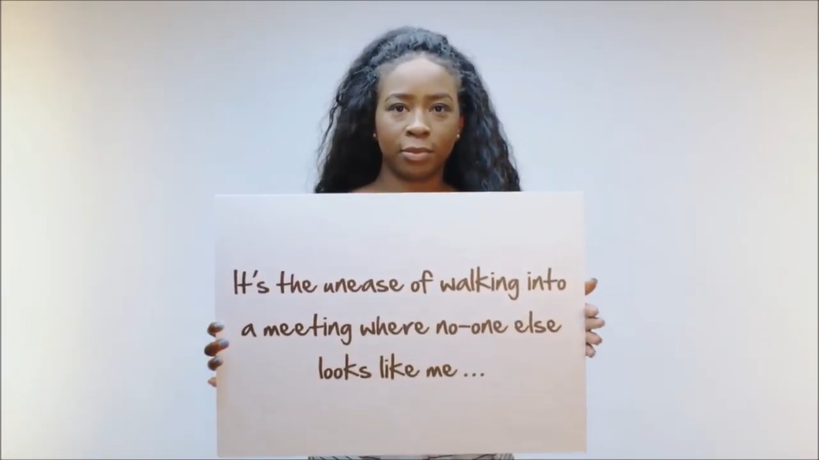
Open Your Mind
Equity, Diversity and Inclusion: https://www.youtube.com/watch?v=Q6eqOBOqESM
Notes:
Mayra plays AND BRING SPEAKERS!
6 min.

Slide 4
Defining Terms
What is the definition of
RACE (biological and social concept)
RACISM (reactive)
ANTI-RACISM (proactive)
SEX/GENDER
SEXISM
MISOGYNY
RACIAL RECONCILIATION
Notes:
Rochelle--4 min.
Michelle—pass out HALF SHEET
RACE (biological and social concept): A concept used in the categorization of humans into groups, called races or racial groups, based on the combination of shared physical traits, ancestry, genetics and social or cultural traits.
RACISM: The practice of discriminating against people based on their race, national or ethnic background.
ANTI-RACISM: Combating racism wherever it is found or preventing racism from occurring.
SEX: male or female division of species (biological)
GENDER: male or female division of species as differentiated by social and cultural roles and behavior
SEXISM: discrimination or devaluation based on a person’s sex or gender
MISOGYNY: ingrained and institutionalized prejudice against or hatred of women
RACIAL RECONCILIATION: Actions to heal the wounds caused by racism.

Slide 5
The Elephant in the Room
http://www.pbs.org/race/005_MeMyRaceAndI/005_01-slideshow.htm
Memorable Quotes
You've got to put yourself in a place to be able to dialogue first, instead of just wanting to ignore it, and run from it. We have to be proactive to set ourselves in a place where we can feel a little uncomfortable, and really start talking. --Frank (street interview)
As long as each group stays comfortably in their space, there’s no struggle. It doesn’t mean there’s equality, it doesn’t mean there’s justice, but there’s just no struggle. It's the boundaries where we see those struggles occur. --John A. Powell (legal scholar)
Not everything that is faced can be changed, but nothing can be changed until it is faced. --James Baldwin (author and activist)
Notes:
3 min.—Rochelle introduces

Slide 6
Small Group Discussion:
Who are you?
How have you defined the terms based on your experience?
What challenges have you experienced due to race and/or gender?
How did you feel?
What helped you move from a state of discomfort to a state of action?
What actions have you taken to dismantle racism and/or end sexism?
Notes:
20 min—all facilitate and guide groups

Slide 7
Share Your Group’s
Common Challenges
Highlighted Actions
What actions have you taken to dismantle racism and/or end sexism?
Notes:
10 min.—Cheryl

Slide 8
Closing Reflections: Idea Wave
What patterns or common themes do we see?
What questions remain?
What further actions are needed?
Notes:
5 min.
Cheryl: Post-It directions to place thoughts on easels
Michelle: Idea Wave

Slide 9
Thank you for joining us!
Contact Information
Mayra Cruz (cruzmayra@deanza.edu)
Michelle Bean (mbean@riohondo.edu)
Cheryl Aschenbach (caschenbach@lassencollege.edu)
Rochelle Olive (rolive@peralta.edu)

